Slide 1
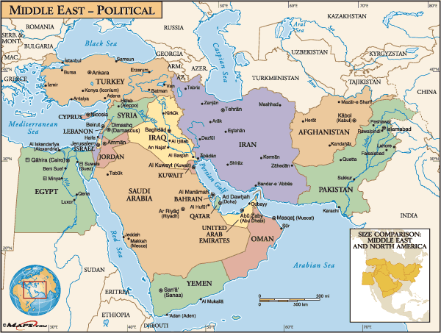
World Geography Southwest Asia

Slide 2
Physical

Slide 3
Sub-regions of Southwest Asia
The Arabian Peninsula - Saudi Arabia Bahrain, Kuwait, Oman, Yemen, Qatar & United Arab Emirates
Lies between Red Sea and Persian Gulf

Slide 4
Sub regions of Southwest Asia
The Eastern Mediterranean - Israel, Lebanon, & Jordan
The Northeast - Turkey, Iran, Iraq, Pakistan & Afghanistan

Slide 6
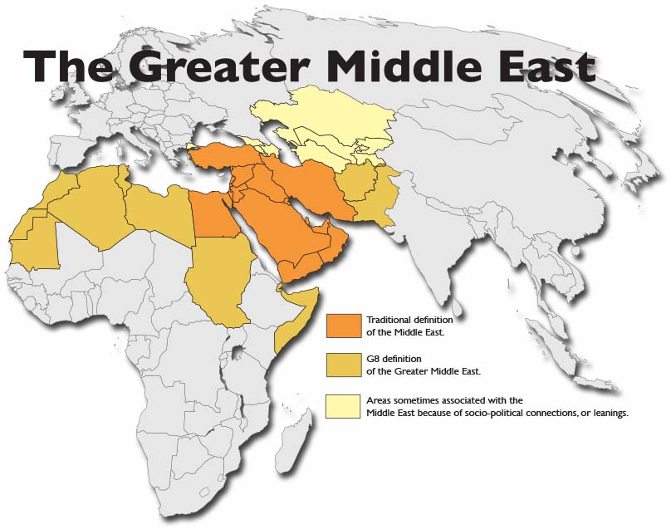

Slide 7
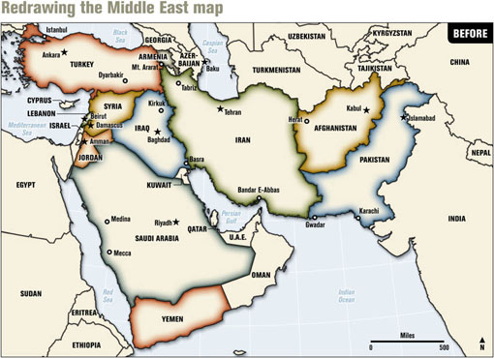

Slide 8
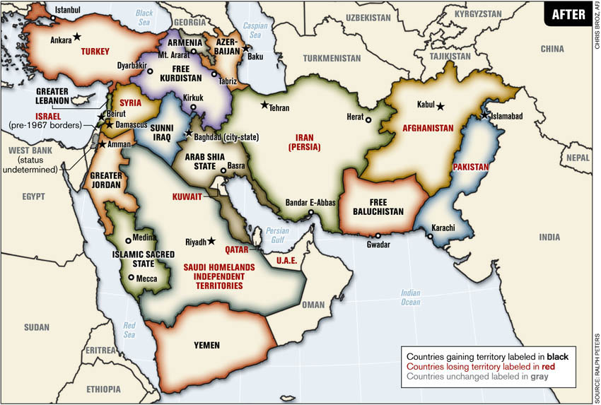

Slide 9
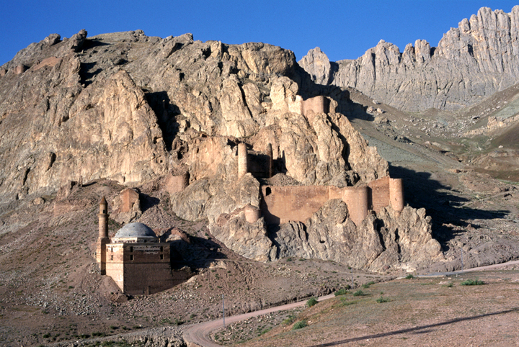
Mountains & Highlands
Zagros and Taurus - experience severe seismic or earthquake activity
- Zagros Mountains isolate Iran from rest of Southwest Asia
- Taurus Mountains separate Turkey from rest of Southwest Asia

Slide 10
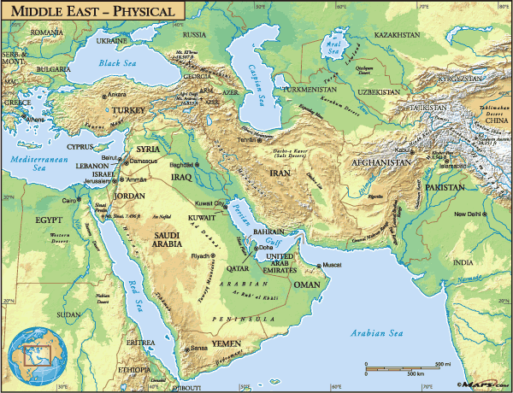

Slide 11
Mountains & Highlands
Golan Heights - plateau near Jordan River, Sea of Galilee
Site of conflict due to strategic location

Slide 12
Seas
Dead Sea
Landlocked saltwater lake
Saltiest body of water on the Earth
Lowest place on earth’s exposed crust: 1,349 feet below sea level

Slide 13
Seas
Mediterranean Sea – borders the Sinai Peninsula
Black Sea - borders Turkey
Caspian Sea - North of Iran

Slide 14
Rivers
Few rivers in the region flow all year
Wadis - riverbeds that are dry except in rainy season
The Tigris and Euphrates
Two of the most important rivers in the region rivers
Flows through Turkey, Syria, Iraq

Slide 15
Rivers
Mesopotamia-
“Land between two rivers“
Rivers meet at Shatt al Arab
Empty into Persian Gulf

Slide 16
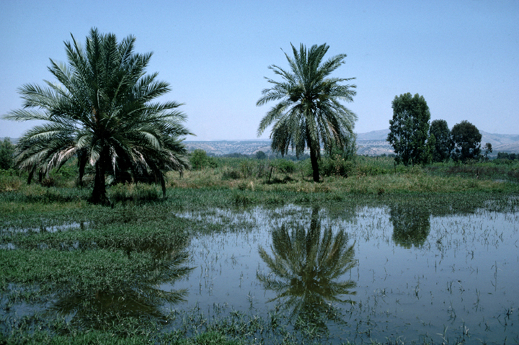
Rivers
Jordan River - Forms a natural border between Israel & Jordan

Slide 17
Climates
Three types of climates are found in Southwest Asia
Most areas get less than 18 inches of precipitation a year

Slide 18
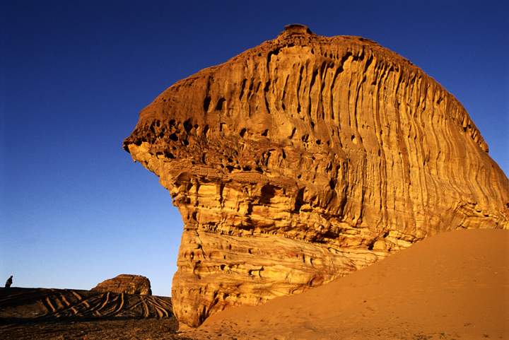
Climates
Deserts
Rub al-Khali (Arabian Peninsula)
- 250,000 sq. miles
Has dunes as high as 800 feet
10 yrs can pass without rain
Israel’s Negev Desert produces crops through irrigation

Slide 19
Climates
Oasis - where underground spring water supports vegetation
Iran has salt flat deserts
Land is salt-crusted
Surrounded by salt marshes
Very hot

Slide 20
Climates
Steppe Climate
- borders deserts
- Warm to hot summer; enough rainfall for grasses, shrubs

Slide 21
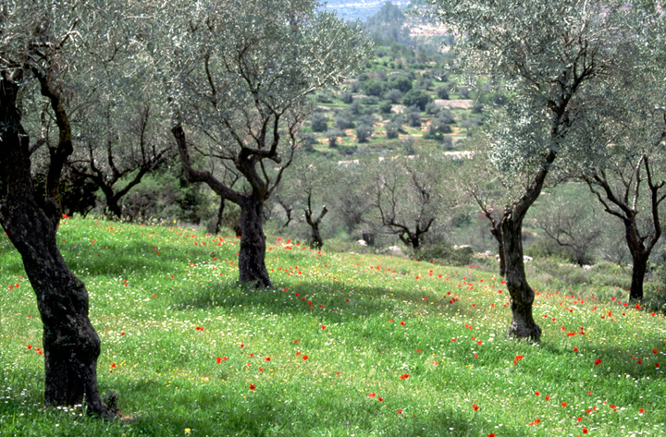
Climates
The Mediterranean Coast - Areas along Mediterranean coast and in Turkey have adequate rainfall - hot summers, rainy winters promote citrus fruits, olives, vegetables - Mild winters and summer irrigation let farmers grow crops all year

Slide 22
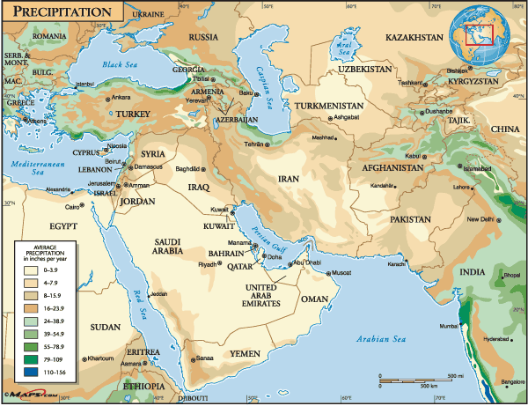

Slide 23
Natural resources
Half of the world’s oil reserves are in Southwest Asia
Oil fields located in Arabian Peninsula, Iran, Iraq & along Persian Gulf coast

Slide 24
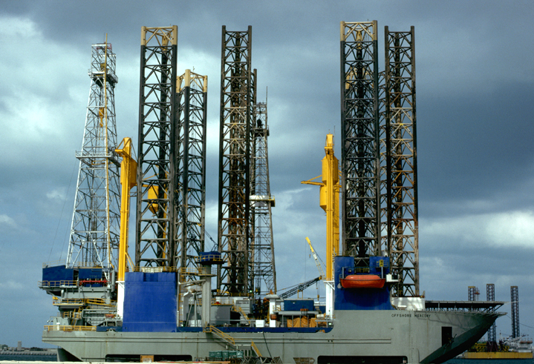
Natural resources
Iran & Turkey have large coal deposits
Small & scattered deposits of copper & potash, are also found in region
Water is the most valuable resource in some parts of the region
Water is harnessed for hydroelectric power in Turkey, Iran, Lebanon & Afghanistan

Slide 25
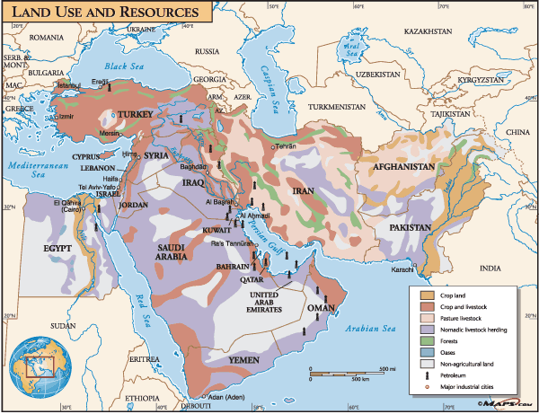

Slide 26
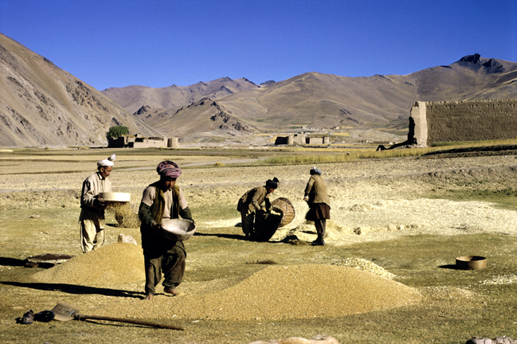
Culture

Slide 27
Ethnic Diversity (a difference in people based on their origins)
Arabs - majority of people in the region
Most are Muslims
Speak Arabic

Slide 28
Turks
Are not Arab, but they practice Islam
Have blended an Islamic culture and a western culture

Slide 29
Iranians “land of the Aryans”
Iran used to be called Persia
Muslim government is theocratic - religious leaders were in control

Slide 30
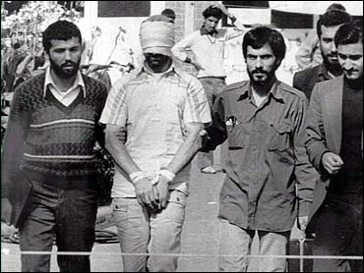
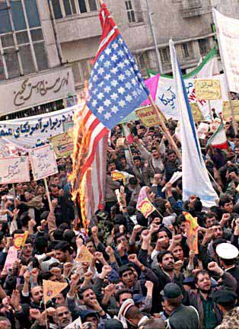

Slide 31
Israelis
Majority of the people are Jewish
Trace their ancestral roots to Hebrews who settle the region in ancient times
Believed God had given them the land as a permanent home

Slide 32
Israelis
Were driven from the land throughout the centuries
Zionism—19th-century movement for a Jewish homeland in Palestine Jews buy land, begin settling
1948 – Israel was established as a home for the Jewish people

Slide 33
History

Slide 34
Early History
Iraq’s Fertile Crescent between Tigris, Euphrates was a cultural hearth
People Built empires in Mesopotamia, the “land between the rivers” - Located between the Tigris & Euphrates Rives

Slide 35
Birth Place of 3 Religions
Judaism
- Began with Gods’ covenant to Abraham
- Synagogue – Place of Jewish worship
Christianity
- Based on the teachings of Jesus
- Believers follow the word of God in the Bible
- Largest religious group in the world
Islam
Based on the teaching of Muhammad
Believed he was God’s prophet
Muhammad lived in Mecca
- All have to follow the five pillars - Mosque – Place of Islamic worship

Slide 36
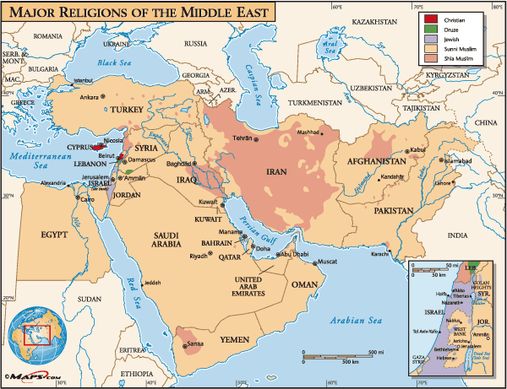

Slide 37
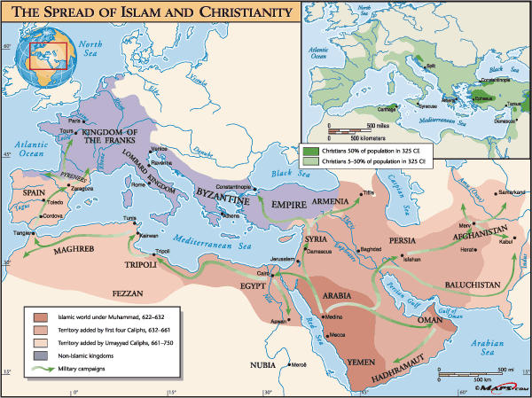

Slide 38
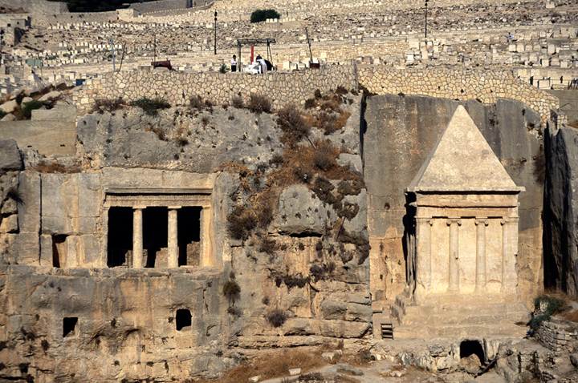
Jerusalem
Jerusalem is capital of Israel & holy city to all three major monotheistic religions
Jerusalem is the third most holy Muslim city after Mecca & Medina

Slide 39
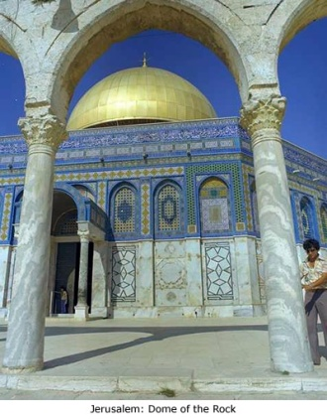
Jerusalem
Dome of the Rock - shrine where it’s believed Muhammad rose to heaven
- Jews believe it is the site where Abraham prepared to sacrifice Isaac

Slide 40
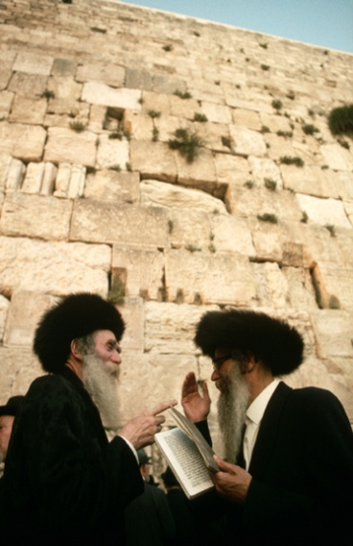
Jerusalem
Western Wall - The holiest site in Jerusalem for Jews (Wailing Wall)
Sole remainder of Second Temple (destroyed by Romans in A.D. 70)

Slide 41
Jerusalem
Dome and Al-Aqsa mosque are located on Temple Mount by Western Wall
Close proximity of holy sites fosters Jewish-Muslim clashes

Slide 42
Jerusalem
Crusades
Series of religious wars between Christians and Muslims to secure holy sites considered sacred by both groups
Eight major Crusade expeditions occurred between 1096 and 1291
Created hostility between Christians & Muslims

Slide 43
Governments Change Hands
Ottoman Empire ruled region from 1520 to 1922, but weakened
WWI – Britain & France gained control of most of region - Suez Canal & oil (discovered in 1932) were valuable

Slide 44
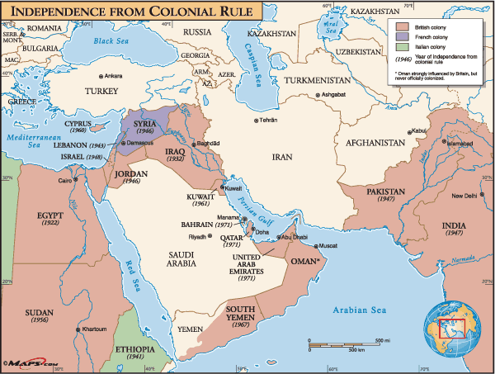

Slide 45
Creating the State of Israel
Britain controlled area of Jordan & Israel after WWI - Arabs & Jews cooperated
1930s & 1940s - German persecution increased number of Jewish immigrants - Arabs begin to resist Jewish stat

Slide 46
Creating the State of Israel
After WWII - many Jewish Holocaust survivors settled in Palestine - UN divided Palestine into two states: one Jewish, one Arab
1948 - Israel was created

Slide 47
Creating the State of Israel
Palestinians -Arabs and descendents who lived in Palestine were displaced - As many as 1 million Palestinians fled Israel & became refugees
Stateless Nation – Name given to a nation of people without land to legally occupy

Slide 48
Creating the State of Israel
Palestine Liberation Organization (PLO) - uses politics, military to regain land in, Israel and return of refugees to Israel

Slide 49
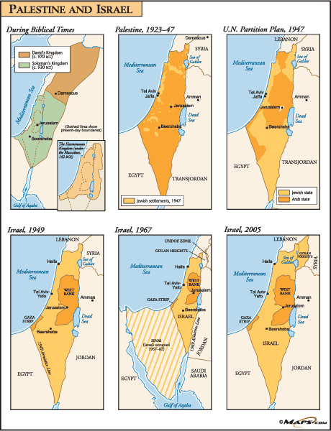

Slide 50
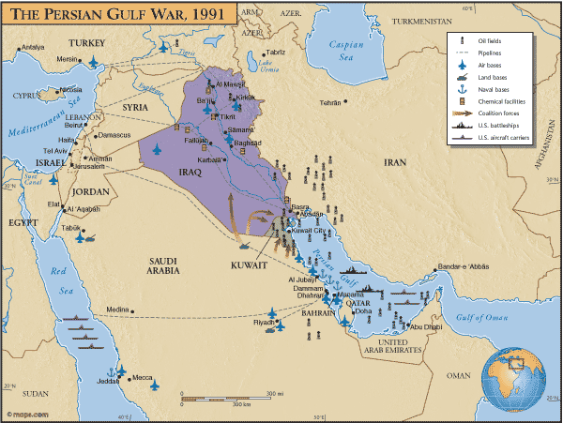
Control of Oil Fields
1980s - Iran, Iraq fight war over Persian Gulf oil fields
1990 - Iraq invaded Kuwait & was driven out in Persian Gulf War

Slide 52
Clashes Over Leadership
Taliban—fundamentalist Muslim political group ruled Afghanistan
protected Osama bin Laden and al-Qaeda terrorist network

Slide 53
Clashes Over Leadership
October 2001 – U.S. attacked Afghanistan following 9–11 - Operation Enduring Freedom targets terrorist assets, infrastructure - March 2002 Taliban removed from power by Osama bin Laden and some Taliban leaders

Slide 54
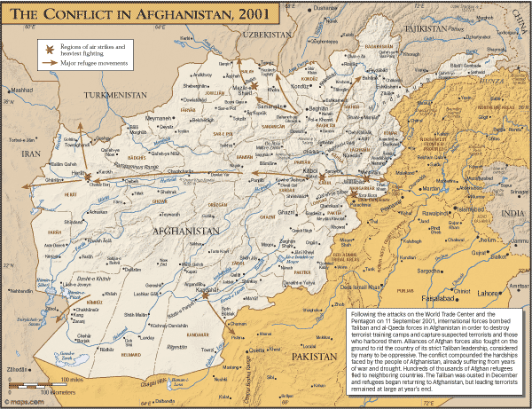

Slide 55
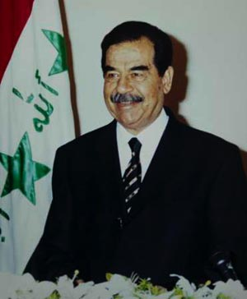
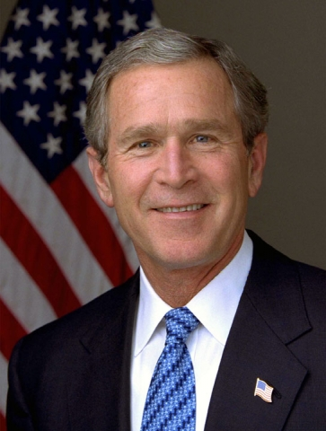
Clashes Over Leadership
UN ordered Iraqi dictator Saddam Hussein to disarm & destroy chemical, & biological weapons after Gulf War 2002 - President George W. Bush turns focus to Iraq
- Bush believed Hussein had weapons of mass destruction - March 2003 - U.S & U.K. attacked Iraq in Operation Iraqi Freedom - May 2003 - major fighting ended - December 2003 - Hussein captured

Slide 56
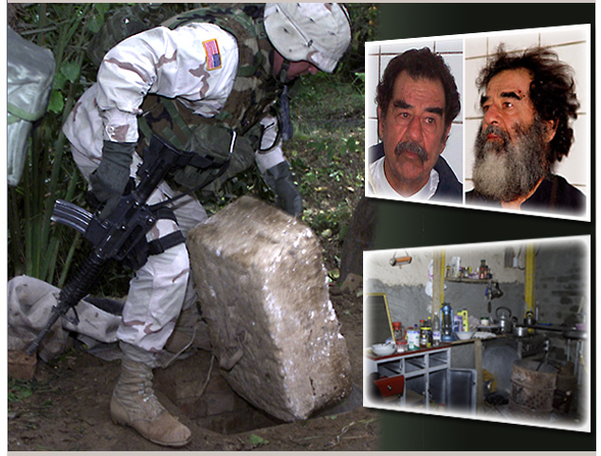

Slide 58
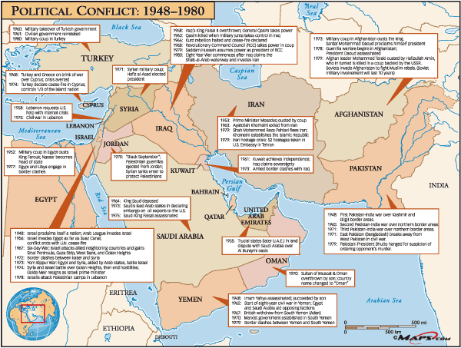

Slide 59
Cultures and Lifestyles

Slide 60
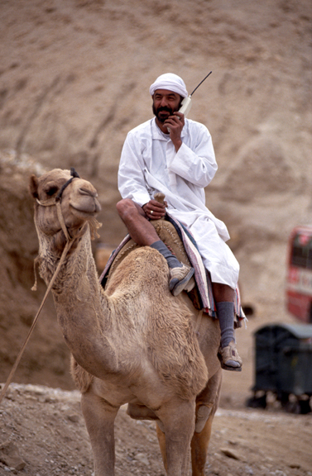
Modern Arabic Life
Rapid development as technology undermines traditional lifestyles
- trucks replace camels; malls replace marketplaces
Villagers, farmers, nomads have moved into cities (Urbanization)
- 25% urban in 1960 to 70% by 2015

Slide 61
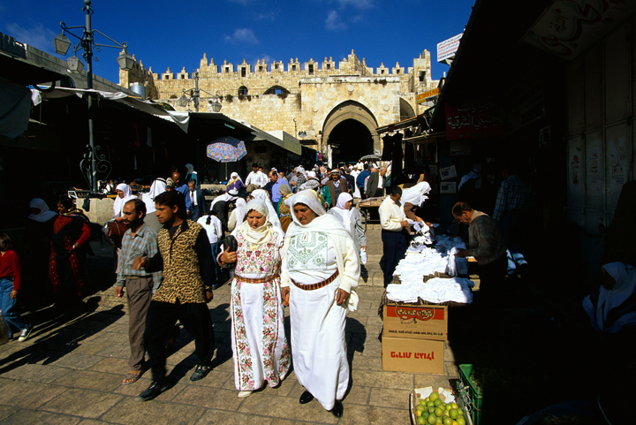
Modern Arabic Life
Religious Duties Shape Lives - Women often cover their heads, faces with scarf, veil
- women’s roles are slowly expanding: more are educated & working - Prayers performed dawn, noon, mid-afternoon, sunset, before bed - attend mosque services on Fridays - Fasting in Ramadan reinforces spirituality, self-control, humility

Slide 62
Modern Arabic Life
Eating In / Eating Out - People don’t eat in restaurants as much as in U.S. - some restaurants have separate male, female sections
- cafés are usually for men only - Most meals are eaten at home, with dinner between 8–11 pm - Meals include hummus (ground chickpeas), baba ganouzh (eggplant dip) chicken, lamb, & dessert of fruit, kolaicha (sweet cake)

Slide 63
Living in North Southwest Asia

Slide 64
Water and Population
Large farms and growing populations require dams & irrigation systems

Slide 65
Water and Population
Irrigation projects cause controversy when the body of water flows through several countries

Slide 66
Water and Population
Turkey is building dams and a man-made lake on upper Euphrates that will deprive downstream countries of water

Slide 67
Water and Population
Israel’s National Water Carrier project - carries water from northern areas to central, south, Negev Desert

Slide 68
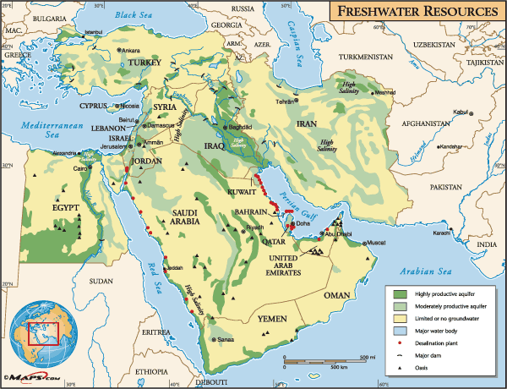

Slide 69
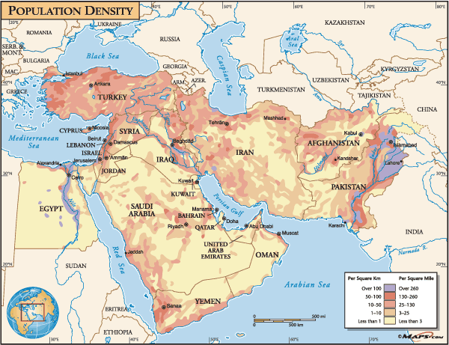

Slide 70
Modern Water Technology
Drip irrigation - small pipes slowly drip water just above ground
Desalinization - Removes salt from ocean water at treatment plants
Plants are expensive, cannot provide enough water
Fossil water - is pumped from underground aquifers - water has been in aquifer for long periods of time - rainfall won’t refill aquifers; only 25–30 years of usage remain

Slide 71
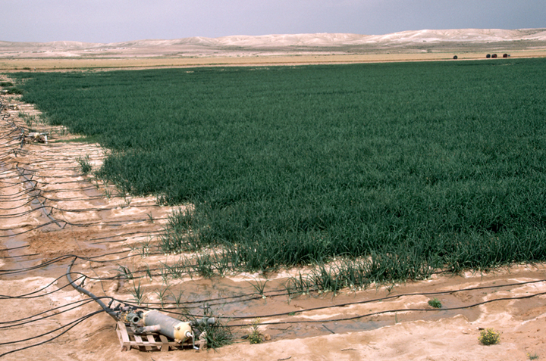

Slide 72
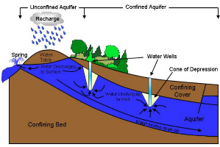

Slide 73
Economy Dependent on Black Gold
Oil is principle resource of economy, makes region globally important - source of almost all of nations’ export money, GNP
Region has 64% of world’s oil deposits, 34% of natural gas reserves - by 2020 will provide 50% of world demand
Strategic commodity—important resource nations will fight over

Slide 74
Economy Dependent on Black Gold
Oil prices rise & fall unpredictably; revenue not assured
Makes steady economic growth difficult; nations need to diversify
1960 - oil-producing nations formed economic group called OPEC - Organization of Petroleum Exporting Countries - coordinate petroleum-selling policies, control worldwide oil prices
- includes Saudi Arabia, Kuwait, Qatar, United Arab Emirates, Iran, Iraq
Nations have made an effort to use oil wealth to diversify economies & develop non-oil resources, & agriculture

Slide 75
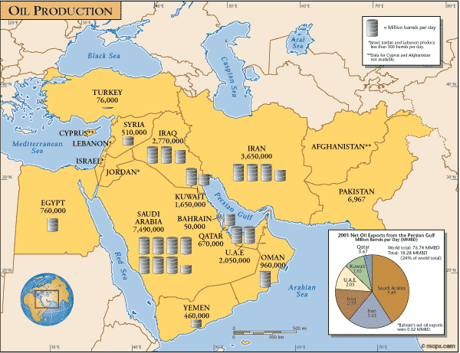

Slide 76
Transporting Oil
Crude oil is petroleum that has not been processed - Refineries - convert crude oil into useful products
Pipelines move crude oil to refineries or ports - ports on Persian Gulf, Red Sea, Mediterranean Sea - tankers carry petroleum to world markets
Risks of Transporting Oil - Oil spills – Largest was in January 1991, during Persian Gulf War - Pipelines may leak - Tankers may collide or run ashore

Slide 77
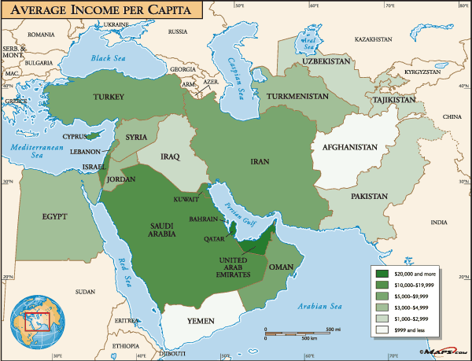

Slide 78
New Industry Requires More Workers
Human resources—skills and talents of a nation’s people - nations must invest in people, including women (education & technology training)
Oil creates so many jobs that local workers couldn’t fill them all

Slide 79
New Industry Requires More Workers
Guest workers - mostly unskilled laborers; do jobs native peoples find unacceptable (South, East Asia) - outnumber native workers in some places -Face problems such as –cultural misunderstandings intolerance, violence toward workers & fear immigrants weaken countries’ national identities

