Slide 1
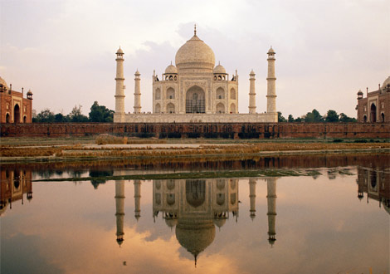
Geography of South Asia Physical

Slide 2
The Indian Subcontinent
India, Pakistan, Bangladesh, Bhutan, Nepal, Sri Lanka,& the Maldives
Subcontinent - large landmass that’s smaller than a continent
called Indian Subcontinent because India dominates the region

Slide 3
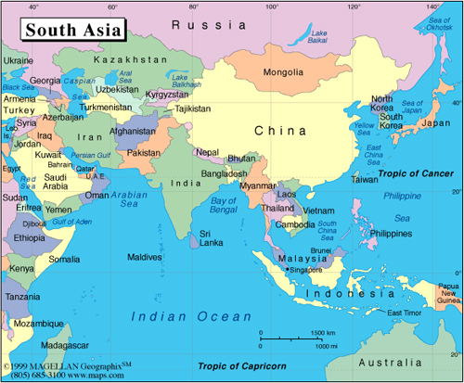

Slide 4
The Indian Subcontinent
Has 1/5 of world’s people
(1/2 the size of U.S.,)
Natural barriers separate subcontinent from rest of Asia
mountains form northern border, Indian Ocean surrounds rest
Arabian Sea to west, Bay of Bengal to east

Slide 5
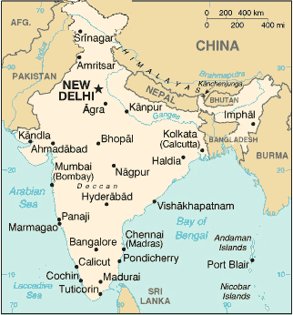
Mountains
Himalaya Mountains—1,500-mile-long system of parallel ranges
- Includes world’s tallest mountain—Mt. Everest
- Forms barrier between Indian subcontinent and China

Slide 6
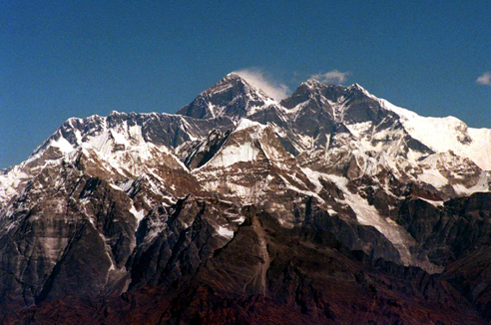

Slide 7
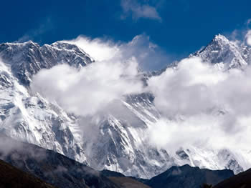
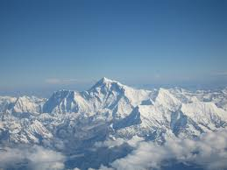
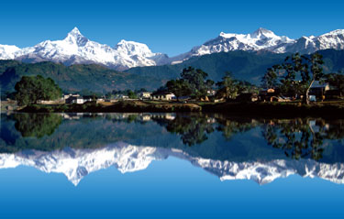

Slide 8
Mountains
Hindu Kush mountains - separates Pakistan & Afghanistan
- historically blocked invasions from Central Asian tribes
- Khyber Pass is one of the major land routes through the mountains
Karakoram Mountains are in northeastern part of Himalayas
- Includes world’s second highest peak, K2

Slide 9
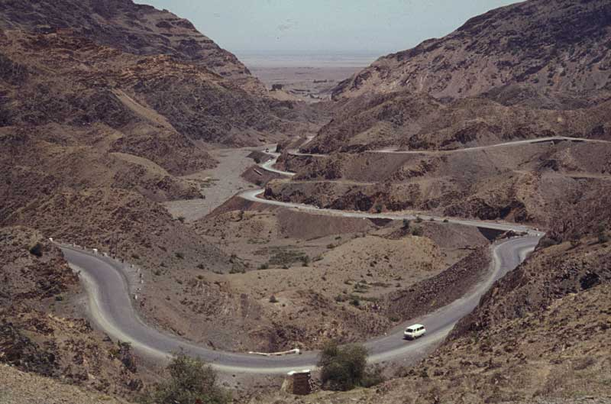
Khyber Pass

Slide 10
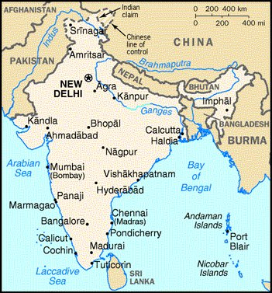
Rivers
Indus River -Flows west, then south through Pakistan to Arabian Sea
Brahmaputra winds east, then west, south through Bangladesh
-Meets the Ganges & forms delta (flow into Bay of Bengal)

Slide 11
Rivers
Feni River - flows from Chittagong Hills to Bay of Bengal
-floods during wet season due to monsoon rains
- Cyclones bring storm surges—high waters that swamp low areas
-1980s - Bangladesh built South Asia’s largest estuary – a broadened seaward end of a river
used large population’s unskilled workers to build dam (abundant resource)

Slide 12
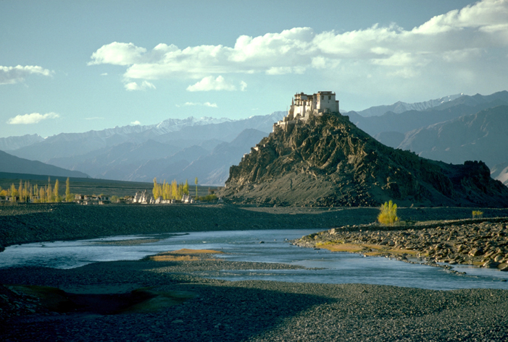

Slide 13
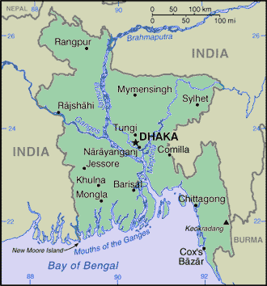
Ganges River
Best-known South Asian river (Known as Gangamai—“Mother Ganges”)
Provides drinking and farming water, transportation
Hindus believe that the Ganges River brings life to its people (Sacred)
- pilgrims come to bathe, scatter ashes of dead

Slide 14
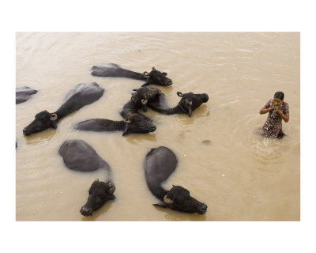

Slide 15
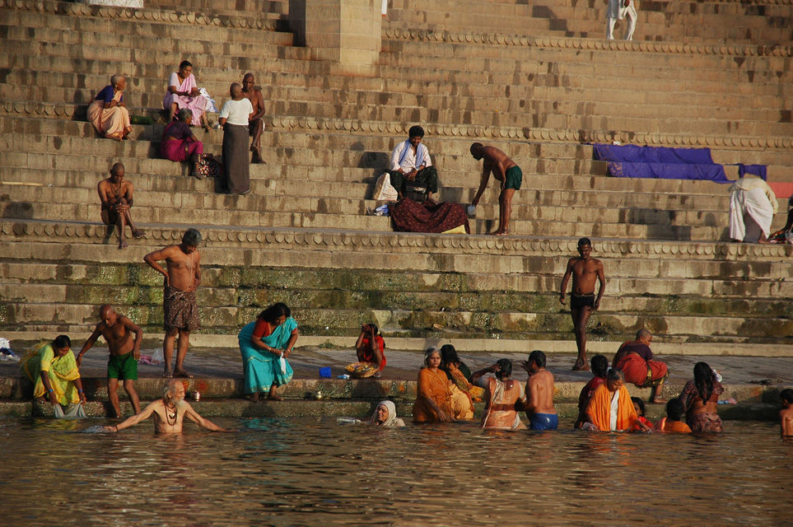

Slide 16
Ganges River
Ganges is one of the most polluted river in world
- sewage, industrial waste, & human bodies
- users get stomach and intestinal diseases such as hepatitis, typhoid, & cholera
1986 - government planned sewage treatment plants & regulations
- today few plants are operational, factories still dump waste
- Clean up will take time, money, a change in how people see river

Slide 17
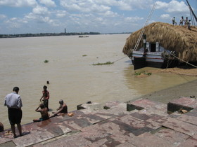
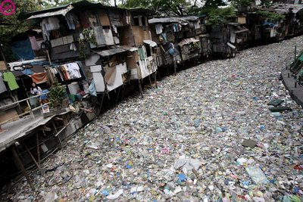
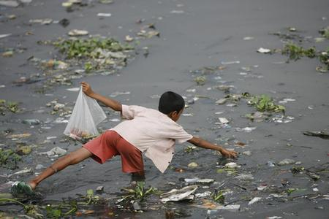
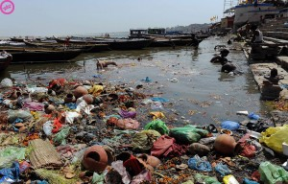

Slide 18
Fertile Plains
Rivers irrigate farmlands& carry rich alluvial soil
- Soil is deposited on alluvial plains—rich farmlands
Indo-Gangetic Plain has some of the world’s most fertile farms
Heavily populated area has 3/5 of India’s people

Slide 19
Offshore Islands
Sri Lanka - Island in Indian Ocean, off India’s southeastern tip
Large, tear-shaped country with lush tropical land
Range of high, rugged, 8,000-foot mountains dominate center

Slide 20
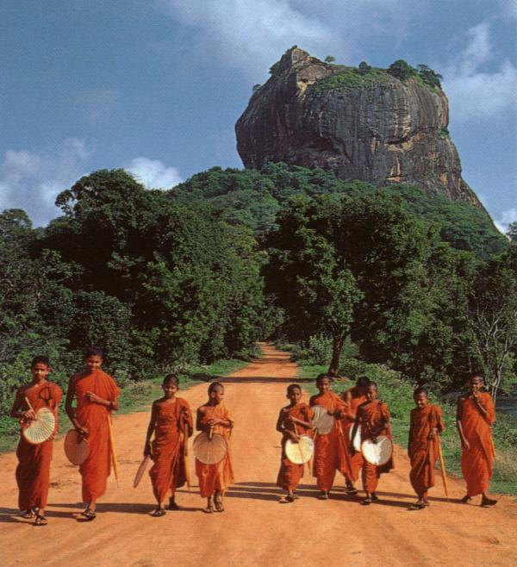
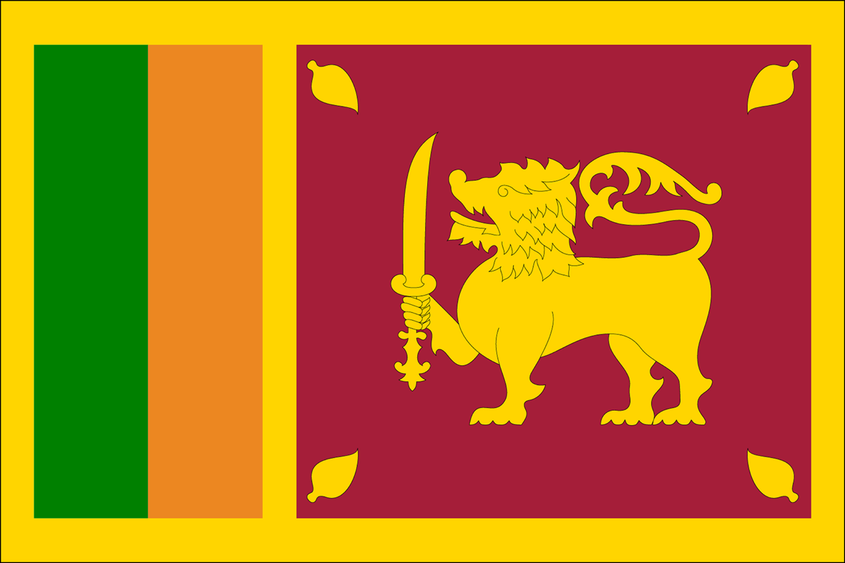
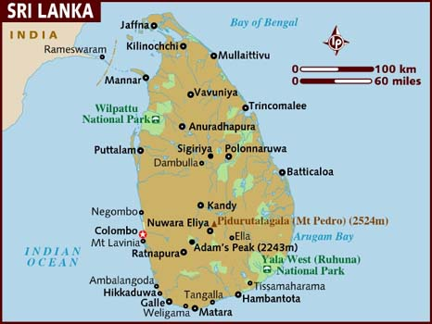

Slide 21
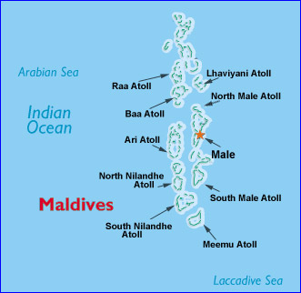
Offshore Islands
Maldives - is archipelago—island group—of 1,200 small islands
- Islands are atolls— - formed from a peak of a submerged volcano
- only 200 islands are inhabited

Slide 22
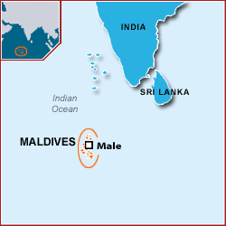
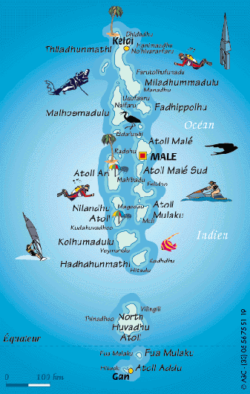
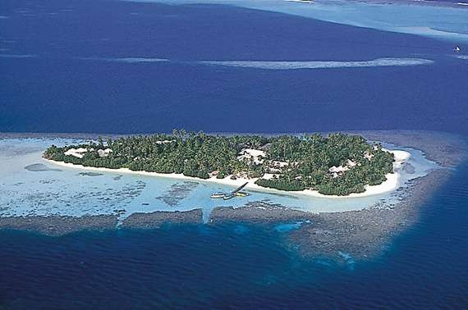

Slide 23
Natural Resources
Water and soil - Provides food through farming & fishing
River systems help enrich land with alluvial soil & water
Also provide transportation & power

Slide 24
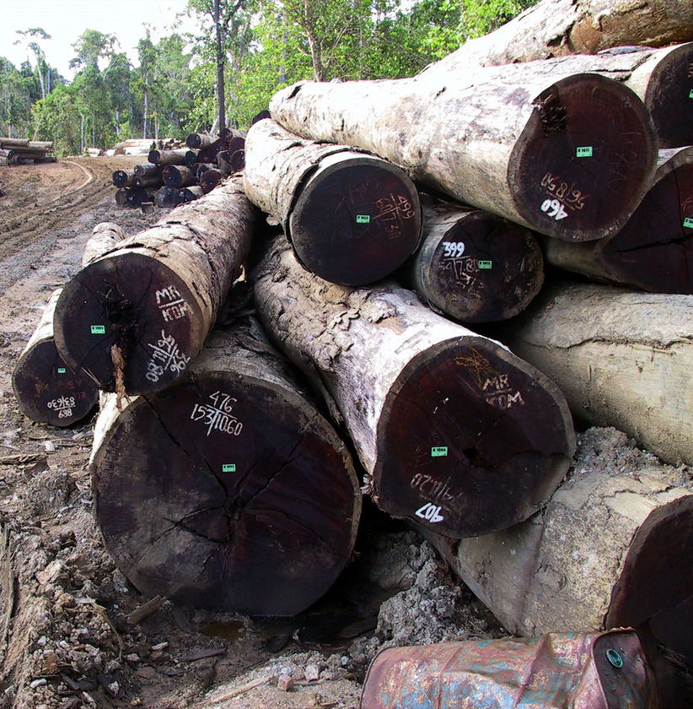
Natural Resources
Rain forests produce hardwoods like sal, teak, bamboo and fragrant sandalwood
-Deforestation is a severe problem (soil erosion, flooding, landslides, loss of wildlife habitats)

Slide 25
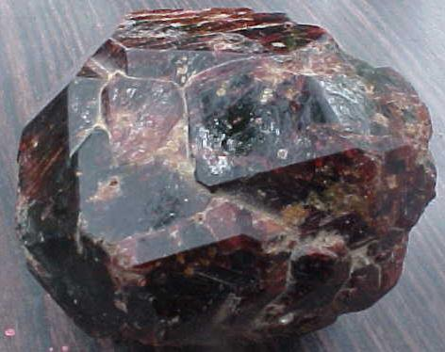
Natural Resources
Minerals
-Coal - India is fourth in world production of coal
- also has petroleum, uranium Iron ore & mica (crystals)
Pakistan & Bangladesh have natural gas resources

Slide 26
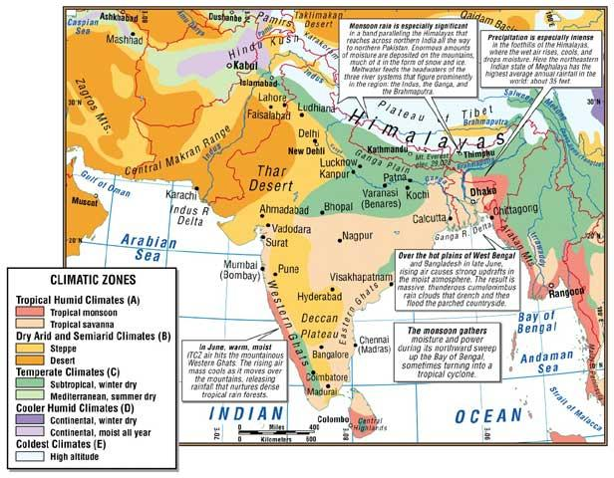
Climate Zones
Cold highland zone - Himalayas & other northern mountains
Humid subtropical – Located in the foothills (Nepal, Bhutan)& Indo-Gangetic Plain
Semiarid zone - West Plain & Deccan Plateau is warm with light rain

Slide 27
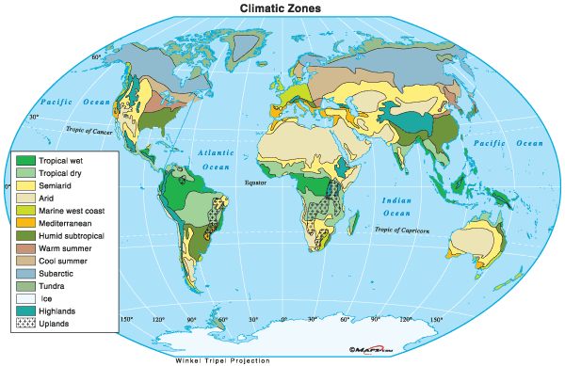

Slide 28
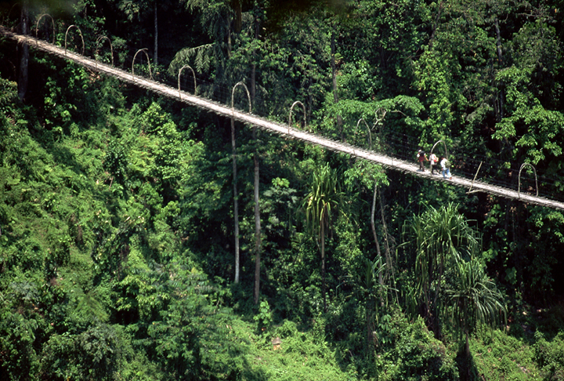
Climate Zones
Desert zone - Thar Desert is driest area, with 10 inches of rain annually
Tropical wet zone - Sri Lanka and coasts of India, Bangladesh
- Cherrapunji, India, holds rainfall record—366 inches in one month

Slide 29
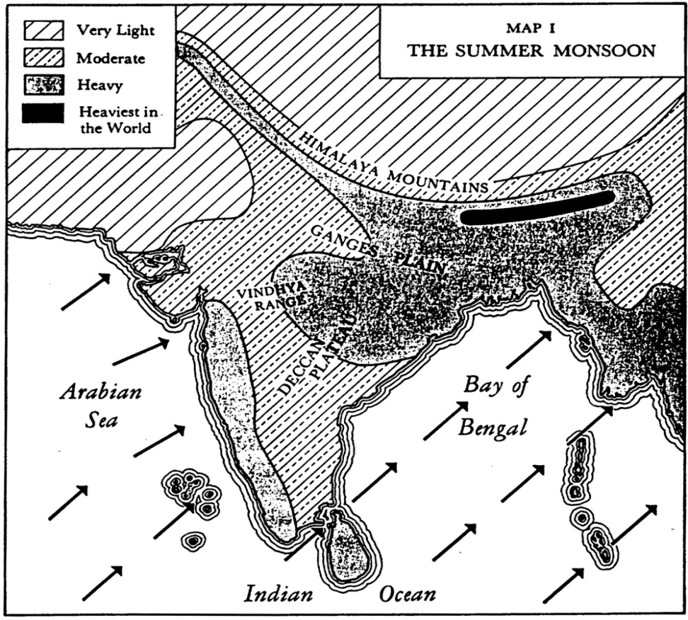
Monsoons and Cyclones
Monsoons—seasonal winds that affect entire region ( two seasons)
Summer monsoon—blows moist from southwest, across Indian Ocean (Brings rain)
Winter monsoon—blows cool from northeast, across Himalayas, to sea (drought)

Slide 30
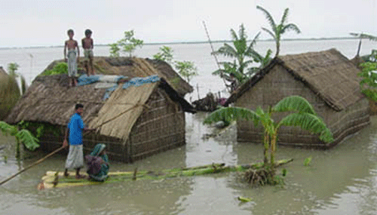
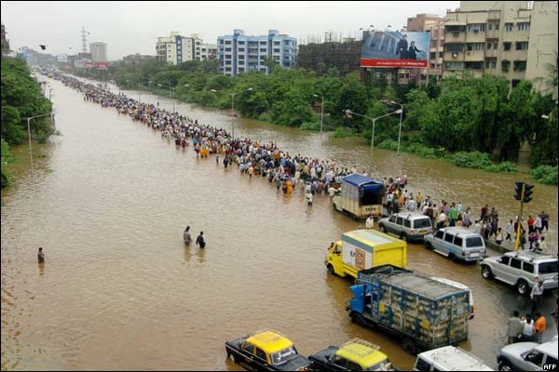
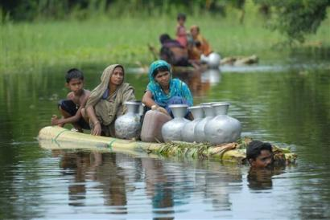
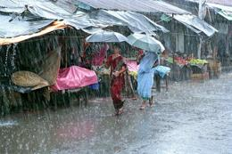

Slide 31
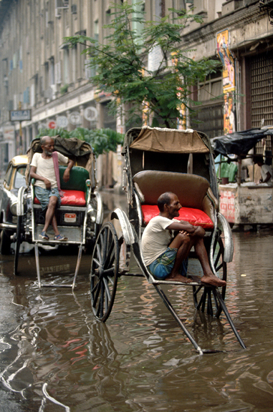
Monsoons and Cyclones
Cyclone—violent storm with fierce winds & heavy rain (hurricanes in North America)
- Bangladesh’s low coastal region swamped by high waves

Slide 32
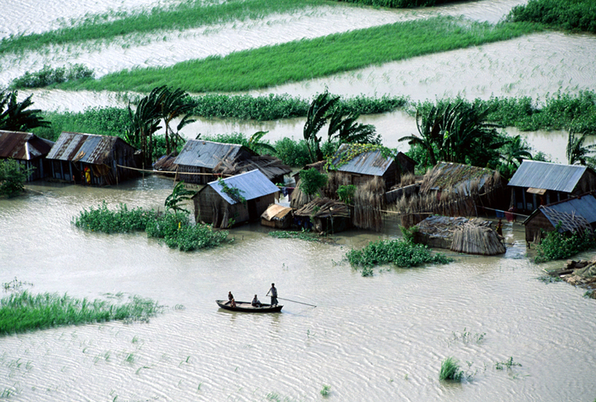

Slide 33
Physical Review
What type of weather is associated with a winter monsoon?
What type of weather is associated with a summer monsoon?
What is an archipelago?
What do the Himalayan Mountains form a barrier between?
What is an atoll?
What are alluvial plains?
What is a subcontinent?
What is an abundant resource in Bangladesh that was used to build a dam on the Feni River?
What is an estuary?
What is a storm surge?
Mount Everest is located in what mountain range?
What desert is located in South Asia?
What type of landform is South Asia?

Slide 34
History

Slide 35
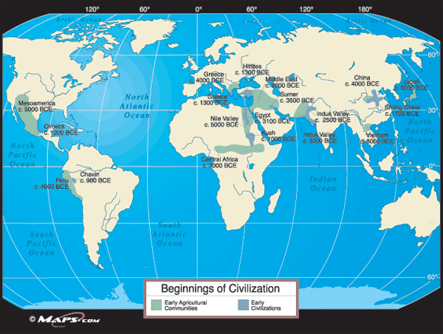
Early History
2500 B.C. - Indian civilization began in Indus Valley
1500 B.C. - Aryans from north of Iran invaded

Slide 36
European Rule
1500s - French, Dutch, & Portuguese built cloth, & spice trades
1757 - British East India Company controlled Indian trade
Raj – 200-years of British rule in India

Slide 37
European Rule
Mohandas Gandhi - Led Indian independence movement (nonviolent resistance)
1947 - India gained its independence from Britain
Muslim Pakistan split from Hindu India

Slide 38
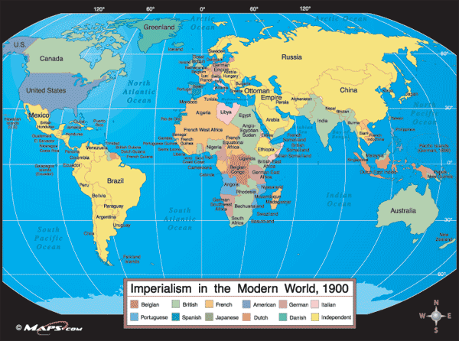

Slide 39
Partition and War
1947 - partition created Hindu India & Muslim Pakistan
Hindu-Muslim violence killed one million people
10 million people crossed borders: Hindus to India, Muslims to Pakistan
Pakistan & India have fought wars over territory

Slide 40
Pakistan and Bangladesh
Ethnic differences led to civil war between West and East Pakistan
1971 - East Pakistan won independence & became Bangladesh (Partition)

Slide 42
History Review
Who led India’s independence movement?
What is nonviolent resistance?
What was the partition of India& Pakistan in 1947?
What was Raj?
What two countries have fought several wars over the territory of Kashmir?
Where did civilization first begin in South Asia?
What country was known as East Pakistan between 1947 & 1971?

Slide 43
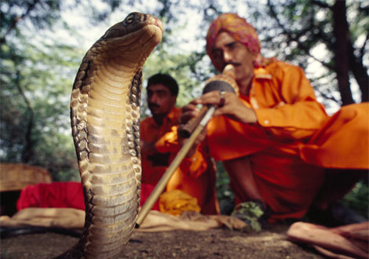
Culture

Slide 44
Languages
India has over 1000 languages and dialects
- Hindi is the official language
Pakistan is more diverse: five main groups, each with own language
- Punjabis, Sindhis, Pathans, Muhajirs, Balochs
Majority of people in Bangladesh are Bengali
- Bengali language based on Sanskit, ancient Indo-Aryan language

Slide 45
Religions
Hinduism – 80% of Indians are Hindu
- Believes in a system of social classes (caste system)
People must live according to his or her dharma or moral duty
-Karma - all good are rewarded and all bad deeds punished
People are reincarnated until they overcome all of their weaknesses and earthly desires, then they are released form the cycle of rebirth

Slide 46
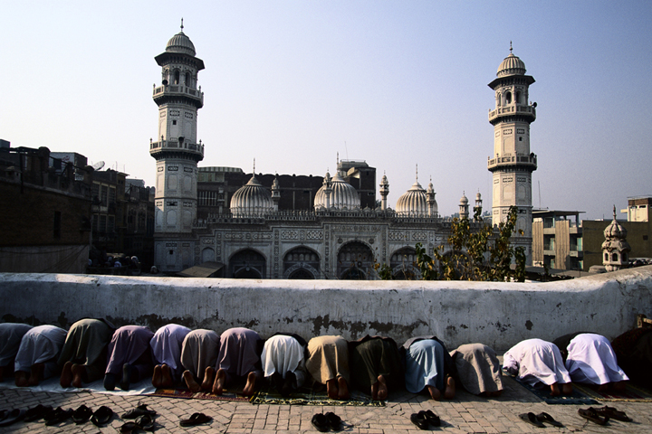
Religions
- Pakistan’s stricter Islamic law includes purdah—women’s seclusion
- women have no contact with men not related, wear veils in public
- Bangladesh’s religious practices are less strict
Islamic – Over 90 % of the populations of Pakistan and Bangladesh

Slide 47
Religions
Buddhism – started by Siddhartha Gautama
By following his guidelines, people could enter into a state of great insight, calm, and happiness called nirvana
Jainism – Believe that every living creature has a soul therefore it is a sin to kill even an insect

Slide 49
Culture Review
What religion do most Indians belong to?
Who founded the religion of Buddhism?
What is the caste system & what religion believes in it?
What is the predominate religion in Pakistan & Bangladesh?

Slide 50
Living In South Asia Today

Slide 51
Daily Life
Most Indians have male-dominated arranged marriages
Diet is mostly vegetarian
- meat is eaten in curry dishes, but is limited by religious beliefs
Sports include soccer, field hockey & cricket

Slide 52
Education
Indian economy is changing & more people are working in factories,& offices
Education is key to change
Literacy has risen steadily since the 1950s
school attendance, literacy still low In slums and rural areas

Slide 53
Population Problems
South Asia must manage population growth so economies can develop
Rapid growth means many citizens lack life’s basic necessities
- food, clothing, shelter

Slide 54
Population Problems
Region has widespread poverty, illiteracy—inability to read or write
- poor sanitation, health education lead to disease outbreaks
Every year, to keep pace, India would have to:
- build 127,000 new schools and 2.5 million new homes
- create 4 million new jobs
- produce 6 million more tons of food

Slide 55
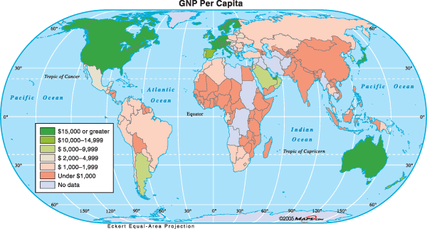

Slide 56
Managing Population Growth
India spends nearly $1 billion a year encouraging smaller families
Programs have only limited success
- Indian women marry before age 18, start having babies early
- Poor people view children as source of money (begging or working fields)
- children can later take care of elderly parents
- have more kids to beat high infant mortality

Slide 57
Managing Population Growth
Education could break cycle of poverty & raise living standards ( limited funds)
- India spends under $6 per pupil a year on education
- U.S. spends $6,320 per pupil a year
- improves females’ status with job opportunities
-better health care education could lower infant mortality rates

Slide 58
Living In South Asia Today Review
What is considered the key to controlling India’s population as well improving its standard of living?
What is illiteracy?
What country in South Asia has the largest population?
Name three reasons that Indian families continue to have a large number of children?
Name three basic necessities:

Slide 59
Economy

Slide 60
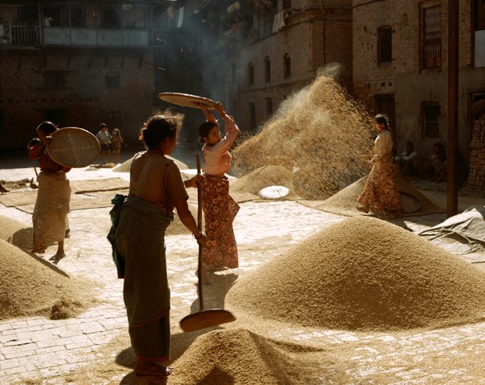
Agriculture
Two-thirds of people farm (Subsistence Farmers)
After famines of 1960s, scientists improved farming techniques& crops
- Green Revolution increased crop yields for wheat & rice
Pakistan & Bangladesh’s Climate hurts yields (arid & stormy)
-freshwater fishing is also vital to economy

Slide 61
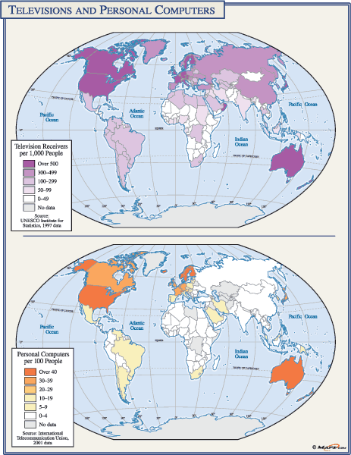

Slide 62
Industry
Cotton textiles have long been a major producer in India
- iron, steel, chemical, food industries develop after 1940s
Neither Pakistan or Bangladesh is highly industrialized
- small factories lack capital, resources, markets to expand
Both export cotton clothes
Microcredit policy allows small loans to poor entrepreneurs
- entrepreneurs—people who start and build businesses
- small businesses join together to get microloans
- program raises standards of living, especially for women

Slide 63
Increasing Tourism
Tourism is fastest-growing industry in Nepal
- people visit capital at Kathmandu to climb Himalayas
- hotels, restaurants, services grow
- also hurts Nepal’s environment; trash, pollution left on mountains

Slide 64
Economy Review
What is Microcredit?
What is an entrepreneur?

