Slide 1
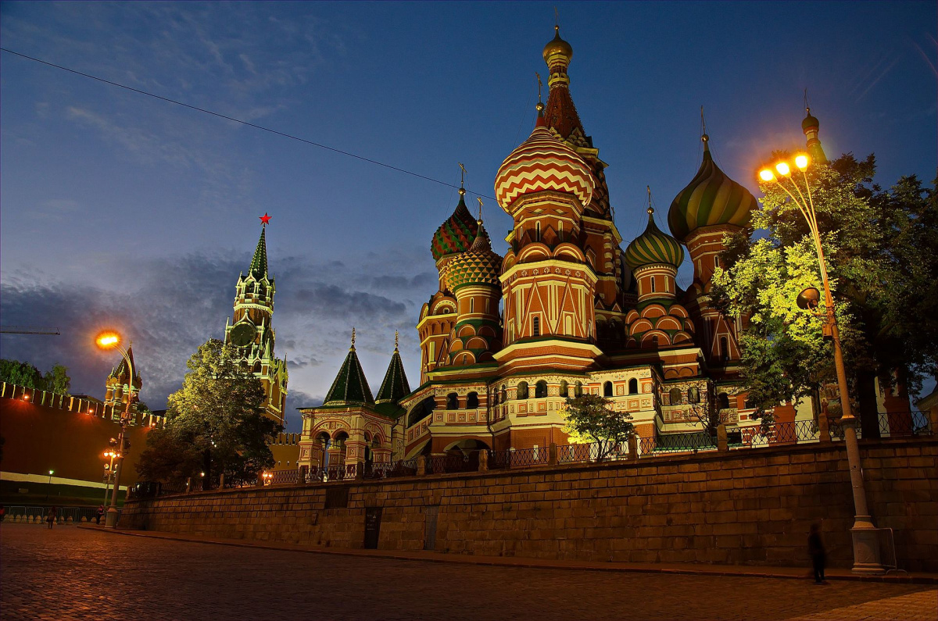
World Geography Russia Notes

Slide 2
Physical

Slide 3
Russia & the Republics
Russia and the Republics cover 1/6 of Earth’s land surface
8.5 million square miles
Three times the land area of U.S.
Russia spans 11 time zones
Distance decay—long-distance communication, transportation are hard

Slide 4
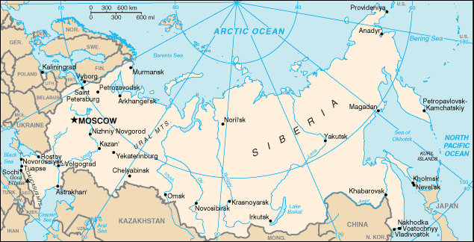

Slide 5
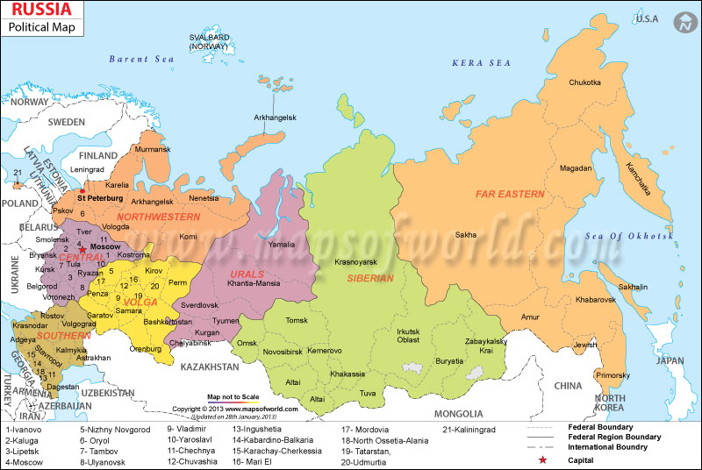

Slide 6
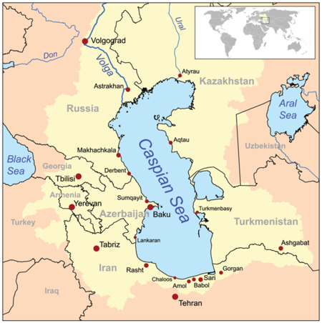
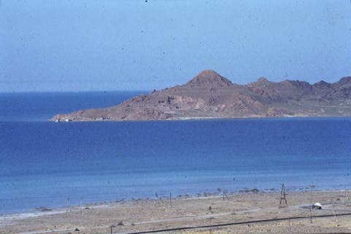
Lakes
Caspian Sea
Largest inland sea in world
750-mile-long (north to south) saltwater lake

Slide 7
Lakes
Aral Sea
East of Caspian
Is also saltwater
Has lost 80% of water volume since 1960 due to irrigation

Slide 9
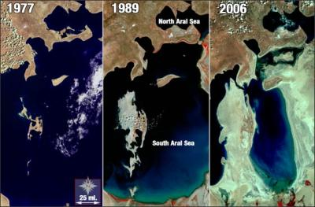
Changes in the Aral Sea since 1977

Slide 10
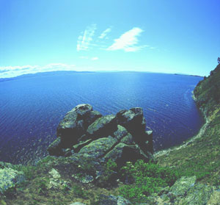
Lakes
Lake Baikal
Deepest & oldest lake in the world
Is 1 mile from surface to bottom at deepest point
400 miles long
Holds 20% of world’s fresh water
Home to 2,500 unique plant & animal species

Slide 11
Natural Resources
Many of Russia’s resources are in Siberia
Frigid, arctic Russian area of Asia
Hard to get at & move resources due to:
Climates
Terrain
Distances
Taiga
Also known as Boreal Forest or Snow Forest
Largest forest on Earth- Covers 11% of the northern hemisphere
Produces 1/5 of the world’s timber

Slide 12
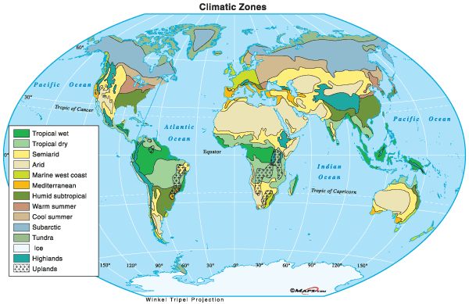

Slide 13
Russia’s Climate
Dominant Climates of Russia
Humid continental
Subarctic
Continentality
The effect the region’s enormous size has on its climates
Distance from sea decreases precipitation
Moisture from Atlantic Ocean is lost further inland
Distance from sea also creates extreme temperatures

Slide 14
Russia’s Climate
Siberia
Average temperatures are usually below 50° F
Siberian temperatures can drop below –90° F
Region has layer of permafrost that can reach depths of 1,500 ft.

Slide 15
Russia’s Climate
Siberia
Buildings on permafrost sink and fall when their heat thaws the ground
Buildings must be set off the ground onto concrete pillars

Slide 16
Review Questions
1. What body of water is Eastern Europe farther away from than Western Europe which results in it having a harsher climate?
2. What mountains divide Europe from Asia?
3. What do people who believe Europe & Asia are one continent call it?
4. What is the oldest & deepest lake in the world?
5. What region in Russia has many resources & a very cold climate cold climate?

Slide 17
Review Questions
6. How many time zones does Russia cross?
7. What is Taiga?
8. Why do builders in Siberia have to take special precautions with their buildings?
9. What is the largest inland sea in the world?
10. What is distance decay?

Slide 18
Culture & Economy

Slide 19
History of Expansion
9th century- Vikings
Sailed from Scandinavia in 862 AD
Established a settlement near Kiev in 882 AD and expanded from there
13th century- Mongol Invasion
Expansion halted due to the invasion of the Mongols (Tatars)
Controlled the region until the 1500s

Slide 20
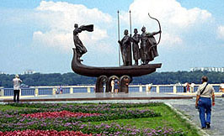
History of Expansion
9th century- Vikings from Scandinavia established a settlement near Kiev, soon the settlement began to expand.
Expansion halted in the 13th century, invasion of the Mongols (Tatars). Who controlled the region until the 1500s

Slide 21
History of Expansion
Ivan the Great
Prince of Moscow
Ended the rule of the Mongols
The first czar of Russia
Extended territory
By the 17th century, the empire expanded to the Pacific Ocean.

Slide 22
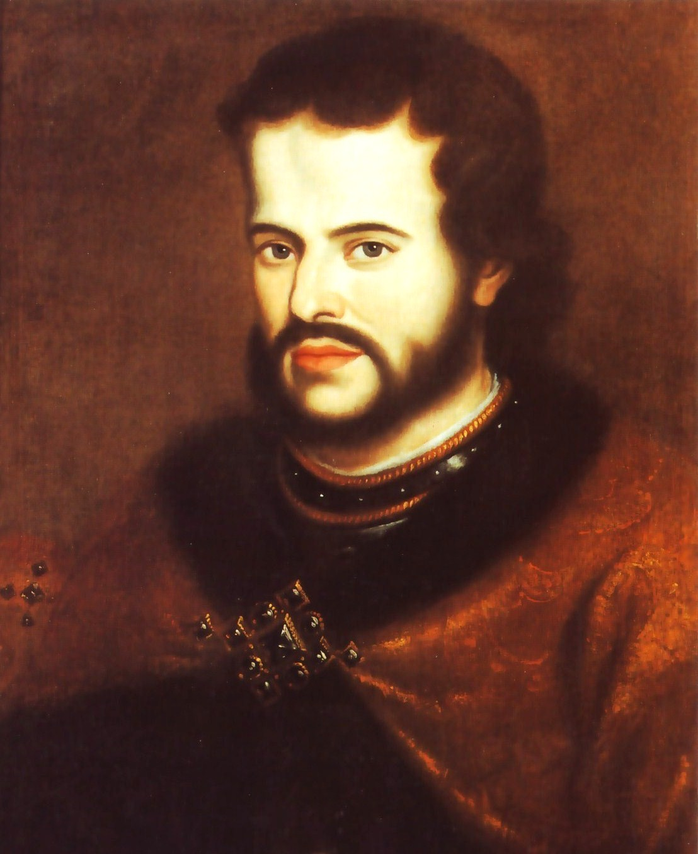
History of Expansion
Ivan the Great
Prince of Moscow
Ended the rule of the Vikings
The first czar of Russia
Extended territory
By the 17th century, the empire expanded to the Pacific Ocean.

Slide 23
Lagging Behind Western Europe
Rapid territorial growth, but less than impressive advances in technology
Peter the Great
Czar from 1682-1725
Moved capital to St. Petersburg
“Window to the west”
Made strides in modernizing Russia
Didn’t develop industry until the end of the 19th century (W. Euro- mid 19th)

Slide 24
Lagging Behind Western Europe
Industry
Harsh working conditions
Low wages
Both contributed to resentment towards the czars

Slide 25
Bolshevik Revolution…a New Beginning
During WW I, anger turned to revolt.
1917- Russian Revolution
Vladimir Lenin
Leader of the Communist Party
Took control of government & the economy from the czars
9 million Russians died “unnatural deaths” from terror, famine, and disease in 5 years (1918- 1923)

Slide 26
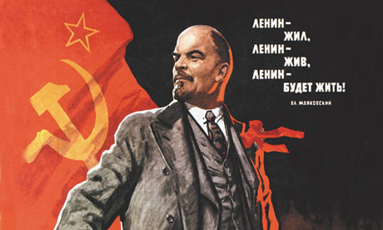
Bolshevik Revolution…a new beginning
During WW I, anger turned to revolt.
1917- Russian Revolution
Vladimir Lenin
Leader of the Communist Party
Took control of government & the economy from the czars
9 million Russians died “unnatural deaths” from terror, famine, and disease in 5 years (1918- 1923)

Slide 27
Bolshevik Revolution…a new beginning
December 1922- Russia became known as the U.S.S.R. (Union of Soviet Socialist Republics); the Soviet Union
1924- Lenin died
Joseph Stalin
General Secretary of the Communist Party
Took control in 1924
Led the Soviets in the fight against Germany
As the war came to a close, tension arose between them and the West; especially the U.S.

Slide 28
Harsh Reality
Rapid industrialization was a major goal
Industrial production and agricultural production increased
Millions starved
Many tried to fight this betrayal, but at great risk.
Under Stalin, some 14 million were put to death. (Some Russian historical archives say the number is closer to 20 million killed under Stalin’s rule.)

Slide 29
Marxism
Karl Marx
Believed that the capitalist system was doomed saying:
It concentrated wealth in the hands of a few
Left everyone else in poverty
Wrote Communist Manifesto
Predicted that communism would replace capitalism
Communist society
Citizens would own property together
Citizens would share the wealth
Command Economy
Government controls all resources and means of production

Slide 30
Cold War
Stalin installed pro-Soviet governments in Eastern European countries (satellite nations).
In the 1940s, tensions between the U.S. and Soviet Union led to conflict…. The Cold War
The rivalry continued into the mid-1980s, when Mikhail Gorbachev started to give more political and economic freedom to the Soviet people.
The Soviet Union officially collapsed in 1991
Region was divided into 15 independent republics
Russia is the largest and most powerful

Slide 31
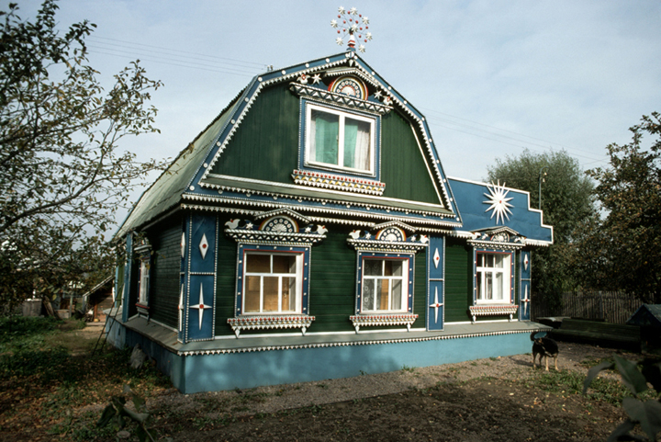
Traditional Russian Country Home

Slide 32
Eastern Europe’s Economy
1945 – 1989
Eastern Europe had a command economy
Central government made major economic decision
Inefficient system brought:
Shortages
Trade deficiencies
Pollution

Slide 33
Eastern Europe’s Economy
1989
Soviet Union tried market economy
Economic decisions are driven by the laws of supply and demand
Making goods consumers want
Little government intervention or central planning

Slide 34
Eastern Europe’s Economy
1992
Russia began process of privatization
Sold government-owned businesses to private individuals & companies
Prices of goods increase 250%

Slide 35
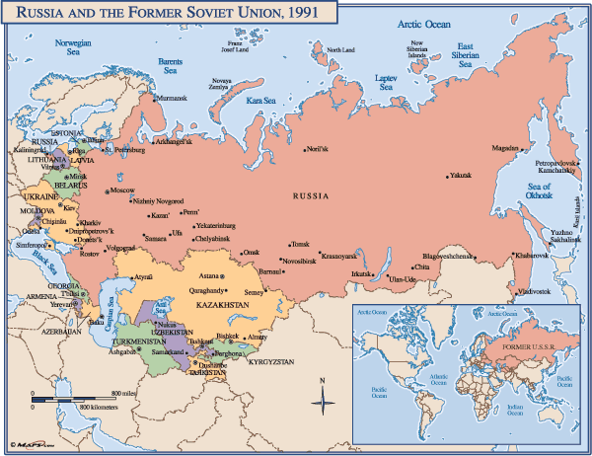

Slide 36
Eastern Europe’s Economy
Lingering Problems
Old equipment
Lack of materials
Few educated workers
Little capital ($$)

Slide 37
Eastern Europe’s Economy
1990s – “Russian mafia”
Criminal organizations
Control 40% of private companies
Control 60% of state- owned companies
Organized crime slowed economic reform by rewarding illegal activity
Government cannot tax such activity

Slide 38
Review Questions
Who is credited with “discovering” Russia in 862 AD?
What were Ivan the Great’s many accomplishments as the first czar of Russia?
What is St. Petersburg known as?
What contributed to resentment towards the czars under the rule of Peter the Great?
What major event brought about the end of the czars?
What actions did Vladimir Lenin take during the revolution? What were the results of the revolution?

Slide 39
Review Questions
Identify the person who wrote Communist Manifesto.
Why did he believe that capitalism was doomed?
How many Russians were killed during the rule of Joseph Stalin?
The conflict between the Soviet Union and the U.S. from the 1940’s to the 1980’s was called the __________ __________.
What happened to the Soviet Union in the early 1990s, and what was the results of this event?

Slide 40
Review Questions
What is the difference between a command economy and a market economy?
What are the disadvantages of a command economy?
What is privatization? What happened to the price of goods after privatization took place?
What are some of the problems that Russia still faces?

Slide 41
Quizlet
Want to challenge yourself on the material covered in the notes for Europe and Russia?
Go to: https://quizlet.com/186144383/geography-test-study-guide-flash-cards/
Pardon some of the spelling and grammar errors. I did not make it, but the content is still quite useful.

