Slide 1
Earth’s Features

Slide 2
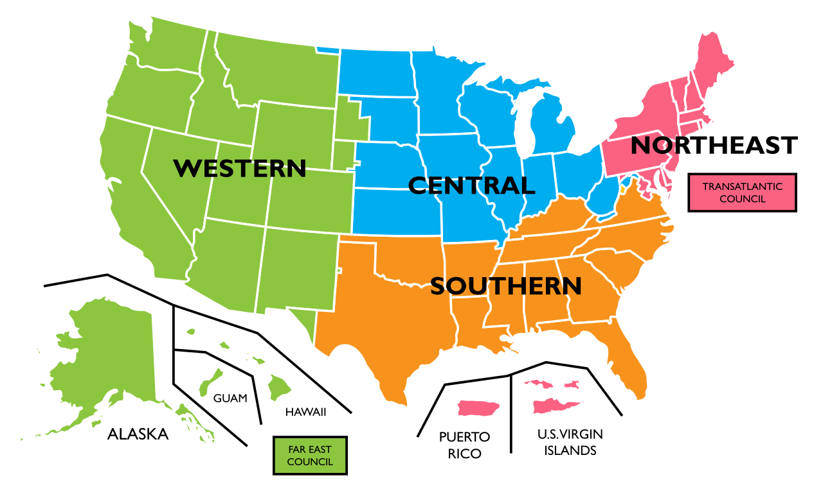
Region
An area with one or more characteristics that set it apart from other areas is called a region.

Slide 3
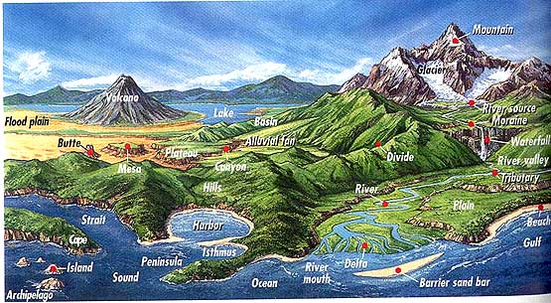
Landforms
Natural features of the Earth’s surface
Found on a map that shows physical features

Slide 4
Continents
There are 7 large landmasses
1. Asia – largest
2. Australia – smallest
Some people consider Europe and Asia to be one continent (Eurasia)
1. divided by the Ural Mountains

Slide 5
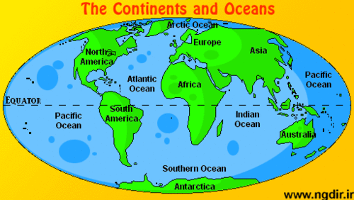
Southern Ocean

Slide 6
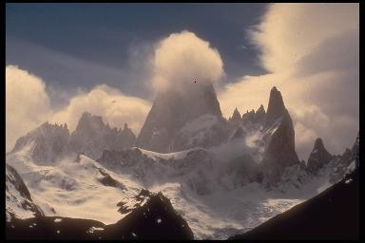
Mountains highest landform, steep slopes with a peak or summit

Slide 7
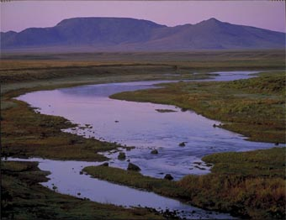
Hills lower than mountains, more rounded

Slide 8
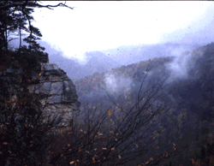
Plateaus higher than surrounding land, usually has one steep side (table top)

Slide 9
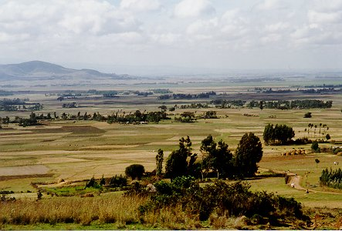
Plains Flat or gently rolling lands 1. Coastal plains have lower elevations 2. Interior plains have higher elevations

Slide 10
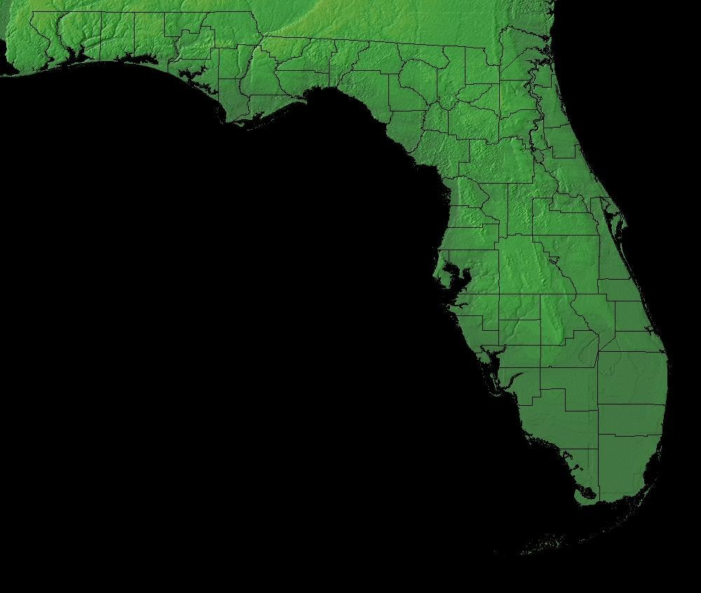
Peninsula Piece of land surrounded by water on 3 sides (Florida)

Slide 11
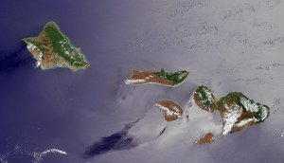
Archipelago A group or chain of islands (Hawaii)

