Slide 1
World Geography Latin America Cultural Notes

Slide 2
History

Slide 3
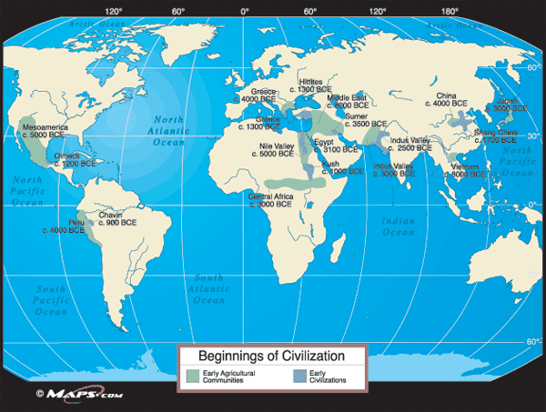

Slide 4
Indian Civilizations
Three important native civilizations that began in Latin America were:
Maya
Aztec
Inca

Slide 6
Mayans
The Maya lived in southern Mexico, Belize, and Guatemala.
Their civilization was at its peak around 250 - 900 AD.

Slide 7
Mayans
The Maya had city states ruled by kings and priests.
They worshipped the gods by ritual sacrifice and blood-letting.

Slide 8
Mayans
The Maya lived in a tropical wet climate with rainforests.
They practiced slash and burn farming and grew squash and corn.

Slide 9
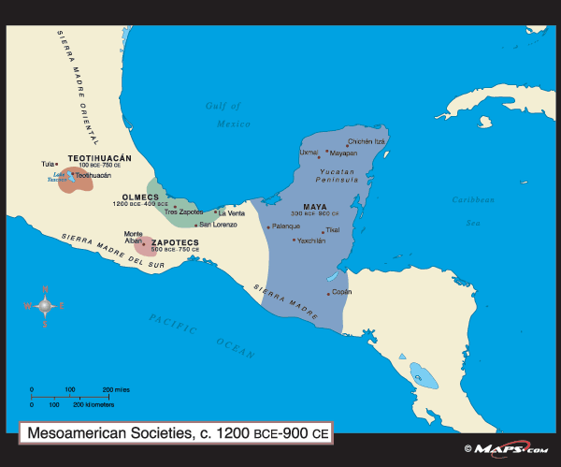

Slide 10
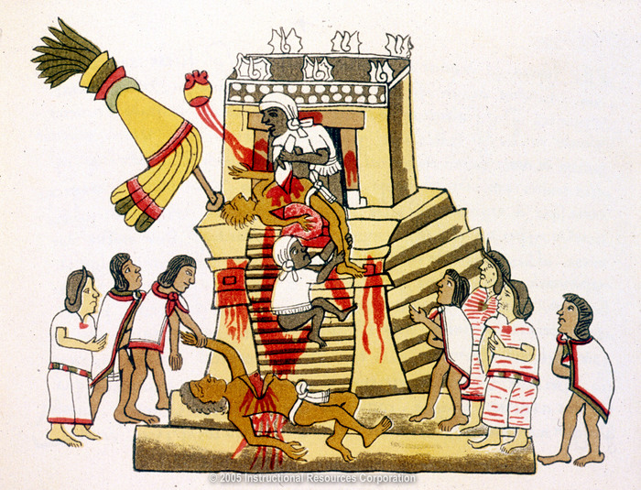
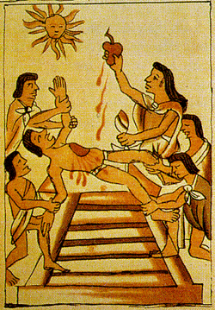

Slide 11
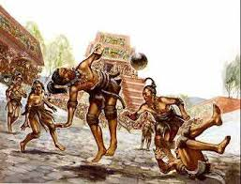
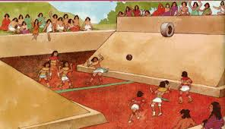
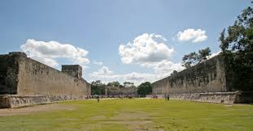

Slide 12
Inca
The Inca lived in South America in Peru and Chile.

Slide 13
Inca
The Inca built a system of roads through the Andes Mountains to connect their empire.

Slide 14
Inca
The Inca did not have a writing system but they kept records with a complicated system of ropes with knots.

Slide 15
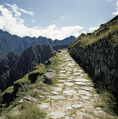

Slide 16
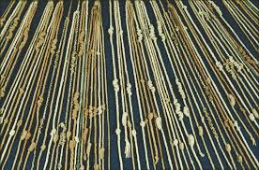

Slide 17
Aztec
The Aztec lived in central Mexico.
Their capital was called Tenochtitlan and it was located on islands in a lake.
Mexico City now stands on the ruins of the Aztec capital.

Slide 18
Aztec
The Aztec also practiced sacrifice and built large pyramids like the Maya.
The Aztec empire flourished from 1400 to about 1520, when it was overthrown by the Spanish.

Slide 19
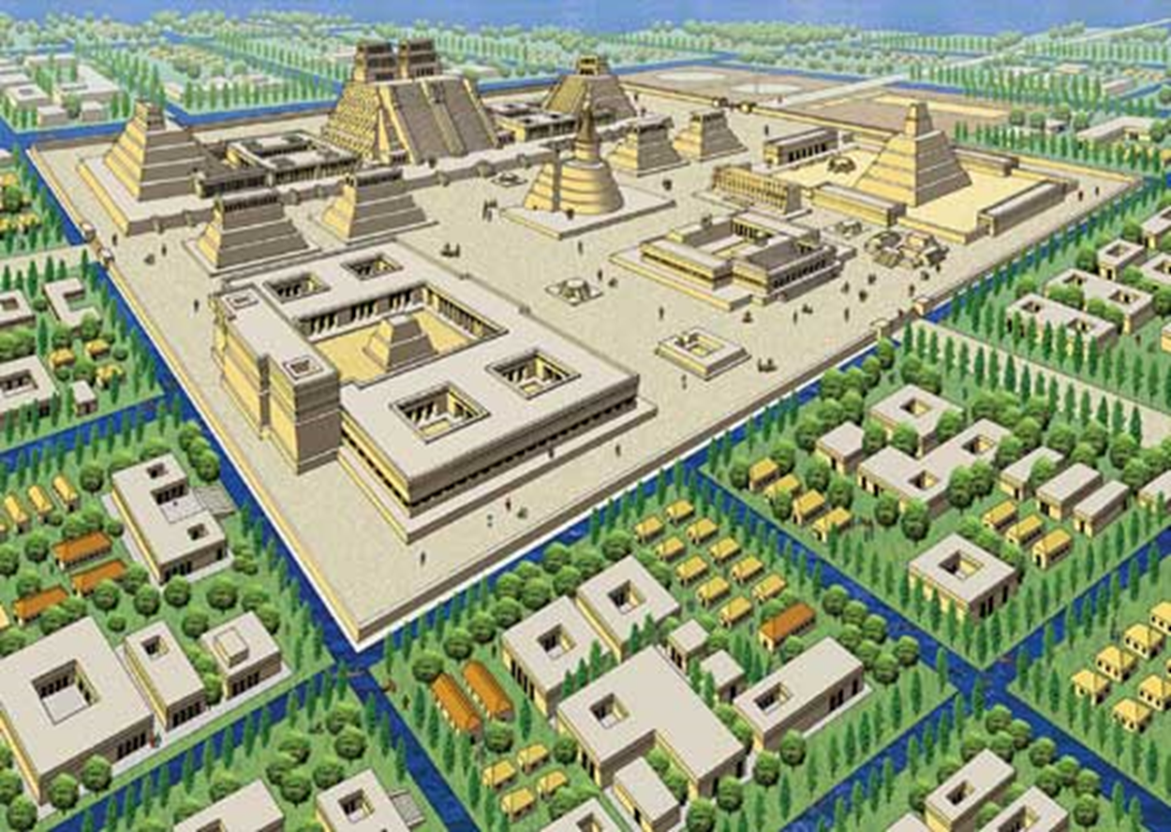

Slide 20
Europeans Arrive
1492 – Columbus discovered America
1494 - Treaty of Tordesillas - agreement between Spain and Portugal
Gave Portugal control of what would become Brazil

Slide 21
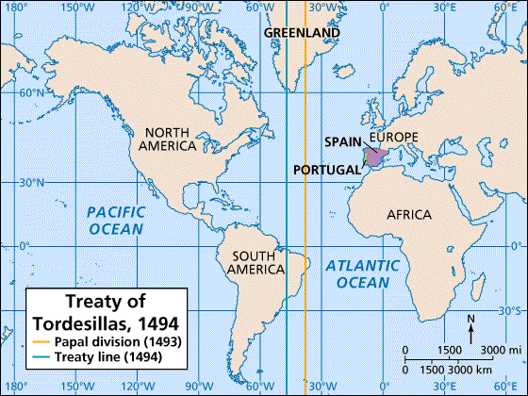

Slide 22
Europeans Arrive
Early 1500s – Cortes and Spanish destroyed capital, & built Mexico City on ruins
- Spanish brought own language, religion; Indian heritage stays strong
- large mestizo population—mixed Spanish, Native American heritage

Slide 23
Europeans Arrive
Pizarro conquered Incas for Spain
Since Spanish conquest in 1500s, Native Americans ruled by others
under Spain: governors ruled the region, acting on behalf of monarchs

Slide 24
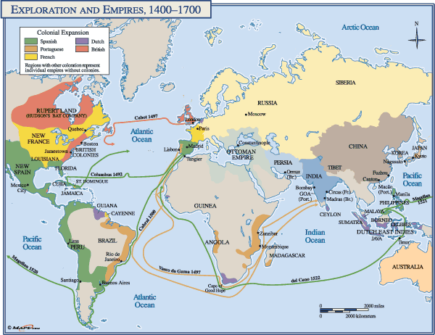

Slide 25
European Colonization
Latin America was colonized by European countries.
Spain colonized Mexico and most of Central America and South America.
Portugal colonized Brazil.
The English colonized Jamaica and Belize.
The French colonized Haiti.

Slide 26
European colonization
The Europeans converted the natives to Roman Catholicism and made them learn their languages.
The most wide spoken languages are Spanish and Portuguese.
The Europeans also brought Africans to work on sugar plantations as slaves.

Slide 27
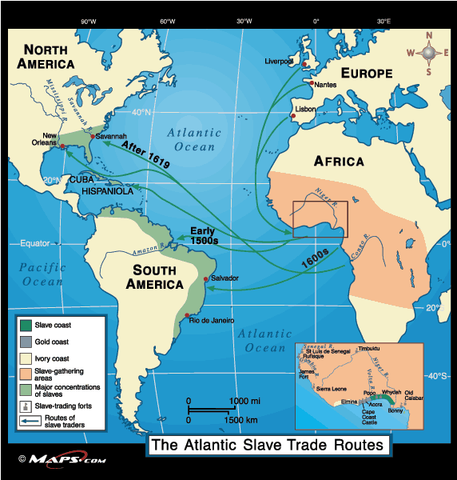

Slide 28
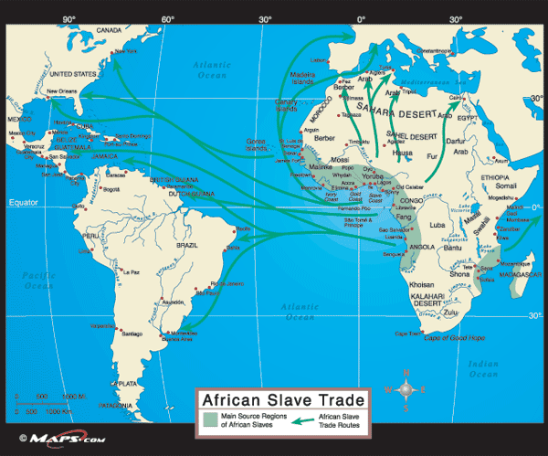

Slide 29
African influences
Latin America is heavily influenced by African culture.
Music - Calypso, steel drum bands, and reggae.
Religion
Voodoo in Haiti
Candomblé in Brazil.

Slide 30
population
Most of Latin America has a mixed population called mestizo.
Mestizos are people of mixed Spanish (EUROPEAN) and Native ancestry (INDIGENOUS).
People in the Caribbean have mixed European, Native, and African ancestry.

Slide 31
Following Independence
Minority of Spanish colonists still ruled after 1800s independence
Oligarchy—non-democratic government of the few
- press censored, free speech limited, & dissent punished
- discrimination against those not in Spanish ruling class

Slide 32
Following Independence
If government couldn’t control people, military would seize power
- form a junta—harsh government run by general
Many 20th-century Latin-American countries ruled by a caudillo-military dictator or political boss
- supported by military and wealthy; sometimes even elected

Slide 33
Rigid social structure
Latin America has a very rigid social structure.
There are many poor people and a few rich people.
The middle class is very small.
During most of its history Latin America was divided among rich landlords who owned most of the land.

Slide 34
Review Questions
What was the Treaty of Tordesillas?
What country colonized Brazil?
What is mestizo?
What is an oligarchy?
What group of Native Americans lived in the Andes Mountains in Peru?
What two cultures blended to shape the development of Mexico?
*Review questions are really important and should be able to be answered without looking it up! HINT!!! HINT!!!

Slide 35
Culture

Slide 36
Languages
Most Latin American countries speak Spanish
Suriname is Dutch-speaking & French Guiana is part of France
Portuguese is the official language of Brazil

Slide 37
Emigration
Emigration - many workers travel to U.S. (2,000-mile border with U.S)
separates families; workers in U.S. send money, return with savings
Growing population, & government policies create a shortage of jobs

Slide 38
Emigration
Many Mexicans migrate to U.S. for work, but can’t get good jobs
School attendance is improving; 85% of school-age kids in class

Slide 39
Urbanization: The Move to the Cities
Subsistence farming barely supports people and their families
People move to cities to improve their lives
Push factors—factors that “push” people to leave rural areas
Pull factors—factors that “pull” people to cities

Slide 40
Urbanization: The Move to the Cities
Rapidly Growing Cities have similar problems
- growing slums
- increasing unemployment and crime

Slide 41
Urbanization: The Move to the Cities
- environmental problems include air pollution, drinking water shortages
failing infrastructure—sewers, transportation, electricity, housing

Slide 42
Urbanization: The Move to the Cities
Six of Latin America’s most populous cities are in South America
Most populous city in Latin America is Mexico City
18 to 20 million in city, 30 million in greater metropolitan area

Slide 43
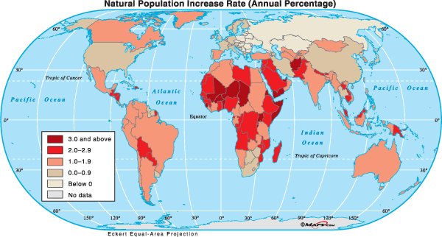

Slide 44
Literacy in South America
Spanish-speaking South American countries have high literacy rates
better than Central America, Caribbean, Mexico, Brazil
90% in Argentina, Chile, Uruguay with rates for women as high as men
Chile has a 95% adult literacy rate & 98% for young people
All children ages 6–13 attend school; free public education

Slide 45
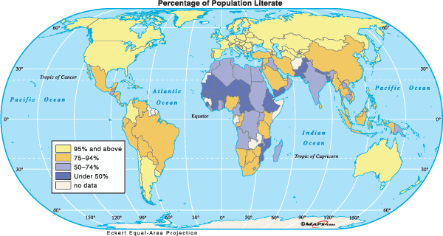

Slide 46
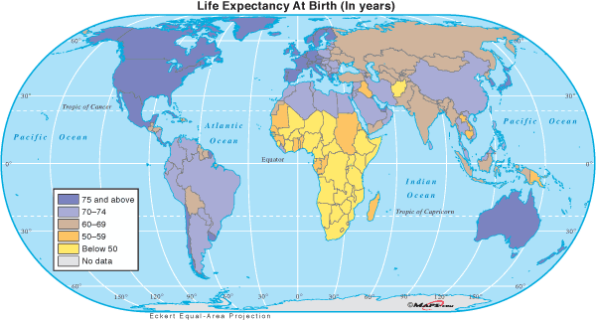

Slide 47
Review Questions
What language do the majority of Latin American countries speak?
What Latin American country speaks Portuguese?
How are push- and- pull factors causing urbanization?
*Review questions are really important and should be able to be answered without looking it up! HINT!!! HINT!!!

Slide 48
Economy

Slide 49
Bridging the Gap Between Rich and Poor
Income gap—difference between quality of life of the rich and poor
- Gap is widening in most Latin American countries
Most countries have free-market economies & minimal government rules
People have freedom, & rewards they need to create wealth

Slide 50
Bridging the Gap Between Rich and Poor
Poor lack skills to fully, equally participate in such an economy
Most have little education; can’t read, can’t find jobs
End up doing menial labor
Conditions in slums bring disease, crime, short life spans

Slide 51
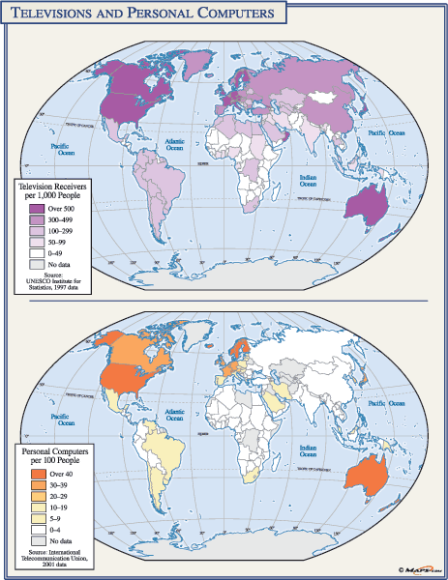

Slide 52
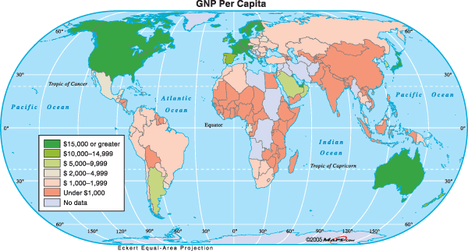

Slide 53
Economics
Gulf oil reserves help Mexico develop industrial economy& manufacturing
Many new factories along U.S. border

Slide 54
Economics
Maquiladoras—factories that assemble imported materials
- export products (electronics, clothes) to U.S.

Slide 55
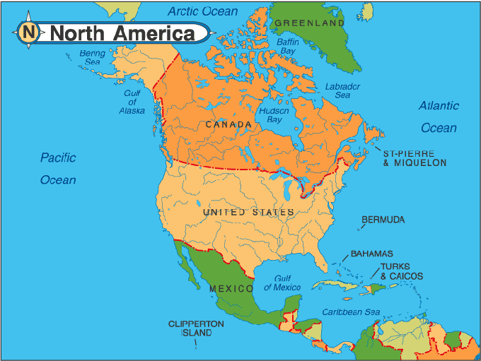
Economics
Mexico is part of NAFTA (North American Free Trade Agreement) with U.S. & Canada
- prosperity through trade expected

Slide 56
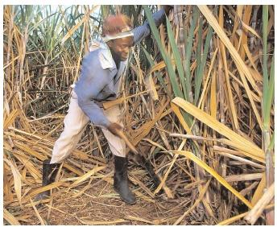
Economics
Sugar cane is Caribbean’s largest export crop
-also bananas, citrus, coffee, spices

Slide 58
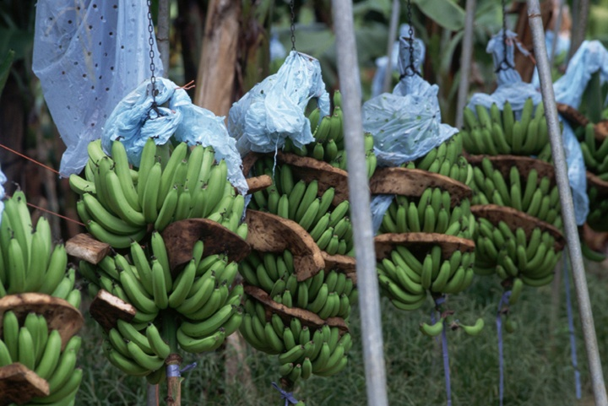

Slide 59
Economics
Poor crop-labor pay leaves Caribbean’s per-capita income very low
Central America plantations produce 10% of world’s coffee, bananas
- mining and forest resources are also exported
Chile’s largest export is copper

Slide 60
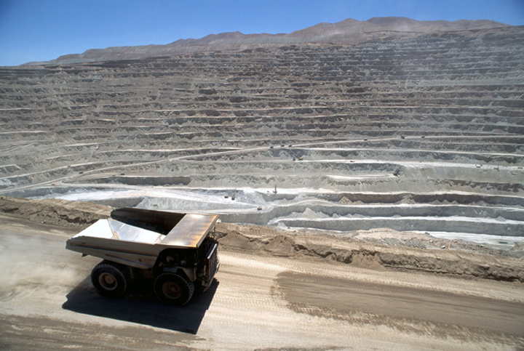

Slide 61
Tourism: Positive and Negative Impacts
Advantages of Tourism
Tourists spend money on souvenirs, trips, restaurants
new hotels, businesses have been built in Mexico and the Caribbean
regional ports serve cruise ships
residents work in restaurants and resorts, guide tours and activities
Helps reduce income gap between rich and poor

Slide 62
Tourism: Positive and Negative Impacts
Disadvantages of Tourism
Resorts built in unspoiled settings create congestion, pollution
Gap between rich tourists and poor residents creates resentment
Local governments run up debt to build tourist facilities

Slide 63
Tourism: Positive and Negative Impacts
airports, harbors, hotels, resorts, sewage systems, shopping malls
Facility owners often live out of country, so profits leave the area
- such owners make decisions that may not be in area’s best interest

Slide 65
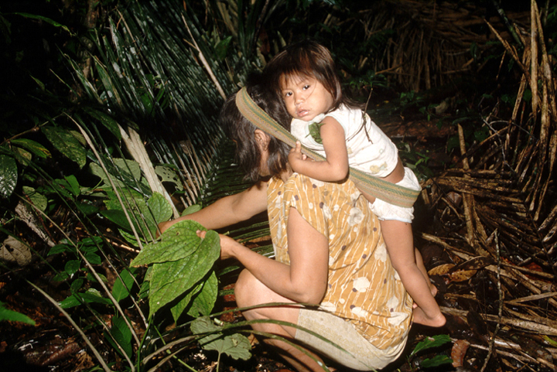
Rain Forest Land Uses
Rain forest has biodiversity —wide range of plant, animal species
50 million acres of rain forest worldwide destroyed annually
Mahogany & cedar harvested, exported from Amazon

Slide 66
Rain Forest Land Uses
Poor native farmers clear rain forest for crops (slash & burn)
Poor soil fertility, increased erosion lead to more timber clearing
Brazil’s growing population: 173 million in 2000, 200 million projected in 2020
Over half of Amazon rain forest is in Brazil

Slide 67
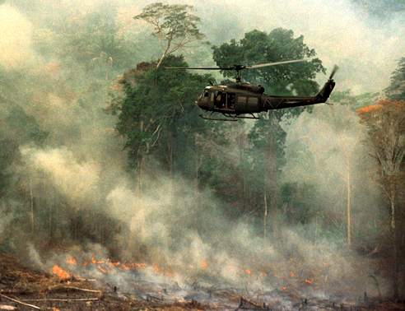

Slide 68
The Price of Destruction
Deforestation—cutting down and clearing away trees
Rain forests regulate climate: absorb carbon dioxide, produce oxygen
Fewer forests means less carbon dioxide absorbed - it builds up in atmosphere, prevents heat from escaping into space
Global warming—atmospheric temperature rises, weather patterns change
Covers 6% of earth’s surface but has 50% of plant, animal species
Researchers are trying to develop medicines from rain forest plants

Slide 69
Moving Toward Solutions
Balancing economic development with rain forest preservation
Some countries restrict economic development
Grassroots organizations try to educate people about rain forests
- protest environmentally damaging plans
One environmental plan is the debt-for-nature swap - group pays part of government’s large debt
- government protects part of rain forest
- approach works in Bolivia

Slide 70
Drug Cartels

Slide 72
Review Questions
What is NAFTA?
What is debt – for nature swap?
What is global warming?
What is biodiversity?
What is deforestation?
What are maquiladoras?
What effect is slash-and-burn farming having on the Amazon Rain Forest?
Name three reasons that it is important to preserve the rain forest.

