Slide 1
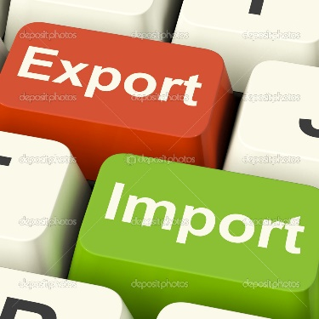
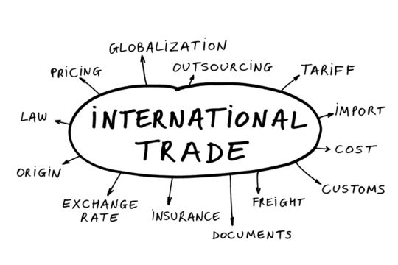
International Trade

Slide 2
Lesson Essential Question
What is the distinction between absolute and comparative advantage?
https://www.youtube.com/watch?v=ol4NexZ0iII
AC/DC Economics: Comparative Advantage & Terms of Trade

Slide 3
Milestone Practice Exam Question
SSEIN1a) Suppose that in France 40 labor hours are required to produce a liter of wine. In Italy, 30 labor hours are required to produce a liter of wine. These figures indicate that
Italy has an absolute advantage in wine production.
France has an absolute advantage in wine production.
Italy has a comparative advantage in wine production.
France has a comparative advantage in wine production.

Slide 4
Milestone Practice Exam Question
SSEIN1a) Suppose that in France 40 labor hours are required to produce a liter of wine. In Italy, 30 labor hours are required to produce a liter of wine. These figures indicate that
Italy has an absolute advantage in wine production.
France has an absolute advantage in wine production.
Italy has a comparative advantage in wine production.
France has a comparative advantage in wine production.

Slide 5
Scarcity, Resource Distribution, & Specialization
Remember those productive resources?
Land, Labor, Capital (human, physical, & financial), and Entrepreneurship
Because each nation has certain productive resources & cannot produce everything it wants, individuals, businesses, & nations must decide what goods & services to focus on
Specialization – a situation that occurs when individuals or businesses produce a narrow range of products to maximize resources, increase productivity, & make a profit
Economic interdependence – a situation in which producers in one nation depend on others to provide goods & services they don’t produce (opposite of independence and isolationism)

Slide 6
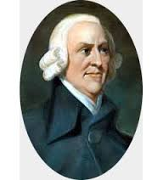
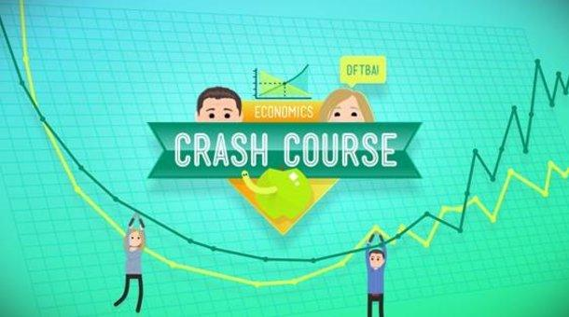
What does this quote imply about trade?
“ Self-sufficiency is inefficiency and inefficiency can lead to poverty”
- Adam Smith
https://www.youtube.com/watch?v=NI9TLDIPVcs
Crash Course Economics #2 Specialization and Trade

Slide 7
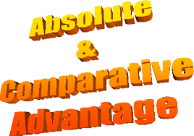
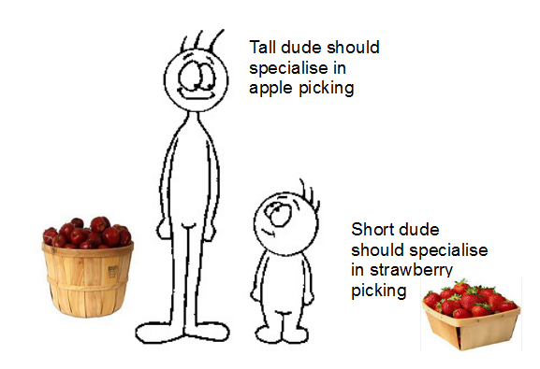
Absolute Advantage – a nation can produce more of a given product using a given amount of resources
Comparative Advantage – a nation’s ability to produce a product most efficiently given all the other products that could be produced (less opportunity cost)
Law of comparative advantage – a nation or person is better off when it produces goods and services for which it has a comparative advantage
https://www.youtube.com/watch?v=FpTBjRf8lGs
AC/DC Economics: Comparative Advantage

Slide 8
Two Men on an Island Activity
Two men live alone on a deserted island. To survive they must undertake a few basic economic activities like carrying water, fishing, cooking, and shelter construction and maintenance.
The first man is young, strong, and educated. He is also faster, better, and more productive at everything.
The second man is old, weak, and uneducated. He produces less than the younger man.
In some activities the difference between the two is great; while in others it is small. For instance, the younger man can gather 20 coconuts every hour, or catch 60 fish per hour! While the older man can only gather 5 coconuts or catch 25 fish every hour.
Who is better at all activities in the scenario above?
What is the opportunity cost for the younger man if he dedicates his hour to gathering coconuts?
What is the opportunity cost for the older man if he dedicates his hour gathering coconuts?
Should they work separately or together on the island? Explain

Slide 9
Coconuts or Fish?
 | Absolute Advantage
 | Coconuts | Fish
Young Man | 20 | 60
Old Man | 5 | 25
Young man has an Absolute Advantage because he can produce both items more efficiently than the old man

Slide 10
Coconuts or Fish?
 | Comparative Advantage
 | Coconuts | Fish
Young Man | 20 60/20 = 3 | 60 20/60 = 1/3
Old Man | 5 25/5 = 5 | 25 5/25 = 1/5
Young man has Comparative Advantage in collecting coconuts because he gives up less fish relative to his production of coconuts than the old man
His opportunity cost for collecting coconuts is lower relative to the old man
The old man has the Comparative Advantage in catching fish because he gives up less coconuts relative to his production of fish
His opportunity cost for catching fish is lower

Slide 11
Comparative Advantage HINT
If it’s an OUTPUT problem, then remember OTHER OVER (Triple O’s!!!)
In other words, how much is being produced using the same amount of resources (inputs)
Also, whoever produces the most has the Absolute Advantage
It it’s an INPUT problem, then remember OTHER UNDER
In other words, how many resources or amount of time is needed to produce a certain product (output)
Also, whoever uses the fewest inputs to produce has the Absolute Advantage (IOU!!!)

Slide 12
Comparative Advantage Practice Problems
Decide if it’s an Output or Input Problem
Determine who has the Absolute Advantage in each
Determine who has the Comparative Advantage in each (must show your work!)
Explain the Opportunity Costs and Terms of Trade
Hours needed to
From 1 ton of tomatoes
 | Paint the Room | Stain the Deck
Dawn | 4 | 3
Court | 6 | 8
 | Ketchup | Spaghetti Sauce
Mitchell | 50 | 20
Chase | 60 | 70
Number produced
Acres to produce
 | Corn | Rice
USA | 20 | 5
Japan | 2 | 20
 | Grapes | Olives
France | 12 | 20
Greece | 12 | 10

Slide 13
Milestone Practice Exam Question
SSEIN1b)
Country X can produce 1,000 units of food and 2,000 units of clothes.
Country Y can produce 1,000 units of food and 1,000 units of clothes.
In order to maximize trade according to the principles of comparative advantage,
country X should produce food and import clothes from country Y.
country Y should produce food and import clothes from country X.
country X and Y should produce both food and clothes to meet their own needs.
country Y should produce both food and clothes, and import additional clothes from country X.

Slide 14
Milestone Practice Exam Question
SSEIN1b)
Country X can produce 1,000 units of food and 2,000 units of clothes.
Country Y can produce 1,000 units of food and 1,000 units of clothes.
In order to maximize trade according to the principles of comparative advantage,
country X should produce food and import clothes from country Y.
country Y should produce food and import clothes from country X.
country X and Y should produce both food and clothes to meet their own needs.
country Y should produce both food and clothes, and import additional clothes from country X.

Slide 15
REVIEW
What 3 things can shift the PPC to the right, showing long-run economic growth?
Which component of GDP is international trade? What percentage does this component account for in America’s GDP? Meaning US has a trade _________.
What are the 4 productive resources (factors of production)? Which one is the most important for economic growth? Why?
Define specialization and explain why it’s so important in economics.
What does it mean when a nation has an Absolute Advantage in production?
Explain the Law of Comparative Advantage.
What’s the #1 focus of comparative advantage?
Do nation’s trade today based on absolute or comparative advantage? Why?
What’s the #1 problem with economics, no matter if a nation is rich or poor?
What is your favorite Girl Scout cookie? How much utility does it give you?

Slide 16
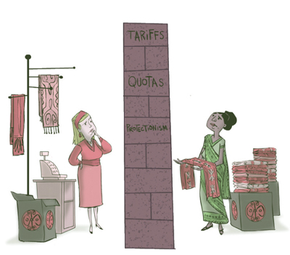
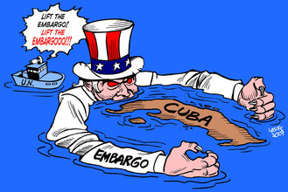
Trade Barriers & Agreements
EQ: Why do countries advocate for free trade and sometimes erect trade barriers?

Slide 17
Trade Barriers
Trade Barrier – a trade restriction, used to prevent a foreign product from freely entering a nation’s territory
Quotas – a limit on the amount of a good that can be imported
Tariffs – a tax on imported goods
Revenue tariff – taxes on imports specifically to raise money (rarely used)
Protective tariff – taxes on imports to protect domestic industries
Subsidies – gov’t “picking a domestic winner” and providing tax dollar “transfer payments” to a certain industry (agriculture, energy, etc.) is NOT allowing for competitive free trade
Protectionists- support trade barriers to (1) protect domestic industries & jobs, (2) promote infant industries, & (3) protect national security
Voluntary Export Restraint – a self-imposed limitation on the number of products shipped to a particular country
Embargo – a law that cuts off most or all trade with a specific country
America has/had an embargo on Communist Cuba & that’s why those cigars are illegal!!!

Slide 18
Trade Agreements or Blocs

Slide 19
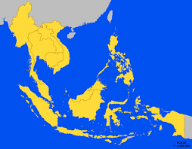
International Cooperation & Agreements
International Free Trade Agreement – results from cooperation between countries to reduce trade barriers and tariffs to promote trade
Some Trading Blocs to know:
North American Free Trade Agreement (NAFTA) – agreement between Canada, Mexico and the U.S. to eliminate tariffs and other trade barriers
European Union (EU) – a regional trade organization of European nations
Association of Southeast Asian Nations (ASEAN)

Slide 20
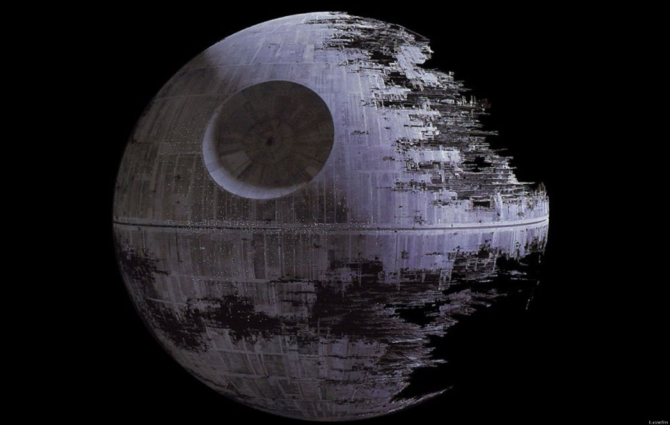
WTO: The EMPIRE
“Don’t underestimate the power of worldwide free trade.”
“Now you will pay the price for your lack of vision”
World Trade Organization (WTO) – a worldwide organization whose goal is to promote free global trade and supervises international trade (Anti-Protectionism)

Slide 21
https://www.youtube.com/watch?v=9MpVjxxpExM

Slide 22
Milestone Practice Exam Question
SSEIN2a) A protective tariff is intended to protect the
consumer from higher prices on foreign goods.
consumer from higher priced goods produced within the country.
manufacturer from higher prices on materials produced within the country.
manufacturer or farmer from lower priced goods imported into the country.

Slide 23
Milestone Practice Exam Question
SSEIN2a) A protective tariff is intended to protect the
consumer from higher prices on foreign goods.
consumer from higher priced goods produced within the country.
manufacturer from higher prices on materials produced within the country.
manufacturer or farmer from lower priced goods imported into the country.
Protective tariff – taxes on imports to protect domestic industries

Slide 24
REVIEW
What is the difference between absolute and comparative advantage again…?
Why would someone support Protectionist polices over free trade (3 reasons)?
Define the following trade barriers: tariffs, quotas, and subsidies and explain how each hinders free trade.
What is an embargo, and what is the primary reason an embargo is enacted on another country? Can you provide a real life example of an embargo?
What is a synonym for a Trade Bloc?
What trading agreement consists of the countries: Canada, U.S., & Mexico?
What trading bloc do nations such as France, Germany & Greece belong to?
What is ASEAN?
What is the primary purpose of the WTO? Define Globalization.
Name at least 5 world currencies other than the U.S. dollar.

Slide 25
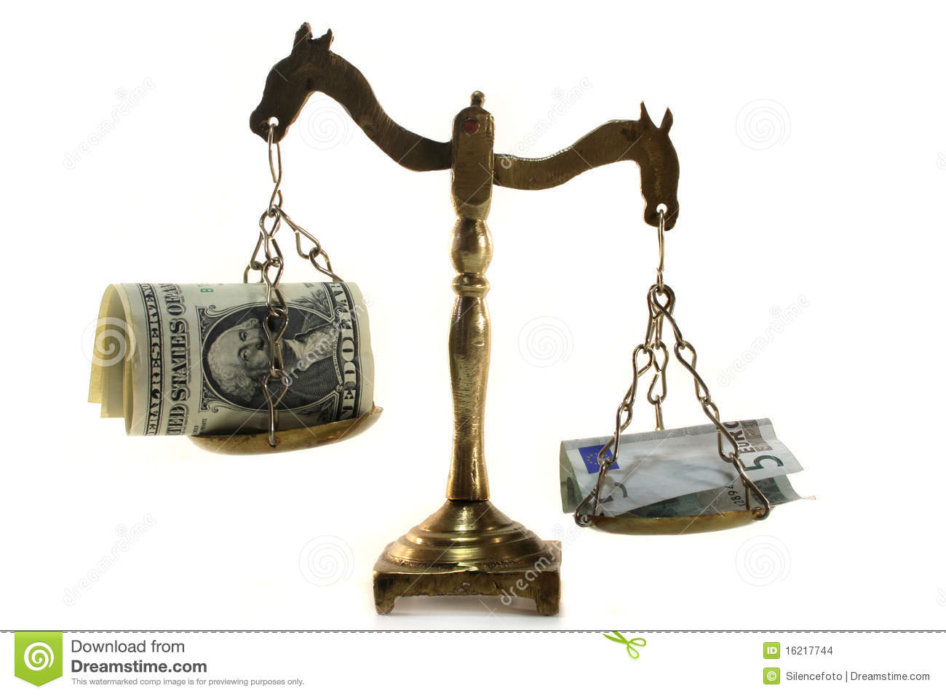
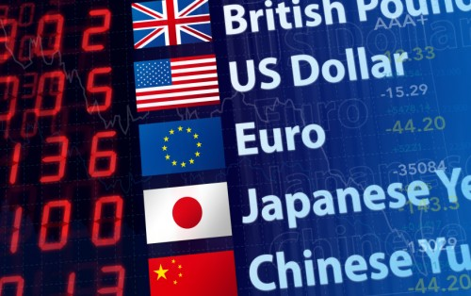
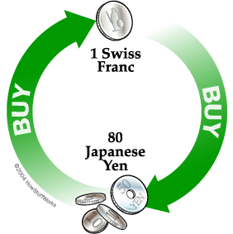
Lesson Essential Question
How do Foreign exchange rates impact International Trade, and what is the difference between balance of trade and balance of payments?

Slide 26
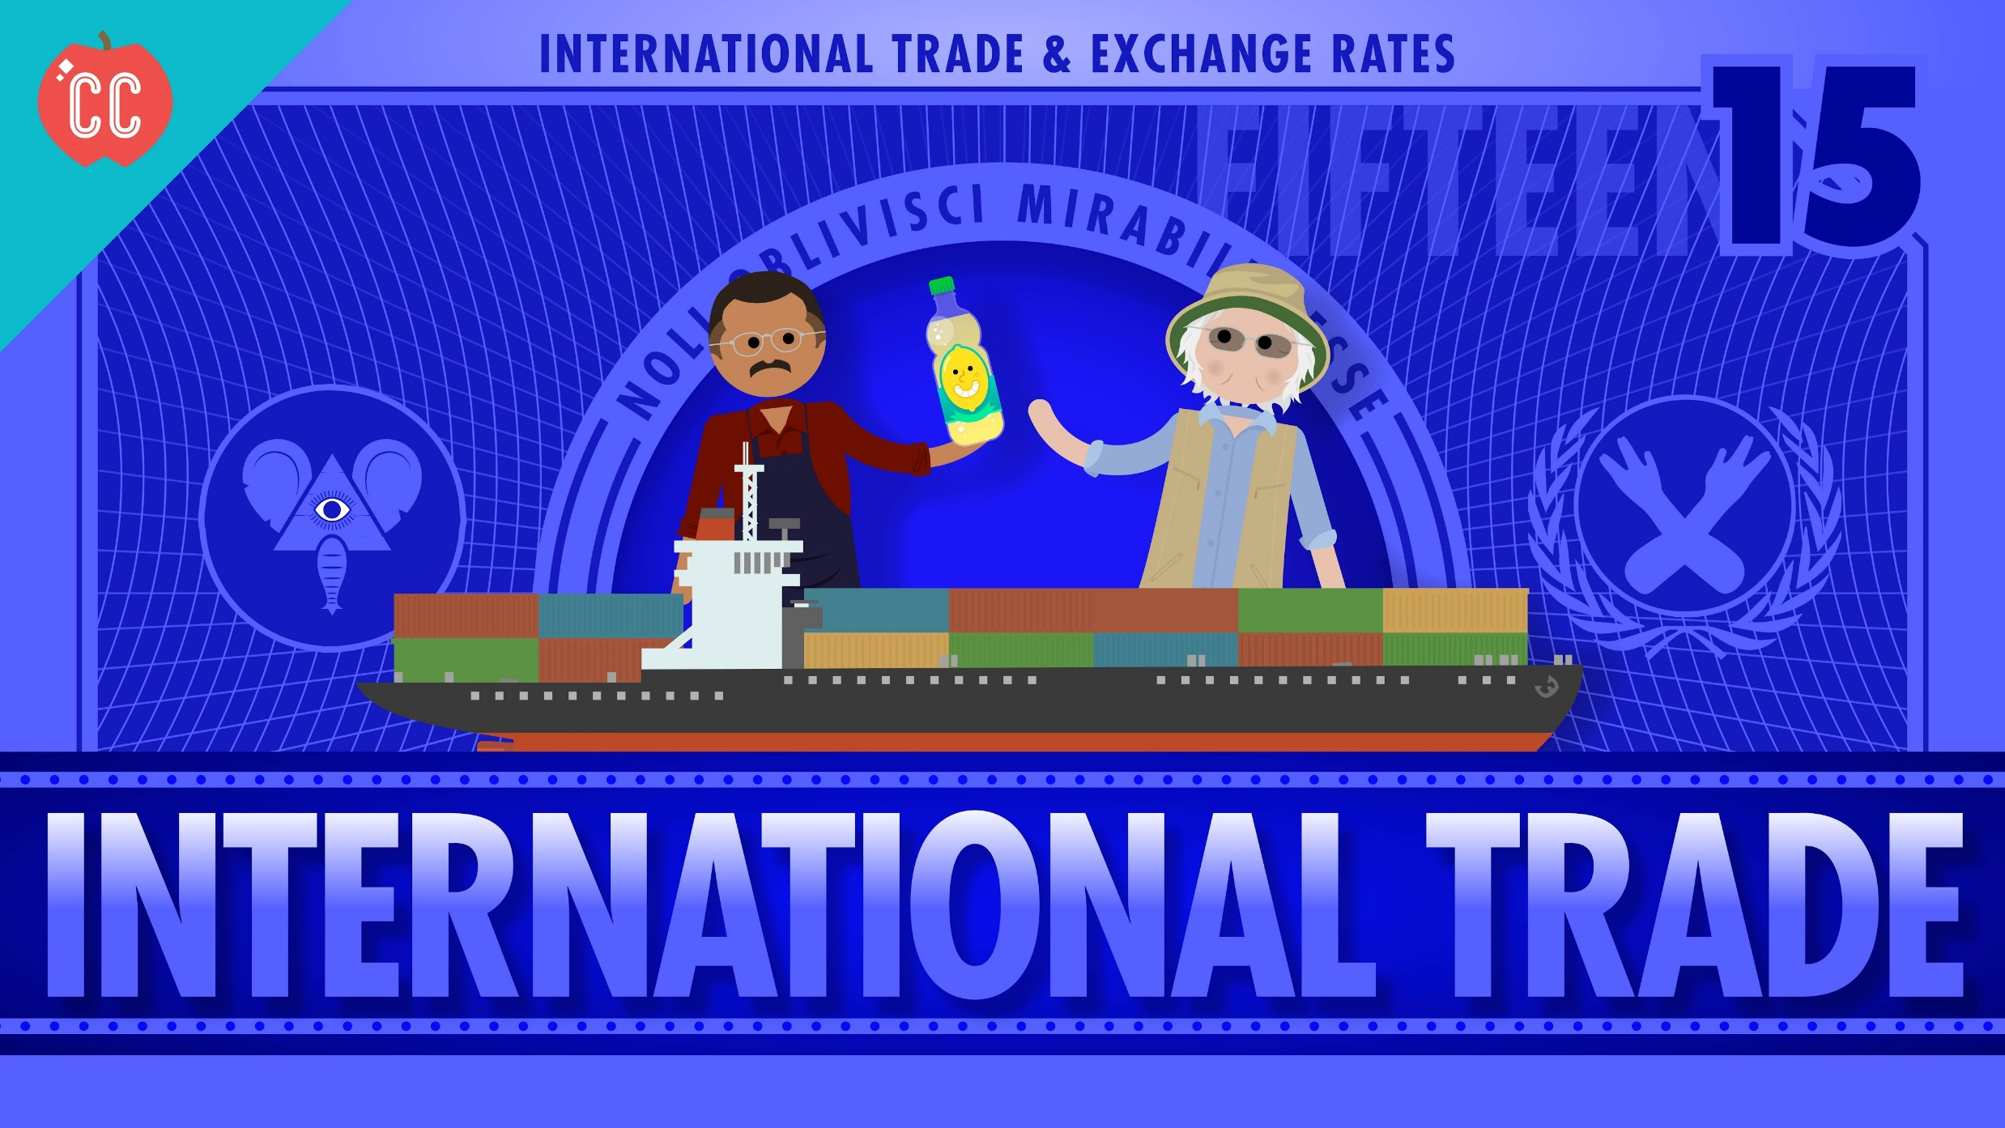
https://www.youtube.com/watch?v=geoe-6NBy10

Slide 27
Foreign Exchange
Foreign Exchange Market – a market in which currencies of different countries are bought & sold
Foreign Exchange Rate – the value of one foreign nation’s currency in relation to another nation’s currency
Flexible Rate of Exchange – system in which the exchange rates for currencies change as the supply & demand for the currencies change (floating rate)
Fixed Rate of Exchange – system in which currency of one nation is fixed, or constant, in relation to other currencies (gold/U.S. dollar)
China purposely devalues it’s currency (yuan) by fixing it to the value of the U.S. dollar in order to be able to export more and have a trade surplus

Slide 28
Determining the Rate of Exchange
Suppose you want to buy a book in Germany where the currency is the euro. The book costs 25 euros. To find out how much 25 euros cost in U.S. dollars, you must know the exchange rate.
$1.25 U.S. dollars = 1.00 in Euros, so the exchange rate is 1.25/ 1.00 = $1.25
If the formula for the exchange rate is: Amount of currency you want to buy x Exchange Rate = Cost in currency you have
So, if I want to buy 25 euros, what would be the cost if U.S. dollars?

Slide 29
Determining the Rate of Exchange
You need 25 euros to buy the book in Germany. How much in US dollars do you need to exchange for the correct number of euros?
Suppose the exchange rate is $1.25.
$1.25 U.S. dollars = 1.00 in Euros
Amount of currency you want to buy x Exchange Rate = Cost in currency you have
So, 25 x 1.25 = $31.25 in U.S. dollars

Slide 30
Determining the Rate of Exchange
While visiting Mexico, you stay in a hotel that cost 500 pesos. How much is that going to cost you in U.S. dollars, if $1 dollar equals 12 pesos?
Determine the exchange rate
Determine how much U.S. dollars you will need to pay for the hotel room.

Slide 31
Determining the Rate of Exchange
While visiting Mexico, you stay in a hotel that cost 500 pesos. How much is that going to cost you in U.S. dollars, if $1 dollar equals 12 pesos
1 Dollar = 12 Mexican Pesos
Exchange rate: 1/12 = .083
How much will it cost to stay in the hotel in US currency?
.083 x 500 = $41.50

Slide 32
FOREX Practice
Foreign Exchange Rate
County / Currency | Foreign Currency in U.S. Dollars | U.S. Dollars in Foreign Currency
UK / Pound | 2.0292 | .4928
Japan / Yen | .0084 | 118.9599
India / Rupee | .0248 | 40.3950
Canada / Dollar | .9394 | 1.0645
SSEIN3a) In relation to the Indian rupee, the Canadian dollar
is worth slightly more.
is worth slightly less
Is worth significantly less.
Is worth significantly more.

Slide 33
FOREX Practice
Foreign Exchange Rate
SSEIN3a) In relation to the Indian rupee, the Canadian dollar
is worth slightly more.
is worth slightly less
Is worth significantly less.
Is worth significantly more.
Canadian currency is .9394 of the US dollar, and India’s rupee is .0248 of the US dollar, so: .9394 > .0248
Another way to look at it: It takes 1.06 Canadian dollars to equal one US dollar (they are almost equal) and it takes 40.395 Indian rupees to equal one US dollar which means it takes a lot more rupees to get to one single US dollar so the Canadian dollar is worth more!
County / Currency | Foreign Currency in U.S. Dollars | U.S. Dollars in Foreign Currency
India / Rupee | .0248 | 40.3950
Canada / Dollar | .9394 | 1.0645

Slide 34
Strong and Weak Currencies
The Fed keeps a measure of the international value of the dollar called the trade-weighted value of the dollar to determine if the value of the dollar is strong or weak as measured against other currencies
As the value of the dollar increases (Appreciates)
IMPORTS to the U.S. become less expensive & increase
EXPORTS from the U.S. become more expensive & decrease = Trade Deficit
This is why the U.S. imports so many goods from China and Mexico!!!
The weak dollar (Depreciates) has the reverse effect:
IMPORTS become more expensive &
EXPORTS are able to sell relatively cheaply = Trade Surplus

Slide 35
The Not Incredible Adventures of the Down & Out Dollar

Slide 36
More FOREX Practice
SSEIN3c) When the dollar depreciates or “falls” compared to other currencies, which group benefits the most?
Those who export products overseas
Those who import products from overseas
Those who have large cash savings on hand
Those who speculate and trade in currencies

Slide 37
More FOREX Practice
SSEIN3c) When the dollar depreciates or “falls” compared to other currencies, which group benefits the most?
Those who export products overseas
Those who import products from overseas
Those who have large cash savings on hand
Those who speculate and trade in currencies
When the dollar depreciates (falls), foreign imports get more expensive which means they fall, but U.S. exports get cheaper, so they rise thus creating a trade surplus.

Slide 38
More FOREX Practice
SSEIN3b) If there was a sudden change in exchange rates that resulted in fewer U.S. Dollars being required to buy a Euro, you could expect
Europeans to buy more American products.
The U.S. dollar to depreciate quicker than the Euro.
The U.S. dollar to appreciate when compared to the Euro.
Gold and silver would shift from Europe to the U.S.

Slide 39
More FOREX Practice
SSEIN3b) If there was a sudden change in exchange rates that resulted in fewer U.S. Dollars being required to buy a Euro, you could expect
Europeans to buy more American products.
The U.S. dollar to depreciate quicker than the Euro.
The U.S. dollar to appreciate when compared to the Euro.
Gold and silver would shift from Europe to the U.S.
That means that it takes less US dollars to exchange for one euro, so the value of the US dollar has gone up (or appreciated).

Slide 40
Even More FOREX Practice
SSEIN3b) Hunter takes two trips to Ecuador. On his first trip, he finds that one U.S. dollar is worth 25,000 Ecuadorian Sucre. On his return trip, he finds that the dollar is now worth 26,000 Ecuadorian Sucre. What is a LIKELY result of this change in exchange rates?
Fewer Americans will travel to Ecuador.
More Europeans will travel to Ecuador
More money will be printed in Ecuador.
More Americans will travel to Ecuador.

Slide 41
Even More FOREX Practice
SSEIN3b) Hunter takes two trips to Ecuador. On his first trip, he finds that one U.S. dollar is worth 25,000 Ecuadorian Sucre. On his return trip, he finds that the dollar is now worth 26,000 Ecuadorian Sucre. What is a LIKELY result of this change in exchange rates?
Fewer Americans will travel to Ecuador.
More Europeans will travel to Ecuador
More money will be printed in Ecuador.
More Americans will travel to Ecuador.

Slide 42
FOREX Graph
Yen
$
$
Yen
S
S
ER
ER
D
D
Qe
Quantity of $
Qe
Quantity of Yen
Show the change in the FOREX graphs, if the U.S. imports more Japanese goods.

Slide 43
Balance of Trade & Payments
Balance of Trade – the difference between the value of a country’s imports & exports
Favorable Balance of Trade: nation has a trade surplus (exports more than it imports)
Unfavorable Balance of Trade: nation has a trade deficit (imports more than it exports)
Which one does the U.S. currently have?
Balance of Payments – a record of all the transactions that occurred between the individuals, businesses, & gov’t units of one nation & those of the rest of the world (consists of the current account and financial account)
See the difference between the 2…? It’s IMPORTANT

Slide 44
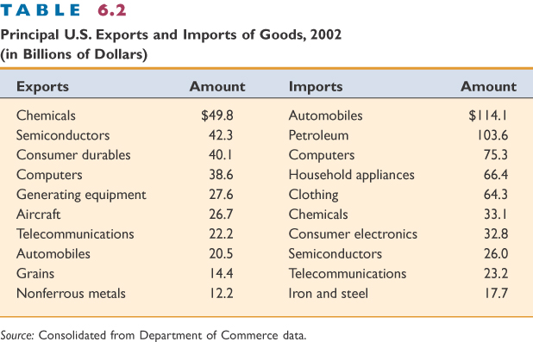
Balance of Trade
Net Exports (X_{N}) = Exports – Imports
Trade Surplus = Exporting more than is imported
Trade Deficit (aka. trade gap) = Exporting less than is imported

Slide 45
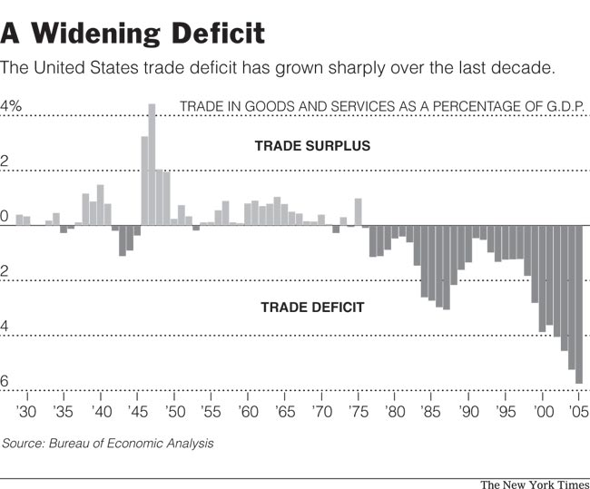
Balance of Trade

Slide 46
Balance of Payments (BOP)
Balance of trade includes only goods and service but balance of payments considers ALL international transactions.
The balance of payments is a broader measure of international trade.
The balance of payments is made up of two accounts:
the current account and
the financial or capital account.

Slide 47
Current Account
The Current Account is made up of three parts:
Trades in Goods and Services (Net Exports)- Difference between a nation’s exports of goods and services and its imports of goods and services
Ex: Toys imported from China, US cars exported to Mexico
Investment (Factor) Income- income from the factors of production (interest, wages, rent, profits) including payments made to foreign investors.
Ex: Money earned by Japanese car producers in the US
Net (International) Transfers- Money flows from the private or public sectors (no good or service is being bought or sold)
Ex: donations, aids and grants, official assistance, wire transfers to someone back home

Slide 48
Financial (Capital) Account
The Financial Account measures the purchase and sale of financial assets abroad.
Purchases of things that continue to earn money (stay in a foreign country)
Examples:
A Korean company buys a factory in Ohio
An American buys a Japanese government bond
When a foreign company buys business in a different country that is Foreign Direct Investment

Slide 49
Milestone Practice
SSEIN1c) Unlike balance of trade, balance of payments includes
imports.
exports.
foreign investments.
foreign exchange reserves.

Slide 50
Milestone Practice
SSEIN1c) Unlike balance of trade, balance of payments includes
imports.
exports.
foreign investments.
foreign exchange reserves.
Balance of trade includes only goods and service (the imports and the exports) but balance of payments considers ALL international transactions. That means they also consider the FOREX! As you may recall, the FOREX determines which nations will export (weaker currency) and import (stronger currency).

Slide 51
FOREX Practice Continued
SSEIN3b) The U.S. increases its imports from Europe. What will be the effects on relative value of the U.S. dollar and the euro on the currency exchange market?
The relative values of the dollar and euro will appreciate.
The relative values of the dollar and the euro will depreciate
The relative value of the dollar will depreciate and the euro will appreciate.
The relative value of the dollar will appreciate and the euro will depreciate.
Draw the Graph…It helps; I promise!!!

Slide 52
FOREX Practice Continued
SSEIN3b) The U.S. increases its imports from Europe. What will be the effects on relative value of the U.S. dollar and the euro on the currency exchange market?
The relative values of the dollar and euro will appreciate.
The relative values of the dollar and the euro will depreciate
The relative value of the dollar will depreciate and the euro will appreciate.
The relative value of the dollar will appreciate and the euro will depreciate.
The U.S. would only increase imports from Europe only if they were cheaper. That will lead to the US supplying more dollars to Europe to buy cheaper products (see graph below). This will eventually lead to a depreciation of the US dollar.
Europe, on the other hand, will export more of their cheaper goods, causing an increase of demand for the euro and their currency will appreciate in value.
euro
$
S
_$__
euro
S
S1
ER
ER1
ER1
ER
D1
D
Q
Q1
Quantity of $
Q
Q1
Quantity of euro

Slide 53
International Trade Concepts
Specialization & Economic Interdependence is the basis for International Trade
Absolute (better at production) v. Comparative Advantage (less opportunity cost)
Most nations use Comparative Advantage today
Protectionism supports Trade Barriers (tariffs, quotas, domestic subsidies) to protect domestic & infant industries and national security
Embargos are placed on nations for POLITICAL reasons (ex: Cuba, North Korea)
Trading Agreements or Blocs eliminate trade barriers between partners
NAFTA, EU, ASEAN
WTO promotes free trade and globalization

Slide 54
International Trade Concepts
Foreign Exchange Markets buy & sell currencies based on the exchange rate (fixed or flexible)
(Appreciate) Strong Currencies = more imports than exports (trade deficit)
(Depreciate) Weak Currencies = more exports than imports (trade surplus)
Balance of trade (favorable or unfavorable) is only looking at exports & imports
America has an unfavorable balance of trade
China has a favorable balance of trade
Balance of payments is a record of ALL TRANSACTIONS that occurred between individuals, businesses, and gov’t

Slide 55
REVIEW
What is bought and sold in the foreign exchange market?
In the foreign exchange market, the buyer is called the ___________ and the seller is called the _________.
What determines the exchange rate based on the flexible (floating) rate of exchange?
When a country’s currency is stronger, it is said to ________________.
When a country’s currency is weaker, it is said to ________________.
The nation with strong currency will always be the _____________ in international trade, and therefore, will have a trade ___________.
The nation with weaker currency will always be the _____________ in international trade, and therefore, will have a trade ___________.
China purposely devalues their currency (yuan) by pegging it to the U.S. dollar. This type of exchange rate is called ___________. Why does China do this???
If a nation exports more than imports, it has a ___________ balance of trade. But, if a nation imports more than it exports it has a ___________ balance of trade.
What is the difference between balance of trade and balance of payments in foreign trade?

