Slide 1

Unit 4: Macroeconomics
Time to Broaden
your Horizons

Slide 2
Milestone Practice
SSEMA1b) The single most important measure of the economy's overall economic performance, or the measure of national output, is called
National Income (NI).
Consumer Price Index (CPI).
Gross National Product (GNP).
Gross Domestic Product (GDP).

Slide 3
Milestone Practice
SSEMA1b) The single most important measure of the economy's overall economic performance, or the measure of national output, is called
National Income (NI).
Consumer Price Index (CPI).
Gross National Product (GNP).
Gross Domestic Product (GDP).

Slide 4

Macroeconomics = study of the behavior and decision making of the economy as a whole
Examples: economic growth, inflation, and unemployment

Slide 5
What is the purpose of studying Macroeconomics?
Measures the health of the whole economy (GDP, Unemployment, Inflation)
Guides gov’t policies to fix the problems (fiscal & monetary policies)
3 Major Economic Goals for every Economy
Promote Economic Growth
Limit Unemployment
Keep Prices Stable (in other words…Limit Inflation)

Slide 6
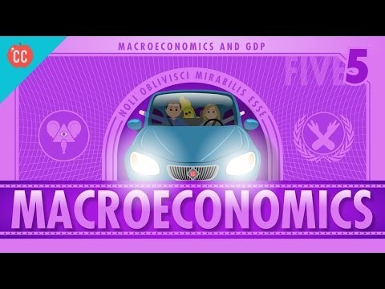

Slide 7
Lesson EQs
What are the components of GDP?
What must be excluded from GDP?

Slide 8
Gross Domestic Product
GDP is the most important indicator of the nation’s economy.
GDP – the total market value (dollar amount) of all FINAL goods & services produced within a country’s national borders in a given time period (usually a year or annually)
  Even if it’s produced by a foreign country
GDP is a measure of NATIONAL OUTPUT & TOTAL INCOME! It’s computed QUARTERLY (that’s every 3 months people!!)

Slide 9

Map of various country’s GDP

Slide 10
Components of GDP (4 SECTORS OF THE ECONOMY)
GDP = C+I+G+(X-M)
Consumption – (1) Private sector (households) consuming goods & services (70% of GDP)
Investment – (2) Business sector (firms) investing in capital goods, which leads to long-term economic growth (15% of GDP)
Government – (3) Public sector taxing & spending (20% of GDP)
Net Exports – (4) Foreign sector includes all consumers & producers outside the U.S. (-5% of GDP which means that USA has a trade deficit & imports more goods than it export)

Slide 11
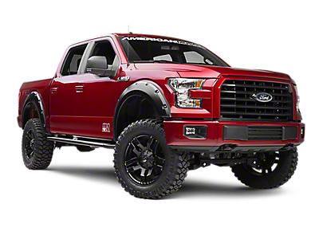
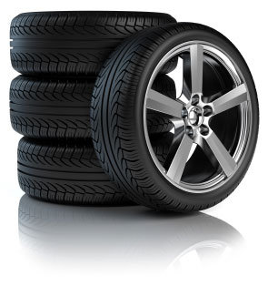



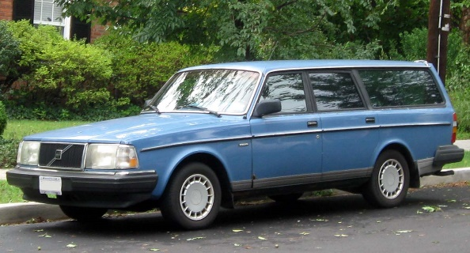
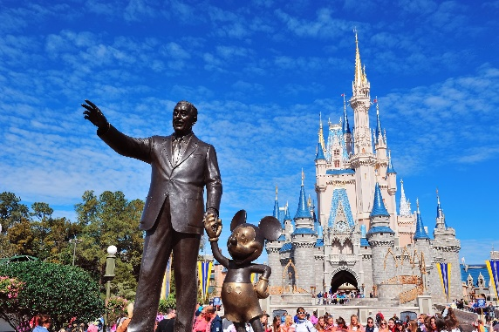
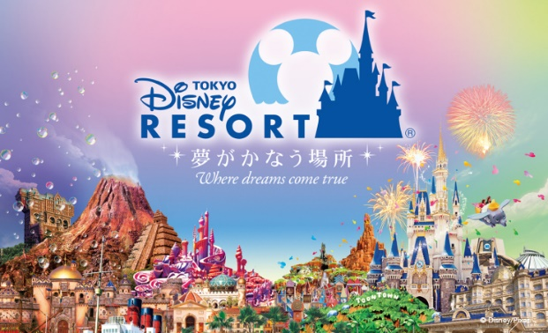
Important things to remember when calculating GDP
Only value of FINAL goods & service (not intermediate products)
Includes Goods and Services (tangible & intangible)
No
and
Yes
Only includes new goods & services produced currently
Hair products and haircuts included
Only measures production within a nation’s borders
New Counts
Not used
Measured within a specific time period (usually annually)
Disney in Orlando; Yay!
Doesn’t Count

Slide 12
GDP Does Not Measure
Intermediate products – inputs used to produce final goods & services (excludes double counting)
Secondhand sales – sales of used goods (yard sales, Craig’s List, used cars)
Nonmarket transactions – transactions that don’t take place in the legal market or aren’t reported (babysitting, lawn care, home repairs done by homeowner)

Slide 13
GDP Does Not Measure
Non-productive transactions – sales or purchases of stocks and bonds (nothing new being produced) and Transfer payments – Gov’t redistribution money programs (social security, welfare, entitlements)
Underground economy (aka: the “BLACK MARKET”) – market activities that go unreported because they are illegal (illegal drugs, prostitution, stolen goods, gambling)
Oh and one more thing… GDP doesn’t indicate the country’s QUALITY OF LIFE

Slide 14
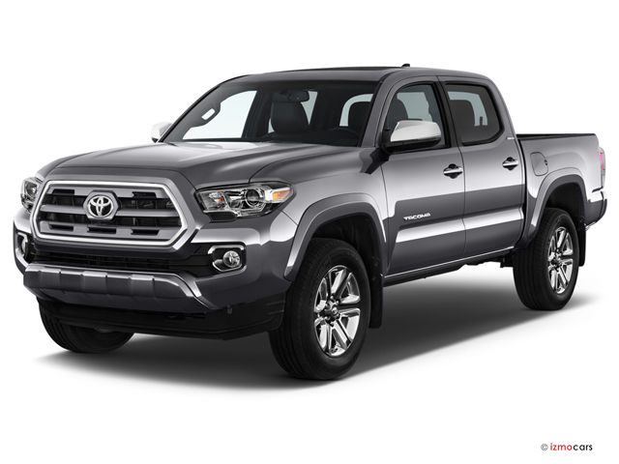


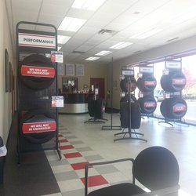
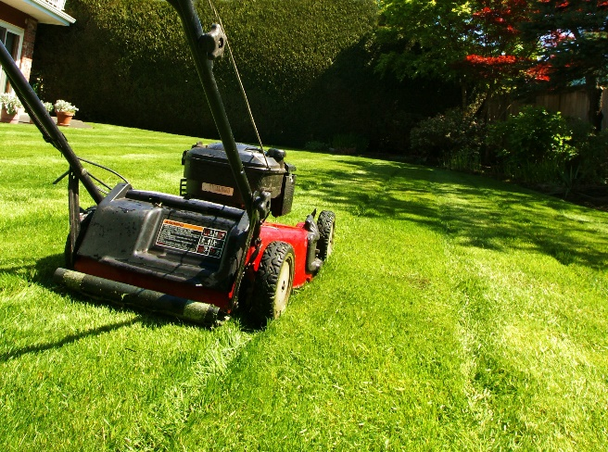
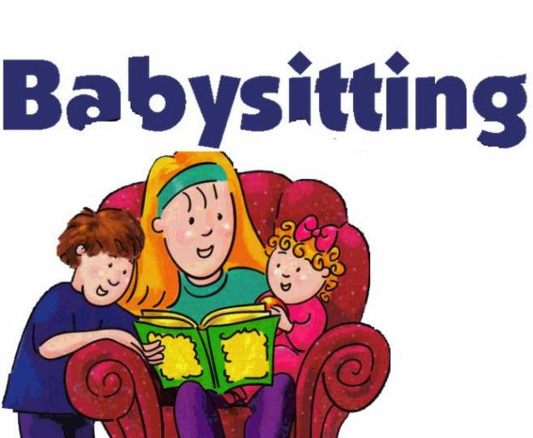

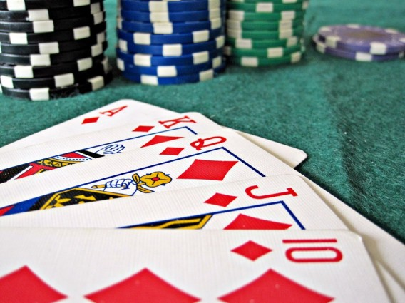
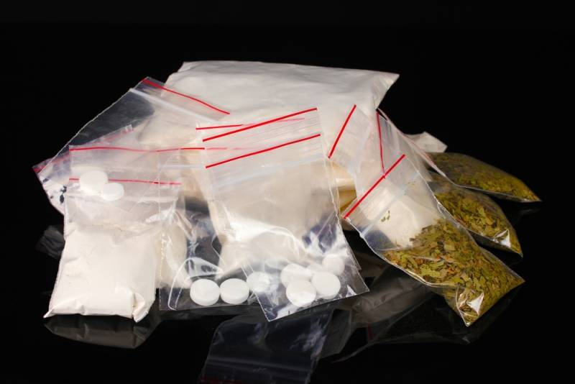
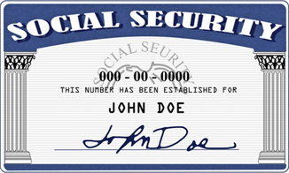

Excluded from GDP
Second-hand Sales
Tires on a new truck not counted (intermediate good)
New tires purchased at Kauffman Tires do count (final good)
Non-market Transaction
Black Market Transactions & Illegal Activities
Transfer Payments

Slide 15
Now It’s Time For Some GDP Practice!!
Write out the GDP formula and explain what each letter stands for; also provide the percentage of each component that makes up our GDP. Then indicate the component(s) of GDP that each of the following transactions fall under:
A family buys a new refrigerator
GM opens a new plant in Detroit, Michigan
Paulding County builds a new middle school
China imports commodities from the U.S.A.
Provide why the following transactions wouldn’t be included in GDP:
Court bought 20 shares of Coca Cola stock.
The tires, bolts, and engine for a new automobile
The illegal sale of imitation purses on the streets of Smyrna.
Mowing your lawn every other Saturday and being paid an allowance
Monthly checks sent to Social Security recipients
Buying a Chipper Jones bobble head from E-bay

Slide 16
Now It’s Time For Some GDP Practice!!
Write out the GDP formula and explain what each letter stands for; also provide the percentage of each component that makes up our GDP. Then indicate the component(s) of GDP that each of the following transactions fall under:
GDP = C+I+G+ Xn Which can be written like this: GDP = C + I + G + (X – M)
Gross Domestic Product = Consumption + Investment + Government + (Exports – Imports)
A family buys a new refrigerator (Consumption)
GM opens a new plant in Detroit, Michigan (Investment)
Paulding County builds a new middle school (Government)
China imports commodities from the U.S.A. (Xn)
Provide why the following transactions wouldn’t be included in GDP:
Court bought 20 shares of Coca Cola stock. (non-productive transaction)
The tires, bolts, and engine for a new automobile (intermediate products)
The illegal sale of imitation purses on the streets of Smyrna. (underground economy)
Mowing your lawn every other Saturday and being paid an allowance (non-market transaction)
Monthly checks sent to Social Security recipients (non-productive transaction: transfer payment)
Buying a Chipper Jones bobble head from E-bay (secondhand sales)

Slide 17
Included or not Included in GDP?
For each situation, identify if it is included in GDP. Identify the category: C, I, G, or Xn. Now what is the GDP for the included items?
$10.00 for movie tickets
$5M Increase in defense expenditures
$45 for used economics textbook
Ford makes new $2M factory
$20K Toyota made in Mexico
$10K Profit from selling stocks
$15K car made in US, sold in Canada
$10K Tuition to attend college
$120 Social Security payment to Bob
Farmer purchases new $100K tractor

Slide 18
For each situation, identify if it is included in GDP the identify the category C, I, G, or X_{n}
$10.00 for movie tickets (included- consumption- service)
$5M Increase in defense expenditures (included- gov’t)
$45 for used economics textbook (excluded- used good)
Ford makes new $2M factory (included- investment)
$20K Toyota made in Mexico (excluded- not made in the US)
$10K Profit from selling stocks (excluded- does not involve capital goods investment)
$15K car made in US, sold in Canada (included- Xn/ export)
$10K Tuition to attend college (included- consumption- service)
$120 Social Security payment to Bob (excluded- transfer pymt)
Farmer purchases new $100K tractor (included- consumption- good)
GDP of all included items: $7,125,010

Slide 19
Milestone Practice
SSEMA1b) What is the difference between nominal and real GDP?
nominal GDP includes the market value of all American companies & citizens globally
nominal GDP is used to calculate inflation
real GDP is adjusted for inflation
nothing; they are exactly the same

Slide 20
Milestone Practice
SSEMA1b) What is the difference between nominal and real GDP?
nominal GDP includes the market value of all American
companies & citizens globally
nominal GDP is used to calculate inflation
real GDP is adjusted for inflation
nothing; they are exactly the same

Slide 21

Nominal GDP vs. Real GDP

Slide 22
How can you figure out which is the most popular movie of all time?
What is the problem with this method?
Nominal Box Office Receipts
TOP 100 FILMS
OF ALL-TIME
(Domestic Gross)*
(Unadjusted for Inflation)
Star Wars: Episode VII - The Force Awakens (2015)
Avatar (2009)
Black Panther (2018)
Avengers: Infinity War (2018)
Titanic (1997)
Jurassic World (2015)
Marvel's The Avengers (2012)
Star Wars: Episode VIII - The Last Jedi (2017)
Incredibles 2 (2018)
The Dark Knight (2008)

Slide 23
How can you figure out which is the most popular movie of all time?
Real Box Office Receipts (adjusted for inflation)
TOP 100 FILMS
OF ALL-TIME
(Domestic Gross)*
(Adjusted for Inflation)
1. Gone With the Wind (1939)
Star Wars: Episode IV - A New Hope (1977)
The Sound of Music (1965)
E. T. The Extra-Terrestrial (1982)
Titanic (1997)
The Ten Commandments (1956)
Jaws (1975)
Doctor Zhivago (1965)
The Exorcist (1973)
Snow White and the Seven Dwarfs (1937)

Slide 24
The Problem with GDP
If a country’s GDP increased from $4 Billion to $5 Billion in one year, is the country experiencing economic growth?
Did the country definitely produce 25% more products?
What is Inflation?
A rising general level of prices
EX: If apples are the only thing being produced
Year 1: 10 apples at $1 each; GDP = $10
Year 2: 10 apples x $1.25; GDP = $12.50
GDP is rising, but country is worse off!

Slide 25
Nominal v. Real GDP
Nominal GDP does not adjust for inflation
Real GDP is adjusted for inflation
Real GDP = nominal GDP/ (price index/100)
So what is the real GDP if the nominal GDP is $5,000 and the Price Index is 125?
Answer: Real GDP = $5,000/(125/100) = $5000/1.25 = $4,000
Your turn to Practice. Calculate the real GDP for the following:
Nominal GDP is $6,600 and Price Index is 150
Nominal GDP is $8000 and Price Index is 135
Nominal GDP is $10,000 and Price Index is 110
Answers:
$4,400.00
$5,925.93
$9,090.91

Slide 26

Lesson EQ
How does GDP correlate to Economic Growth?

Slide 27
Economic Growth
Aggregate Demand – the total amount of goods & services that households, businesses, gov’t, and foreign investors will buy at each & every price level
--------------------------------------------------------------------------------------------------------------------------------------------------------------------------------------------------------------------------------------------------------------------------------------------------
Aggregate Supply – the total amount of goods & services that producers will provide at each & every price level
--------------------------------------------------------------------------------------------------------------------------------------------------------------------------------------------------------------------------------------------------------------------------------------------------
Real GDP per capita – real GDP divided by the total population & reflects each person’s share of real GDP (measures a nation’s standard of living)

Slide 28
Economic Growth
Economic Growth is a sustained increase in an economy’s real GDP
  Raises the standard of living
  Eases the burden of gov’t by increasing the tax base
  Solves domestic problems:
    Creates more jobs & income
    Lowers unemployment & reduces welfare rolls
    Increases wages due to competition for labor
    Reduces crime rates because of lower poverty rate

Slide 29
Why do some countries have higher GDPs than others?
  Productivity
1. Economic System
  Example#1: Capitalist countries have historically had more economic growth.
  Capital (like robots) can produce more than people
  Countries with more capital, can produce more products than countries without a lot of capital.
2. Property Rights
3. Capital
  Ex: Capital stock is machinery, tools, and man-made resources.
  Example#1: India has over a billion people (human resources) but relatively few capital resources and therefore a lower GDP than the U.S.
  Example#2: Japan has few natural resources but a high GDP
4. Human Capital (Knowledge)
5. Natural Resources
  Ex: Syria has a lower GDP because it is mostly desert.

Slide 30
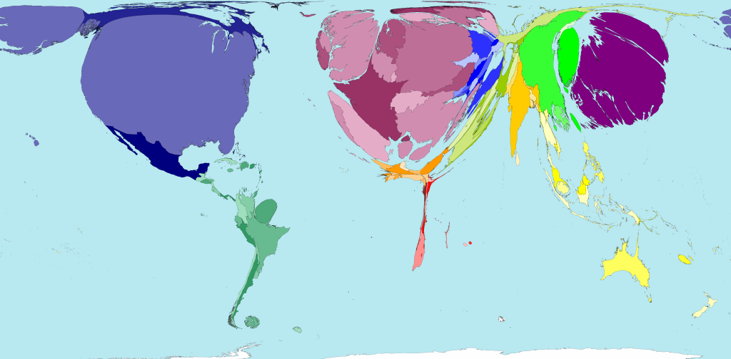
World GDP Distribution

Slide 31
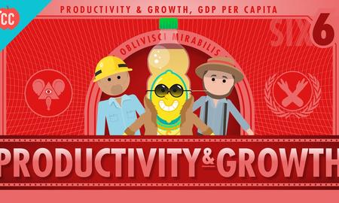
https://www.youtube.com/watch?v=UHiUYj5EA0w

Slide 32
Milestone Practice
SSEMA1c) Inflation is defined as a rise in the general level of prices. When inflation occurs, the buying power of the dollar would
increase.
decrease.
remain stable.
not be affected by inflation.

Slide 33
Milestone Practice
SSEMA1c) Inflation is defined as a rise in the general level of prices. When inflation occurs, the buying power of the dollar would
increase.
decrease.
remain stable.
not be affected by inflation.

Slide 34

REVIEW
What is the study of macroeconomics, and when did it originate?
What are the 2 goals of macroeconomics, and what 2 policies does the gov’t use to direct the economy?
What 3 areas of study does macroeconomics focus on?
What is the nation’s #1 measure of economic growth?
What is the definition of GDP?
What are the 4 components of GDP? Give me the Output Expenditure Model formula and provide each component’s percentage as well as the sector of the economy (oh yeah, it’s that important!!!).
What 5 things are excluded from GDP and why?
What is the difference between nominal and real GDP?
How is real GDP calculated…? Yes, I mean provide me the formula!
What do you like to do during rainy weather…and you can’t say sleep!!?

Slide 35
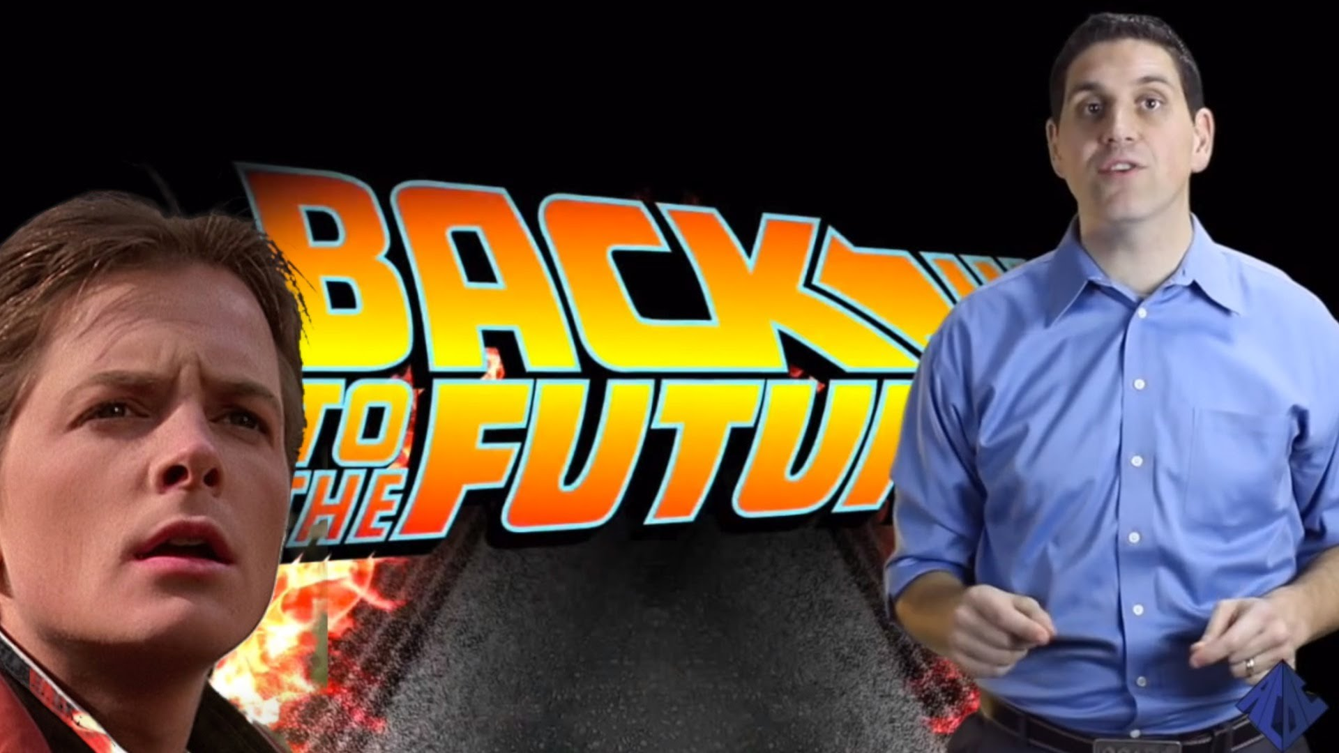
https://www.youtube.com/watch?v=3GTgniuxA50
We go Back to the Future to understand GDP!

Slide 36
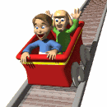
THE BUSINESS CYCLE
What are the 4-6 phases of the business cycle, and why do business cycles occur?

Slide 37
Why is this Business Cycle Graph WRONG???
Real GDP
Full Employment
1920s
1930s
1950s
1970s
1980s
2010
Time

Slide 38
Real GDP
Now this is more like it!
Full Employment
Notice that we have experienced long run economic growth over time, and that the Economic Boom and peak of the 1920’s is actual lower than the Great Recession of 2009.
1920s
1930s
1950s
1970s
1980s
2010
Time

Slide 39
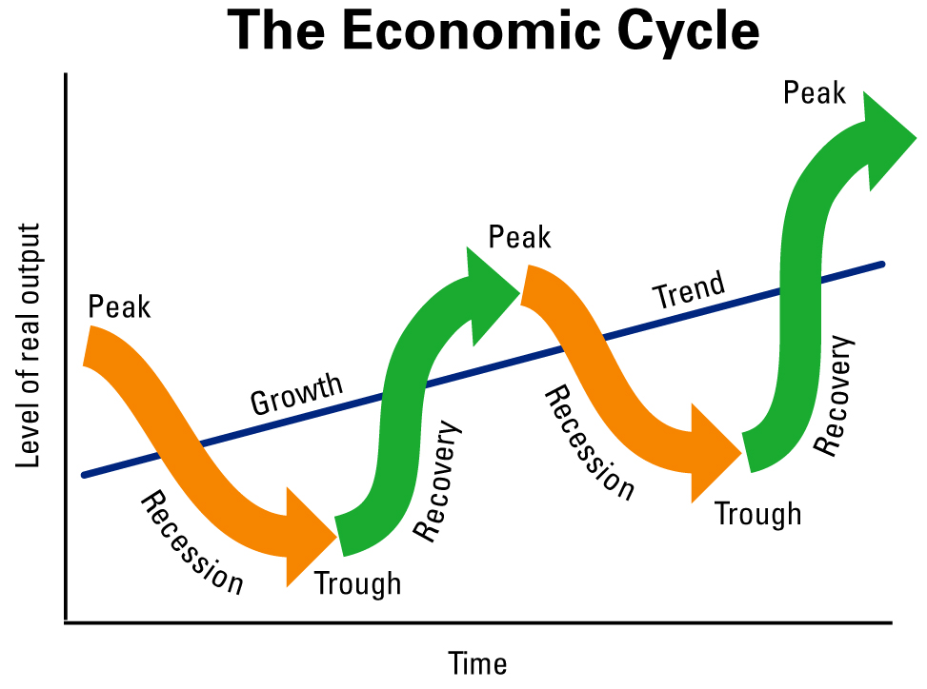
Business Cycles – economy-wide fluctuations in a market or economy over several months or years
Recovery/Expansion – period of economic growth as experienced by GDP
Peak – when GDP stops rising
Contraction/Recession – economic decline marked by falling real GDP (rise in unemployment occurs)
Trough – economy reaches its lowest point, real GDP stops falling & has “bottomed-out”
Recovery is a return to a normal state of the economy, where the economy begins to show signs of health, such as recovery in the housing market
Video Clip
https://www.youtube.com/watch?v=6XpXsC-yNHI
Business Cycles

Slide 40
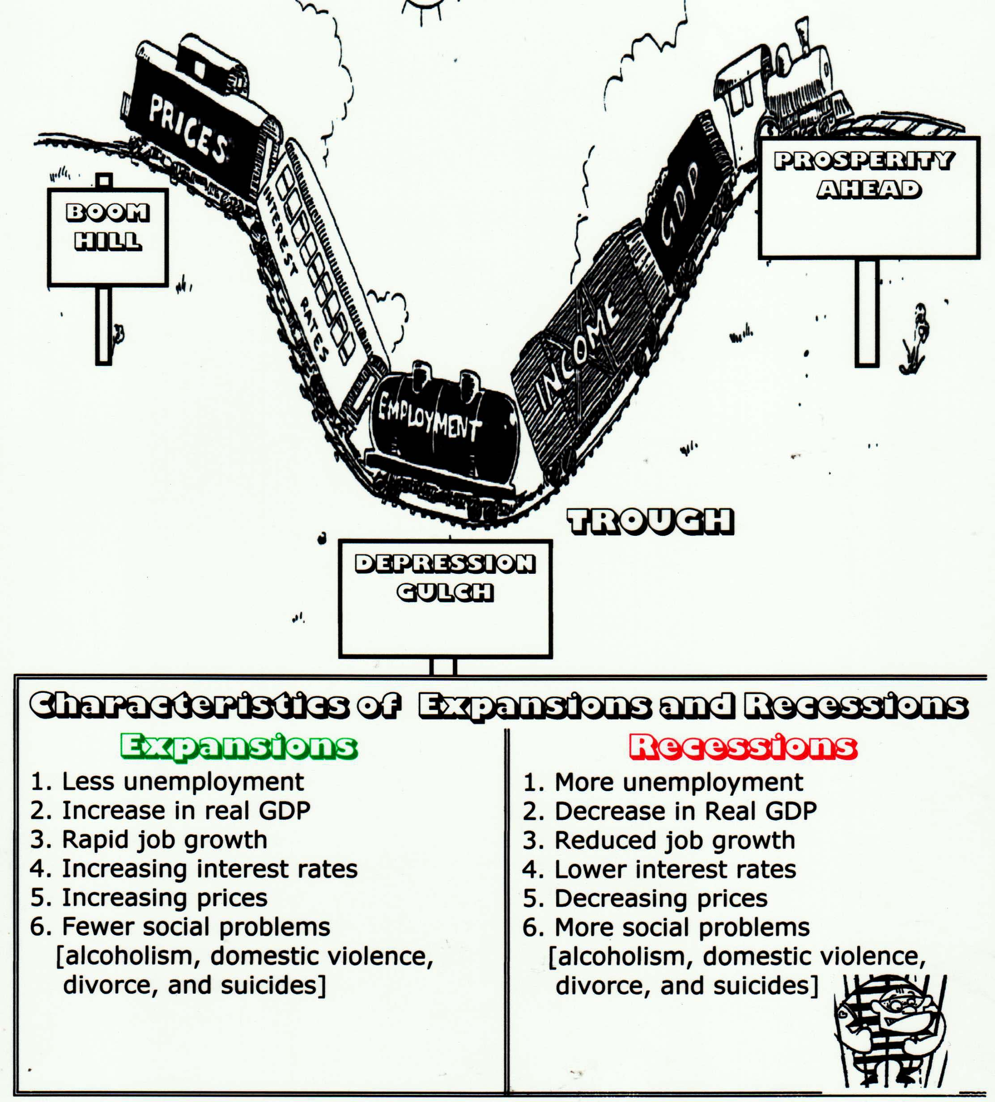

Slide 41
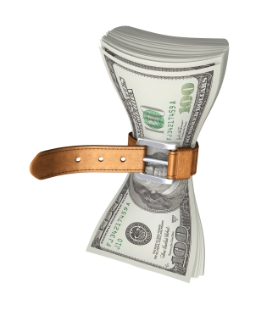
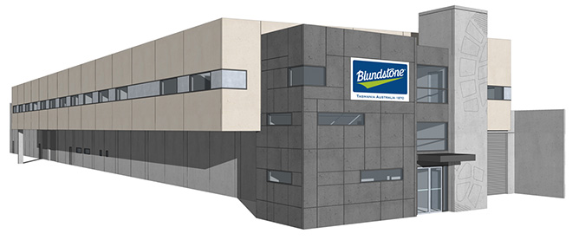
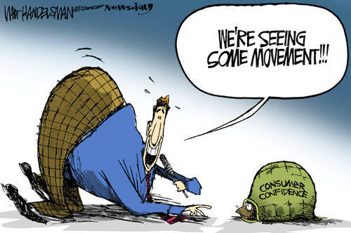
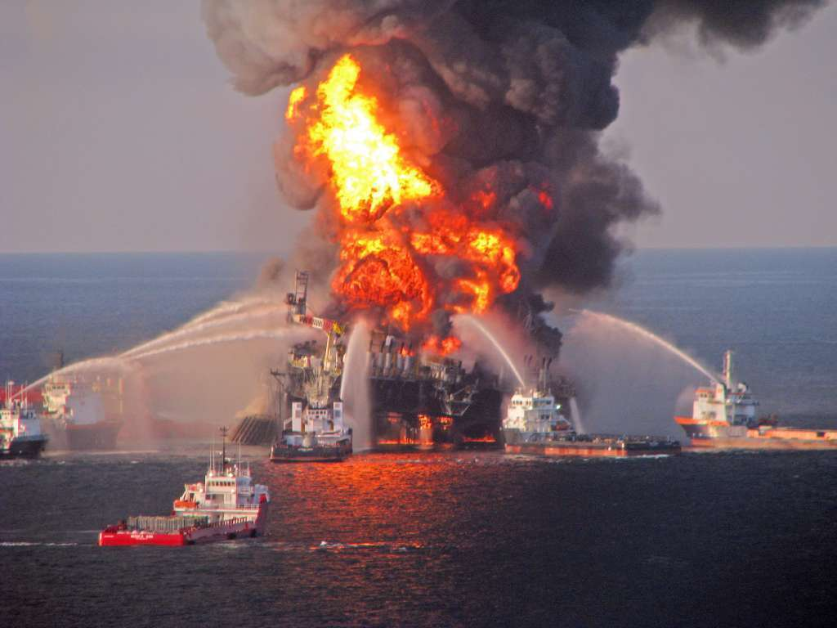
4 Variables that Influence Business Cycles
Business Decisions – investments in physical capital (plants, equipment, inventory)
Interest Rates & Credit – easy money v. tight money (low or high interest rates)
Public/Consumer Expectations – consumer confidence in the economy
Supply Shocks – oil prices, politics, war, natural disasters

Slide 42

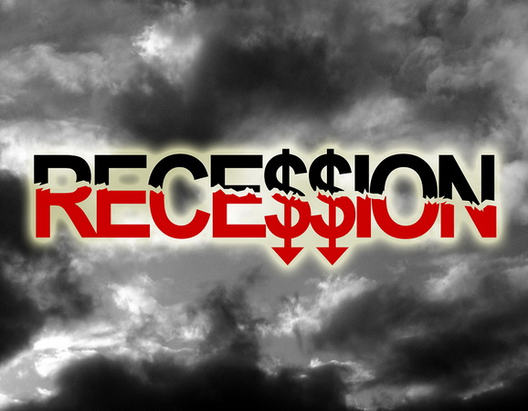
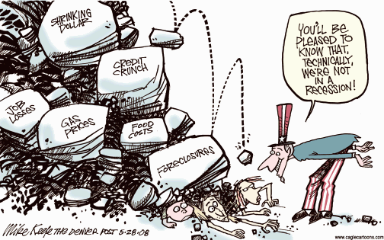
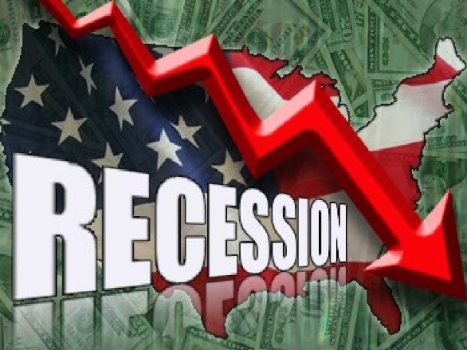
Recession
Recession – decline in REAL GDP for 2 or more consecutive quarters (6+ months)
Rise in unemployment, falling profits, bankruptcies, foreclosures, etc.

Slide 43
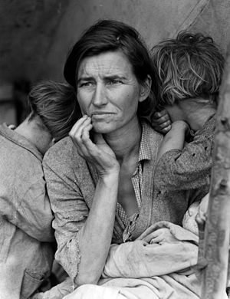
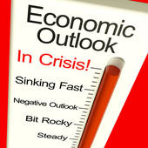
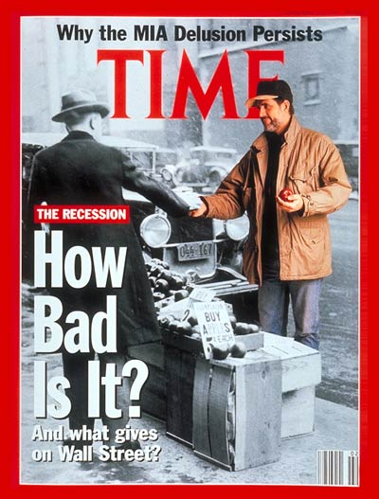
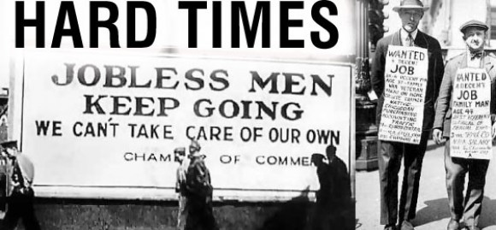
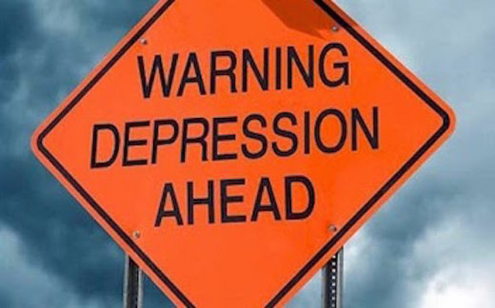
Depression
Depression – prolonged and severe recession

Slide 44
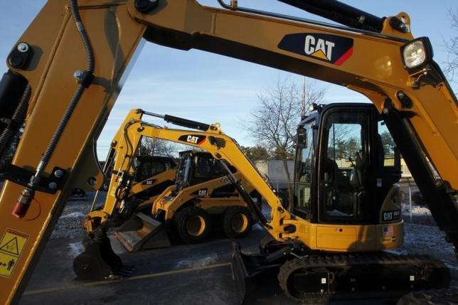
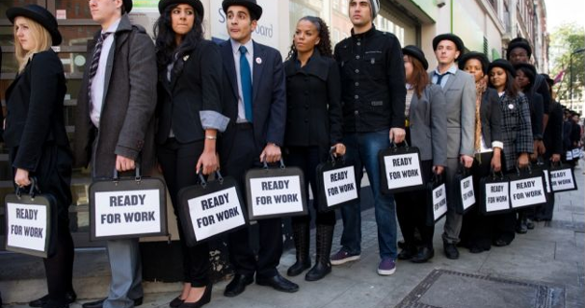
Economic Indicators
Leading Indicators – indicate where the economy is going BEFORE it happens: building permits, capital good orders, raw material prices
Coincident Indicators – reflects the CURRENT status of the economy: personal income, sales volume, production levels
Lagging Indicators – these indicators come in AFTER THE FACT: unemployment figures, business income reports

Slide 45
Business Cycle
Real GDP
Which point shows the economy at full employment?
Which point demonstrates a peak?
Which point shows a recession?
Which point shows a trough?
Which point demonstrates a recovery?
Which point shows an expansion?
Which point shows a contraction in the business cycle?
D
G
C
A
F
E
B
Time

Slide 46
Business Cycle
Real GDP
Which point shows the economy at full employment? G
Which point demonstrates a peak? A
Which point shows a recession? E
Which point shows a trough? B
Which point demonstrates a recovery? F
Which point shows an expansion? C
Which point shows a contraction in the business cycle? D
D
G
C
A
F
E
B
Time

Slide 47
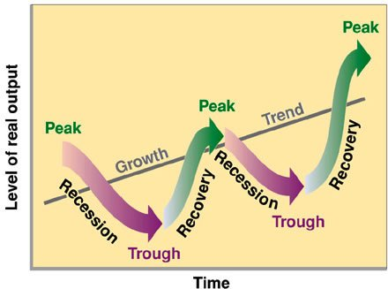
Milestone Practice
SSMA1f) A period during which real GDP declines for two quarters in a row, or six consecutive months, is MOST LIKELY a
peak.
recession.
recovery.
trough.

Slide 48
Milestone Practice
SSMA1f) A period during which real GDP declines for two quarters in a row, or six consecutive months, is MOST LIKELY a
peak.
recession.
recovery.
trough.

Slide 49
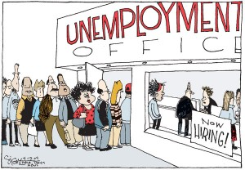
Unemployment
How is unemployment defined and measured?

Slide 50
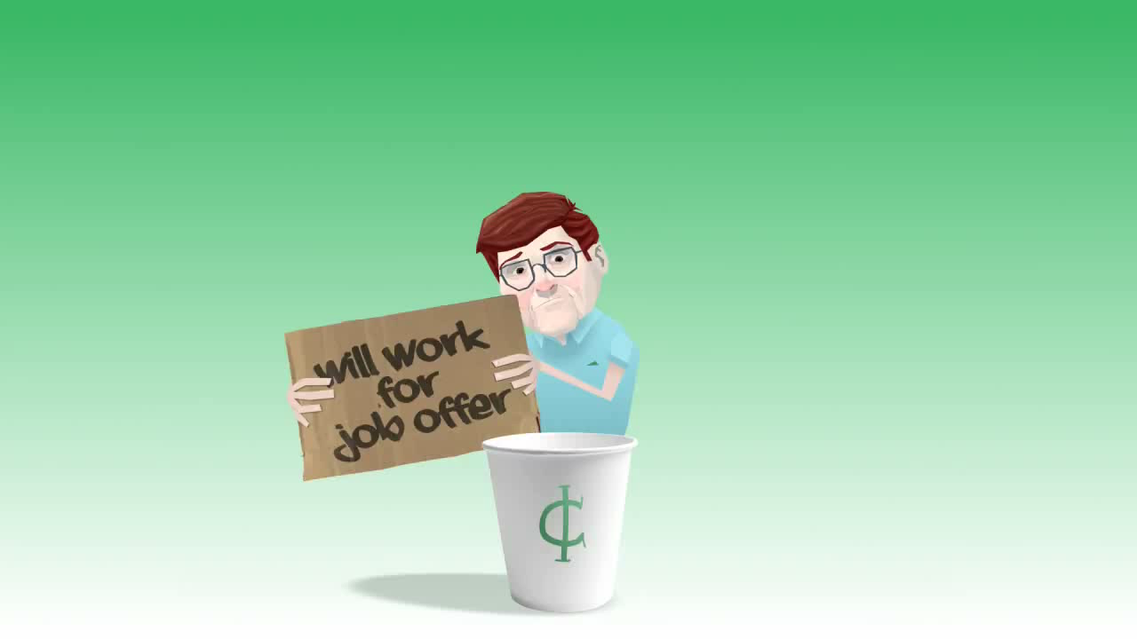
Are You Unemployed Game Show!!!!

Slide 51
What is Unemployment?
The Unemployment rate:
The percent of people in the labor force who want a job but are not working.
Unemployment
rate
# unemployed
x
=
100
# in labor force
Who is in the Labor Force?
  Above 16 years old
  Able and willing to work
  Not institutionalized (jails, hospitals)
  Not in military, in school full time, or retired
Why is a stay at home mom not unemployed?
51

Slide 52
Unemployment Rate, Underemployed, & Full Employment
Unemployment rate – % of people in the civilian labor force who are unemployed
Unemployment rate doesn’t include:
  People who have given up looking for a job either dropped out or don’t want one (discouraged workers)
  People who are underemployed (working part-time when full-time is desired, or working at a job they are overqualified to do)
Economists consider full employment at about 95% employment or 5% unemployment rate (Natural Rate of Unemployment or NRU)

Slide 53
4 Types of Unemployment
Frictional – caused by movement in the economy & is always present, resulting from temporary transitions made by workers & employers (changing jobs, moving locations, looking for 1st job, stay-at-home parents going back to work)
Seasonal – occurs as a result of seasonal changes or when industries slow down or shut down for a season (summer jobs, holiday seasons, etc.)
Structural – jobs that are permanently lost due to changes in technology (workers replaced by machines, computers, technology, automation), outsourcing jobs to other countries, & consumer tastes
Natural Rate of Unemployment includes frictional, seasonal & structural
Cyclical – rises during recessions and economic downturns due to swings of the business cycle
  Cyclical unemployment harms the economy the most, so the government attempts to soften the negative impact with fiscal policy

Slide 54
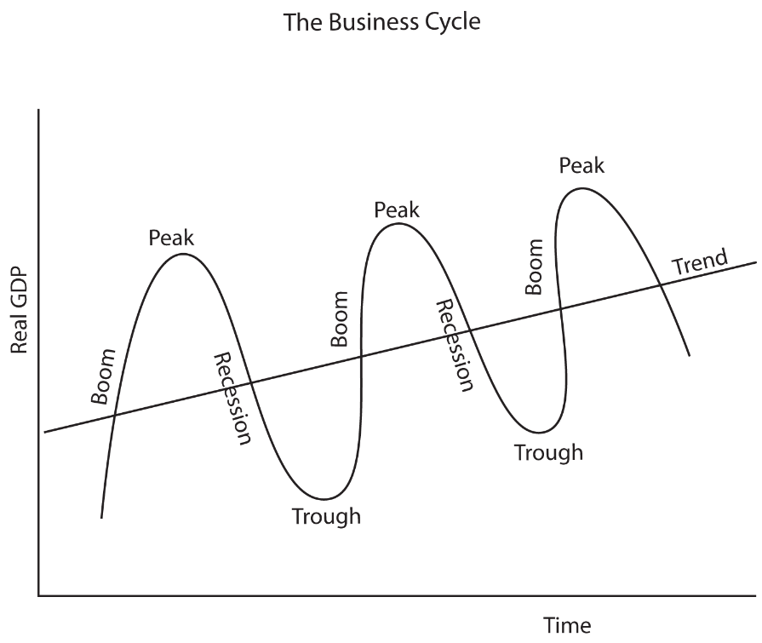
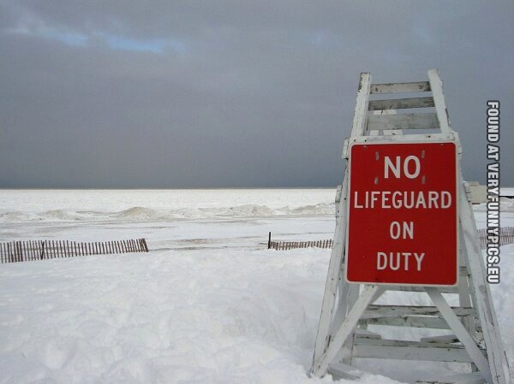

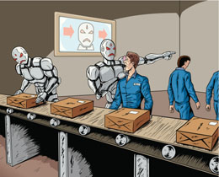
Name that type of unemployment
#1
#2
#3
#4

Slide 55
Name that type of unemployment
#1
#2
Seasonal
Cyclical
#3
#4
Frictional
Structural

Slide 56
Milestone Practice
SSEMA1e) Mitchell just discovered that he was laid off from his factory job and that his position has been permanently replaced by
machines. What type of unemployment does this unfortunate
situation represent?
cyclical unemployment
frictional unemployment
structural unemployment
seasonal unemployment

Slide 57
Milestone Practice
SSEMA1e) Mitchell just discovered that he was laid off from his factory job and that his position has been permanently replaced by
machines. What type of unemployment does this unfortunate
situation represent?
cyclical unemployment
frictional unemployment
structural unemployment
seasonal unemployment

Slide 58
REVIEW
Draw the properly labeled Business Cycle with your finger and explain the 4-6 phases of the Business Cycle in detail.
Now draw a properly labeled PPC with your finger and put the following points on it: Full Employment, Recession, Expansion (Inflationary Gap). See the similarity…? Now you’re starting to get it!!!
What is the definition of a Recession?
Which phase of the Business Cycle is unemployment rate the lowest? Highest?
What is the difference between nominal and real GDP? How do you calculate?
List and explain the 4 types of unemployment; and provide an example of each.
What is the natural rate of unemployment (NRU)? What types of unemployment are included in the NRU? Which type of unemployment is bad?
What 2 gov’t policies are used to combat a Recession and Unemployment?
What is your favorite thing about Spring?

Slide 59
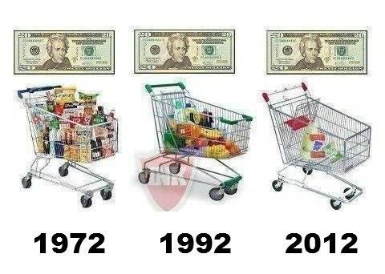
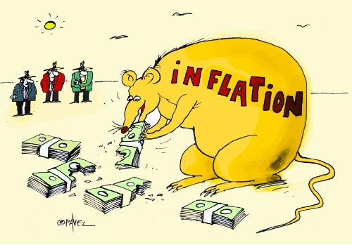
What is inflation, how is it calculated, and how does inflation impact the economy?

Slide 60
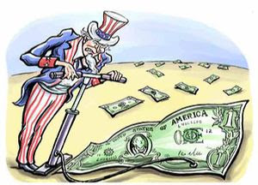
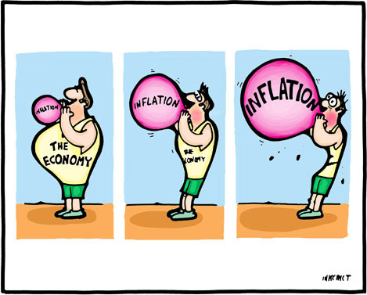
Inflation
Inflation – a general & sustained increase in the average price level of ALL products in the economy
Inflation rate is the % change in the price level from the previous period or base year (normal rate is 1-3%)
Degrees of Inflation:
Anticipated inflation – 1-3% per year (“creeping”)
Walking inflation – 4-10%
Galloping inflation – 10-30%(politically unstable Latin American countries or former Soviet communist bloc countries)

Slide 61
Inflation
Hyperinflation – 50+% per year (extremely rare & is last step before total monetary collapse & absolute CHAOS!!!)
Deflation – reduction of the general level of prices in an economy
  Deflation is actually worse for an economy than inflation because it occurs due to a long & severe Recession

Slide 62
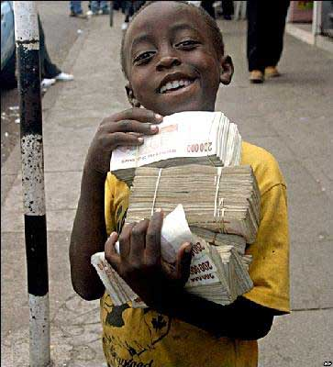
Goal #3
LIMIT INFLATION
Country and Time-
Zimbabwe, 2008
Annual Inflation Rate-
79,600,000,000%
Time for Prices to Double-
24.7 hours

Slide 63
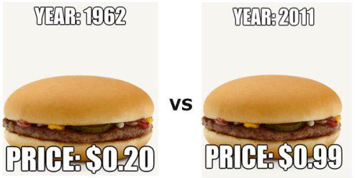
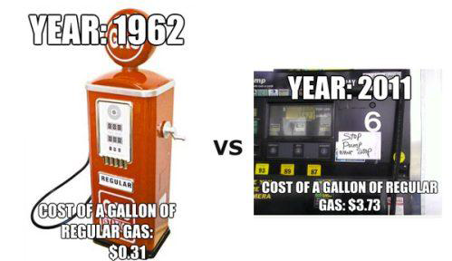
Inflation over the Years

Slide 64
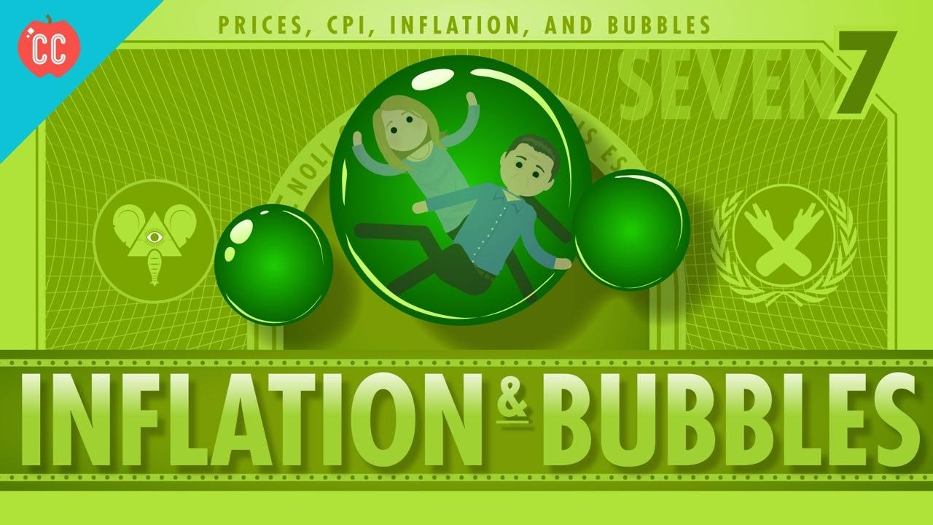
https://www.youtube.com/watch?v=T8-85cZRI9o

Slide 65
CPI
Consumer Price Index (CPI) – an index used to measure inflation; measures the overall cost of goods and services commonly purchased by consumers
current year cost
CPI = base year cost X 100

Slide 66
Three Types of Inflation
Quantity Theory – excess monetary growth (too much money in circulation); in other words the Federal Reserve (central bank) allows the supply of money to increase faster than real GDP, decreasing the actual value of the dollar
  “Too much money chasing too few goods!”
  Like monopoly money

Slide 67
THREE Types of Inflation
Demand-Pull Inflation– when aggregate demand for goods & services exceeds existing supplies
  Think supply & demand: If demand for goods increases faster than the companies can make the stuff, then there’ll be a SHORTAGE of supply.
  Too much demand…not enough supply = Shortage…what happens to prices? Prices are pulled higher!

Slide 68
THREE Types of Inflation
Cost-Push Inflation – when producers raise prices in order to meet increasing costs of inputs (Productive Resources: Land, Labor, Capital, Entrepreneurship)
  Price of energy (oil), labor cost, union demands, gov’t regulations & taxes
  Cost-Push Inflation is the worse because it causes the dreaded … STAGFLATION!!!

Slide 69
Demand-Pull Inflation on an AD/AS Graph
LRAS
Price Level
AS
Price Levels Increase = Inflation
PL1
PL
AD1 = C + I + G + Xn
AD = C + I + G + Xn
YFE
Y1
Real GDP
Real GDP Increases = Inflationary Gap

Slide 70
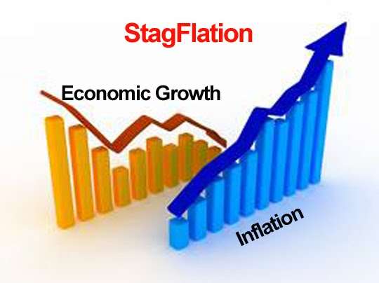
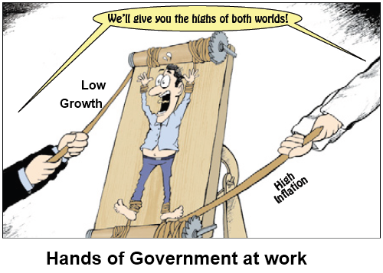
Stagflation
Stagflation – a decline in real GDP with a rise in price levels; in other words…..a combination of a stagnant economy with high inflation
The worst of both economic worlds; is there any hope???

Slide 71

Causes of Inflation Cartoon: “Why play Leapfrog”(1944)

Slide 72
What does Stagflation Look Like on a, AD/AS Graph?
LRAS
If Aggregate Supply (AS) decreases and shifts to the left of full employment (LRAS) because of increased cost of production (price of resources), then real GDP decreases (output), price levels increase (inflation), and the unemployment rate increases.
This is known as cost-push inflation and it causes Stagflation, which is the worse position an economy can be in. There is nothing the government (fiscal policy) or the Fed (monetary policy) can do in this economic situation.
AS1
Price Level
AS
PL1
Price Levels Increase = Inflation
PL
Result is Stagflation
AD
Y1
YFE
Real GDP
Real GDP Decreases = Recession

Slide 73
Destabilizing Effects of Inflation (Know These)
Dollar buys less, meaning the dollar loses value over time, thus decreasing one’s purchasing power
Extremely hard on retired workers living on fixed incomes like social security
People change spending habits, which disrupts the economic business cycles
Unanticipated Inflation in the long run favors the debtors over the creditors

Slide 74
Milestone Practice
SSEMA1c) The Consumer Price Index (CPI) is best used to determine
the Dow Jones Index.
the rate of inflation.
the unemployment rate.
currency exchange rates.

Slide 75
Milestone Practice
SSEMA1c) The Consumer Price Index (CPI) is best used to determine
the Dow Jones Index.
the rate of inflation.
the unemployment rate.
currency exchange rates.

Slide 76
REVIEW
What are the 3 goals of macroeconomics?
Define GDP, List the 4 components & percentages, and explain the difference between nominal and real GDP.
What are the 4-6 phases of the Business Cycle. Define Recession.
How is the unemployment rate determined? In other words, who is considered unemployed by the U.S. census bureau?
What are the 4 types of unemployment? Give an example of each. Which one is the “bad” unemployment; not counted as the NRU?
Define Inflation. What does Inflation do to the purchasing power of the dollar?
Is Inflation or Deflation worse? Why?
Explain the 3 theories that cause inflation and draw an AD/AS Graph with your fingers demonstrating each. Which one is the worse type of inflation, and why?
Define Stagflation.
Are you a dog or cat person? Why? (Inner Self-Analysis Time!!!!)

Slide 77
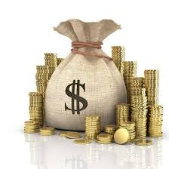



Money
“Money, get away
Get a good job with more pay and you're okay
Money, it's a gas
Grab that cash with both hands and make a stash
New car, caviar, four star daydream
Think I'll buy me a football team”
- Money by Pink Floyd
What is meant by liquidity of money, what are the types of money, and what are the three functions of money in a market economy?

Slide 78
Types of Money
Commodity money – money that has an alternative use as a commodity, which has intrinsic value
  Intrinsic value – item would have value if not used as money
  Gold, silver, cigarettes (WWII), tulip bulbs (1600’s Europe), etc.
Representative money – Paper money backed by something tangible (gold or silver)
  Gold standard – gold used as money; money backed by gold
Fiat money – “order/decree”; government issued money
  Paper dollars
  Money that is intrinsically worthless
  Legal tender - is money that a government has required to be accepted in settlement of debts

Slide 79
Functions of Money
Video Time! https://www.youtube.com/watch?v=Dugn51K_6WA
(Crash Course Economics #11: Money & Finance)
Money – most basic of all financial assets, used to buy goods and services
  Something that is regularly accepted in exchange for goods and services
3 Functions of money:
Medium of Exchange – exchange/payment for products; buyers give sellers in exchange for goods/services
Unit of Account/Standard of Value – an expression of value; a way for comparing the values of goods and services
  Keep track of debts and investments
Store of Value – money holds its value if you decide to store it instead of spend it
  Helps people convert purchasing power from present to future value

Slide 80
Money in the USA
Liquidity – ease with which an asset (liquid asset) can be converted into money/medium of exchange
    Ex: Liquid – checking account; non-liquid – House
M0 – currency and coins (money on hand in your possession)
M1 – money that people can gain access to easily and immediately (high liquidity): currency, checking accounts, traveler’s checks
M2 – consists of M1 money plus savings accounts, and timed deposits (CD’s); sometimes called “near monies”
Money supply – quantity of money in the economy
  As of February 2015, the M1 money supply in the United States was $2,988 billion. This is based on figures reported by the Federal Reserve.

Slide 81
7 Characteristics of Money
Durability – must withstand physical wear and tear that is a part of being used over and over again
Portability – people need to be able to take money with them from place to place
Divisibility – money must be easily divided into smaller denominations
Stability – money’s purchasing power (value) should be relatively stable
Uniformity – money must be uniform, easy to count & measure
Scarcity – the money supply must be kept in limited supply
Acceptability – everyone in an economy must be able to exchange the objects that serve as money.

Slide 82
Milestone Practice
SSEMA2a) Purchasing a hot dog and peanuts at Sun Trust Park while enjoying a Braves baseball game best describes what function of money?
liability
unit of account.
medium of exchange
store of value.

Slide 83
Milestone Practice
SSEMA2a) Purchasing a hot dog and peanuts at Sun Trust Park while enjoying a Braves baseball game best describes what function of money?
liability
unit of account.
medium of exchange
store of value.

Slide 84


The Federal Reserve (aka: the FED!!!!!!)
What is monetary policy, and how is the Federal Reserve structured?

Slide 85

https://www.youtube.com/watch?v=1dq7mMort9o

Slide 86

Who’s face is on the $100,000 dollar bill???
WHY?
President Woodrow Wilson

Slide 87

Monetary Policy & the Fed
Monetary policy (“money”) – directly affects the nation’s money supply (expansionary or contractionary) to influence the cost & availability of credit
The Federal Reserve (“The Fed”) – the central bank of the U.S.
  Created by Congress with the Federal Reserve Act of 1913
Central Bank – institution designed to oversee the banking system and regulate the quantity of money in the economy

Slide 88

Structure of the Federal Reserve
Central Bank is in Washington, D.C.
Run by a 7 member Board of Governors
Appointed by POTUS & confirmed by the Senate to 4 year terms
Board is led by the Chairman of the Fed
Who is the current Chair?
Chair Jerome H. Powell appointed by President Trump in 2018

Slide 89

Structure of the Federal Reserve
Fed is comprised of Twelve Federal District Reserve Banks
–One Federal Reserve Bank for each district
–Each FRB monitors economic and banking conditions in its district

Slide 90


The Federal Open Market Committee (FOMC)
7 member Board of Governors plus the President of the FED of NY make up the permanent members, and 4 of the remaining 11 regional bank (U.S.) presidents on a 1 year rotating basis
FOMC meets 8 times a year to monitor the money supply
All attend, but only 5 of the 12 members vote, President of New York Fed always votes (financial capital of the world)
Topic of discussion: Increase (expansionary) or decrease (contractionary) money supply

Slide 91
Milestone Practice
SSEMA2b) What is the name of the "central bank" of the United States?
Bank of the U.S.
Federal Reserve
Bank of America
Internal Revenue Service

Slide 92
Milestone Practice
SSEMA2b) What is the name of the "central bank" of the United States?
Bank of the U.S.
Federal Reserve
Bank of America
Internal Revenue Service

Slide 93
REVIEW
What is liquidity of money mean?
What is the difference between M1 and M2 money? Which is more liquid?
What is the difference between commodity and fiat money? Which type of money does the U.S. use?
List, explain, and briefly give an example of the 3 functions of money in a market economy.
What are the 2 main goals of a nation’s central bank?
What’s the name of the U.S. central bank?
How is the Fed structured…Board of Governors…Districts…and such?
Who is the current chair of the Fed? Who did he/she replace?
Describe the Federal Open Market Committee (FOMC): who meets, how often they meet, and the primary purpose of the meeting.
Briefly explain monetary policy.
Who is your favorite band/artist? How many times have you seen them live??

Slide 94

https://www.youtube.com/watch?v=RaeIBeJT5hY

Slide 95

What are the three “tools” that the Fed uses to control monetary policy, and how does each tool impact the nation’s money supply and availability of credit?

Slide 96

How the FED Stabilizes the Economy
These are the three “Tools” of the Money Supply
https://www.youtube.com/watch?v=QpS81Zwxwgs&list=PLD7C33AB80B405B9A&index=9
AC/DC Macro: 3 Tools of Monetary Policy
Copyright
ACDC Leadership 2015

Slide 97
FED’s Tools of Monetary Control
Open-Market Operations – purchase & sale of U.S. government bonds/securities (I.O.U.s with interest) by the Fed
Most often used method to control the money supply because it has an IMMEDIATE EFFECT
To increase the money supply, Fed buys bonds from the banks & credits the banks with money

Slide 98
FED’s Tools of Monetary Control
Easy-Money Policy – expansionary monetary policy, goal is to expand the economy by lowering interest rates, encourages banks to lend money to consumers, discourage saving, increases the money supply; only problem is that it increases inflation (Remember: AD = C’ + I’ + G + X-M)
  Policy is used stimulate the economy by promoting business investments & consumer spending
To decrease the money supply, Fed sells bonds to the banks & withdrawals money from the banks

Slide 99
FED’s Tools of Monetary Control
Tight-Money Policy – contractionary monetary policy, goal is to slow the economy by raising interest rates, cause inflation to slow, discourage borrowing, encourage saving, restricts the money supply
  Policy slows down business activity & investments & stabilizes prices, which reduces aggregate demand

Slide 100









Expansionary Monetary Policy
Buy BIG (Think Big economy, so Increase the Money Supply!!!)

Slide 101
Contractionary Monetary Policy
Sell small (Think small economy, so Decrease the Money Supply!!!)

Slide 102
FED’s Tools of Monetary Control
Reserve Ratio Requirements – regulations on the minimum amount of reserves that banks must hold against deposits
Fractional-reserve system – banks hold only a fraction of deposit reserves as opposed to a 100% reserve system (how banks “create” money)
Banks must have a supply of reserves to protect against "runs" or "panics“
  Currently 10% requirement on M1 (“liquid” money: currency, checking accounts, traveler's checks)
Influences how much money banks can create from each deposit (reserves)
  Increase in RR, banks must hold more reserves, can loan out less (Contractionary)
  Decrease in RR, banks must hold less reserves, can loan out more (Expansionary)

Slide 103
FED’s Tools of Monetary Control
Discount Rate – interest rate on loans the FED charges its MEMBER BANKS
Fed is the lender of last resort
Banks borrow from Fed when it has low reserves; too many loans, high withdrawals
Lower discount rate encourages borrowing (Expansionary)
Higher discount rate discourages borrowing (Contractionary)

Slide 104
Milestone Practice
SSEMA2c) All of these are ways in which the Federal Reserve system can
setting the discount and interest rates
establishing reserve requirements for banks
buying and selling US government securities
control the stock market.
regulate the money supply.
decrease consumer spending.
challenge Presidential power.

Slide 105
Milestone Practice
SSEMA2c) All of these are ways in which the Federal Reserve system can
setting the discount and interest rates
establishing reserve requirements for banks
buying and selling US government securities
control the stock market.
regulate the money supply.
decrease consumer spending.
challenge Presidential power.

Slide 106
Federal Reserve and Monetary Policy
Fed’s Policy | Recessionary Gap _________________ | Inflationary Gap __________________
Open Market Operations
Reserve Requirement
Discount Rate

Slide 107
Now You Try to Implement and/or Explain the Proper Monetary Policy or Result
The Fed increases the Reserve Requirement: Expansionary or Contractionary?
The Fed buys U.S. bonds: Expansionary or Contractionary
The economy is experiencing an inflationary gap; what should the Fed do with the Discount Rate?
The economy is in a recessionary gap; what should the Fed do with Open Market Operations?
If the Fed sells bonds/U.S. securities, what will happen to the following: money supply, interest rates, real GDP, unemployment %, and price levels?
If the Fed increases the money supply, what happens to interest rates?
Why would the Fed implement a contractionary monetary policy?
Why would the Fed implement an expansionary monetary policy?
What is the Discount Rate?
What is the current Reserve Requirement?

Slide 108

Recession of 2008
Quantitative easing (QE) is a type of monetary policy used by central banks to stimulate the economy when standard monetary policy has become ineffective
Fed purchased short term bonds & long term investments to increase the money supply
Fed Chairman Ben Bernanke utilized QE to attempt to stimulate the economy

Slide 109
Milestone Practice
SSEMA2d) Which of these actions of the Federal Reserve can slow
economic growth?
The Federal Reserve regulates the amount of money that flows into and out of the nation’s economy.
The Federal Reserve buys U.S. securities.
The Federal Reserve decreases the reserve requirement.
The Federal Reserve increases the discount rate.

Slide 110
Milestone Practice
SSEMA2d) Which of these actions of the Federal Reserve can slow
economic growth?
The Federal Reserve regulates the amount of money that flows into and out of the nation’s economy.
The Federal Reserve buys U.S. securities. (expansionary)
The Federal Reserve decreases the reserve requirement. (expansionary)
The Federal Reserve increases the discount rate.
(You want a tight money policy, so you want the answer that is purely contractionary.

Slide 111
Milestone Practice
SSEMA2e) When the Federal Reserve buys government securities on the open market, what effect does this action have on the nation’s money supply and interest rates?
Money Supply - Decreases / Interest Rates – Increase
Money Supply - Increases / Interest Rates – Increase
Money Supply - Decreases / Interest Rates – Decrease
Money Supply - Increases / Interest Rates - Decrease

Slide 112
Milestone Practice
SSEMA2e) When the Federal Reserve buys government securities on the open market, what effect does this action have on the nation’s money supply and interest rates?
Money Supply - Decreases / Interest Rates – Increase
Money Supply - Increases / Interest Rates – Increase
Money Supply - Decreases / Interest Rates – Decrease
Money Supply - Increases / Interest Rates – Decrease
By buying securities on the open market, banks take the bonds, and give the banks money increasing the money supply. In turn, consumers need the interest rates to be decreased to be willing to take out loans on the now available money supply.

Slide 113
REVIEW
Define monetary policy?
Who is the current Fed chair?
What are the 3 “Tools” the Fed uses to manipulate the money supply?
Who attends the FOMC, how often does the FOMC meet, and what is discussed?
If the economy is experiencing a recession, what might the Fed do with the Discount Rate?
What happens to interest rates if the Fed sells U.S. securities? Why?
If the economy is in an inflationary gap, what might the Fed to with the Reserve Requirement ratio? Why?
If there is a significant increase in cyclical unemployment, what should the Fed do with Treasury Bonds?
How do Households (C) and Firms (I) react to lower interest rates?
If aggregate demand (GDP) increases, what happens to unemployment rate?

Slide 114

Fiscal Policy
What is fiscal policy, and how does the government use fiscal policy to expand or contract the economy?

Slide 115
Milestone Practice
SSEMA3a) The federal government uses government spending and tax
rates to help control recessions and encourage economic activity. This
is called
fiscal policy.
monetary policy.
supply-side economics.
open market operations.

Slide 116
Milestone Practice
SSEMA3a) The federal government uses government spending and tax
rates to help control recessions and encourage economic activity. This
is called
fiscal policy.
monetary policy.
supply-side economics.
open market operations.

Slide 117

https://www.youtube.com/watch?v=otmgFQHbaDo

Slide 118
Gov’t Spending and Crowding-Out
Each year Congress & the president work together to establish the federal budget (plan for spending federal tax money & revenues) for the fiscal year (12 month period)
Federal gov’t spends trillions of dollars & has become a major factor in the economy: resource allocation, income redistribution, and competition with the private sector, which is known as the Crowding-out Effect
Non-discretionary fiscal policy – spending required by current law
  Automatic Stabilizer (Laws that are already on the books; ex: Progressive Income Tax)
  Makes up well over ½ of all federal spending
  Most of this spending is in entitlements (social welfare programs)
    Social Security, Medicare, Medicaid, Food Stamps, Unemployment
Discretionary fiscal policy – actions taken by the gov’t to correct economic instability
  Spending that gov’t must authorize each year (Congress passes a law)
  American Recovery and Reinvestment Act of 2009 was a Stimulus Bill that called for $831 billion in gov’t spending to help America get out of the Great Recession
  More than 1/3 of federal revenue
    Interstate highways, national parks, space & research programs, FBI, etc.
    Largest expenditure is national defense (about 50%)

Slide 119
Fiscal Policy Gov’t Tools
Fiscal Policy – federal government’s use of taxes & gov’t spending to affect the economy
2 GOALS: (1) increase aggregate demand (2) fight inflation
When economy slows, gov’t may use expansionary fiscal policy to increase aggregate demand & stimulate a weak economy
  Expansionary Fiscal Policy: Increase Gov’t Spending and/or Decrease Taxes
When economy experiences an inflationary period, gov’t may use a contractionary fiscal policy to reduce aggregate demand & slow the economy in a period of too-rapid expansion

Slide 120

https://www.youtube.com/watch?v=SYFYla1H7KE

Slide 121
Now Time for round 2!!!
Draw the AD/AS Graph and shift of each question, and then explain what happens to (1) real GDP, (2) Price Level, (3) Unemployment rate
Business investment decreases
Gov’t raises income taxes
Fed buys bonds
America experiences a trade surplus
US Government raises the national minimum wage
Gov’t increases spending

Slide 122
Price Level
AS
PLe
AD = C + I + G + Xn
Ye
Real GDP

Slide 123


Lesson EQ
How does the federal government generate revenue?

Slide 124
3 Types of Tax Structures
Progressive Tax – % of income paid in taxes increases as income increases
  More you make, more they take, so wealthy bear the burden
  Federal Income Tax
Proportional Tax – % of income taxes remains the same for all income levels (some like to call it a Flat tax)
  Everyone pays the same %, so no one bears the burden
  Sales Tax
Regressive Tax – % of income paid in taxes decreases as income increases (Sales Tax)
  More you make, less they take, so poor bear the burden
  Sales Tax (Again; I know; so how can that be…hmm??)

Slide 125
What is the Impact of Taxes on the Economy?
Price Level
LRAS
Price Level
LRAS
AS
AS
PL1
Inflationary
Gap
PL
PL
AD1 = C’+I’+G+Xn
PL1
AD
Recessionary
Gap
AD
AD1 = C’+I’+G+Xn
Y1
Ye
Ye
Y1
Real GDP
Real GDP
If Gov’t decreases taxes, then AD increases and shifts right because C and I would increase, thus speeding up the economy (Inflation)
If Gov’t increases taxes, then AD decreases and shifts left because C and I would decrease, thus slowing down the economy (Recession)

Slide 126
Other Types of Federal Taxes
FICA (Federal Insurance Contributions Act) – payroll tax that funds Social Security & Medicare (1965)
Social Security – funds people of old age (62+), survivors & disabilities (1935)
Medicare – national health insurance program that helps pay for people over the age of 65 or with certain disabilities
Medicaid – national health insurance for people within the poverty threshold
Unemployment – insurance for workers laid off through no fault of their own
Corporate Income Taxes – taxes paid on profits
Excise tax – tax on the manufacture or sale of specific items (usually regressive)
Estate & Gift Taxes (“Death Tax”) – taxes property transferred after death
Customs Duties – collected on imports (used to be largest source of revenue)
User Fees – taxes based on the Benefit Principle (sounds better than taxes though!!!)

Slide 127
Milestone Practice
SSEMA3b) The leaders of a small country decide that they need to enact a contractionary fiscal policy. Which action is consistent with this fiscal policy?
reduce taxes
lower its discount rate
reduce government spending
lower the price of securities

Slide 128
Milestone Practice
SSEMA3b) The leaders of a small country decide that they need to enact a contractionary fiscal policy. Which action is consistent with this fiscal policy?
reduce taxes
lower its discount rate
reduce government spending
lower the price of securities

Slide 129


What is Keynesian Economics, and how does this concept differ from the Classical laissez-fare theory of capitalism?

Slide 130

https://www.youtube.com/watch?v=xKGtmzLP8gw

Slide 131
Keynesian Economics
Great Depression of 1930s changed economists’ minds on the role of gov’t in the economy
Keynesian economics believes that in times of RECESSION aggregate demand needs to be STIMULATED by gov’t action & forms the basis of demand-side fiscal policy
  Deficit Gov’t Spending!!! In other words, Gov’t spends money that it doesn’t have to stimulate the economy
  Multiplier effect
Keynes “revolutionary” idea of expansionary fiscal policy to attain full employment & an active role of gov’t in the economy challenged Adam Smith & Classical economists who supported limited gov’t and the laws of supply & demand to drive the economy
Excessive aggregate demand due to gov’t or consumer spending can lead to inflation and when the economy experiences stagflation, demand-side policies are ineffective
Drives up the national debt too!!! Remember $19 trillion?
Crowding Out Effect – a situation in which the gov’t outbids private bond interest rates to gain loanable funds (gov’t undermines the private sector)

Slide 132



Ladies & Gentlemen…the National Debt!!!
Oh, the horror!
http://www.usdebtclock.org/
Gov’t deficit spending increases the National Debt

Slide 133

Keynes v. Hayek: Fight of the Century Rap!!!

Slide 134

Should America be concerned about the growing economic power of China, and our increasing national debt?
http://www.dailymotion.com/video/x2nuvld
What would happen if China collected on the U.S. debt?

Slide 135
Supply-Side Economics
Supply-side economics are designed to provide incentives to producers to increase aggregate supply
  In other words: fiscal policy focused on cutting the cost of production to encourage producers to supply more (lower taxes & less Gov’t regulation)
Remember the role of gov’t in the economy falls into 3 categories:
  (1) taxation (2) spending (3) regulation
Supply-side economics favor less gov’t involvement, deregulation, & cutting tax rates on individuals & corporate income to encourage working, saving, and investing

Slide 136


Now it’s your turn to choose to support either the Classical theorists or Keynesian “demand-side” fiscal policy. Choose wisely because the debate will be intense!!!!
VERSES
You must (1) explain your overall basic economic philosophy, (2) provide the reasoning why your economic plan is best for society, (3) and point out the flaws of the rival political philosophy. Be sure to use historical examples to support your point of view and to discredit the opposing point of view. This should be fun!

Slide 137

https://www.youtube.com/watch?v=bv-uNNkE39I&list=PLD7C33AB80B405B9A&index=14

