Slide 1
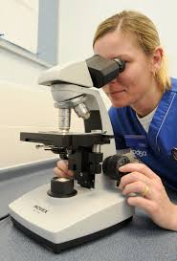
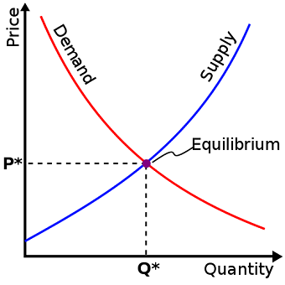
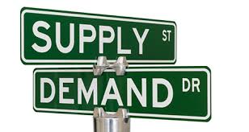
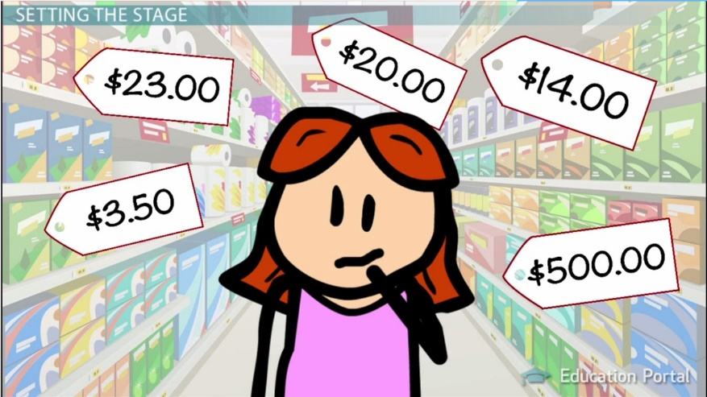
Unit 3: Microeconomics
Microeconomics – The study of the economic behavior and decision making of small units, such as individuals, families, and firms (businesses)

Slide 2
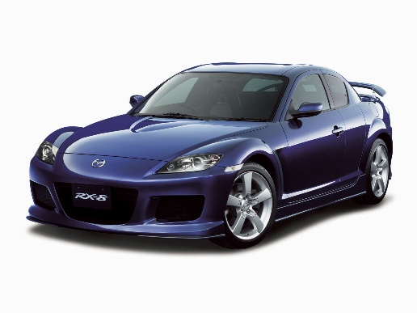
Demand Activator
Three people enter a Mazda dealership all interested in buying a brand new car. All three initially stop to look at the Mazda RX8. The first person tells the salesperson that they “really like the RX8” but they “don’t have any money today”, and are “saving their money for a purchase within the next 6 months”. The second person tells the dealer that they “have the money to buy”, they “are going to ultimately buy RX8”, but they are shopping various dealerships and are “not willing to buy today”. The third person tells the dealer that they “love the RX8!”, they “have the money” and they “want to buy it today.” Answer the following questions based on the above scenario:
1. List each customer (1-3). Next to each customer, write each of the following that apply to their situation:
1. Desire to buy
2. Ability to buy
3. Willingness to buy
2. Which customer do think was most appealing to the salesperson, and why?
3. Which customer would you have helped first, and why?
Desired Item | Ability | Willingness

Slide 3
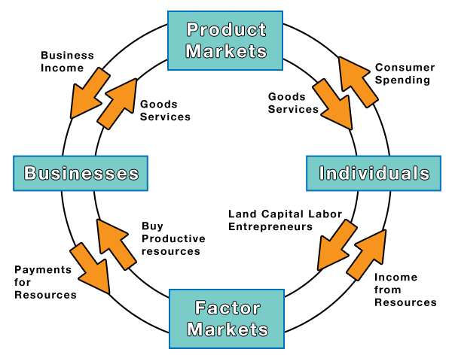
Milestone Review
SSEMI1b) The diagram shows the circular flow of goods and resources in a market economy. According to this diagram, where do individuals sell their labor?
in households
in the factor market
in the product market
in the revenue market

Slide 4
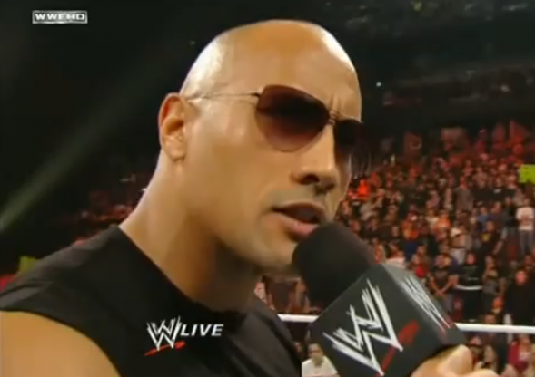
And always REMEMBER this key factor of microeconomics…
Money serves as the MEDIUM of EXCHANGE in a Market Economy
The ROCK says to “know your role”
And these transactions always occur because of voluntary, non-fraudulent exchange

Slide 5
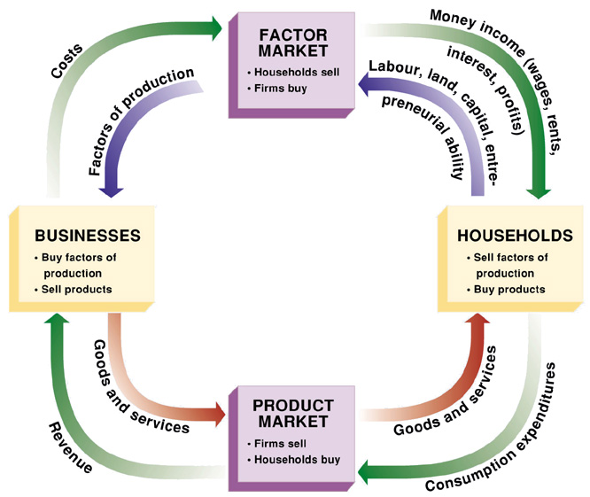
Circular Flow Model
How does the Circular Flow Model summarize the relationship & interaction between households, businesses, and government?
Buys F.O.P.
Taxes
Gov’t
Taxes
Subsidy
Transfer
Payment
Public Goods
Public Goods
Buys Outputs

Slide 6
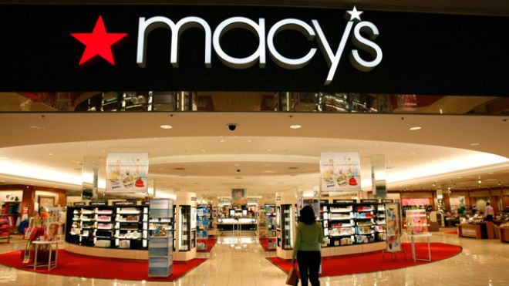
How does the Circular Flow Model demonstrate the role of Consumers & Producers in a Market Economy?
Markets have a Buyer
Markets have a Seller

Slide 7
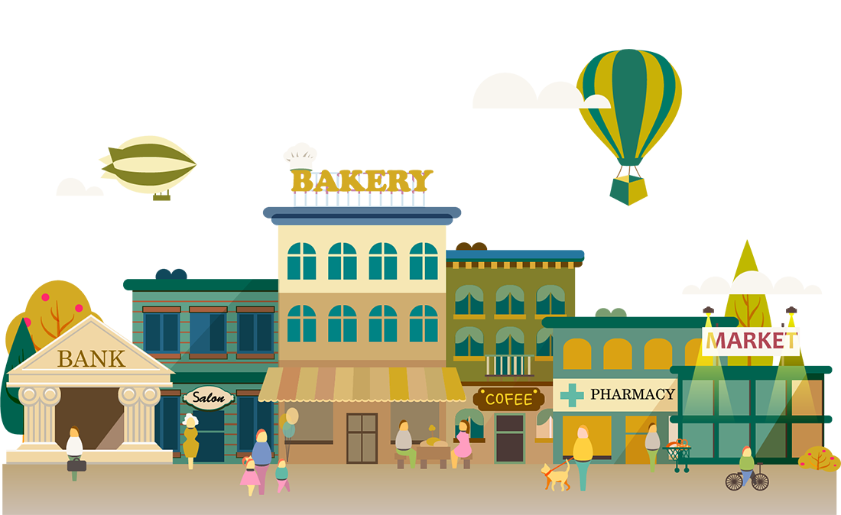
Households and Firms
Household – Person or group of people living in a residence
Consumers use the final goods & services (outputs) to satisfy wants and needs (utility)
Firm – business organization that uses resources to produce goods/services, which it then sells
Suppliers transform “inputs” (F.O.P.) into “outputs” (products)

Slide 8
Factor (Resource) Markets
Factor Markets – the markets where productive resources (F.O.P) are bought & sold
Inputs:
Firms are the buyers, households are the sellers
Land - Rent
Labor - Firms (businesses) hire workers & pay them wages
Capital – Interest
Entrepreneurs - Profit

Slide 9
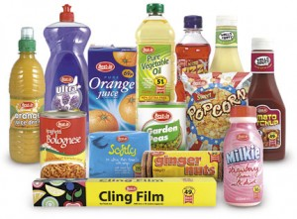
Product Markets
Product Markets – Households & firms interact; producers sell their goods & services to consumers
Households are buyers of goods & services
Firms are sellers of goods & services (outputs)

Slide 10
https://www.youtube.com/watch?v=mN5HPJYJzus
AC/DC Econ Movie 1.7: Circular Flow Matrix

Slide 11
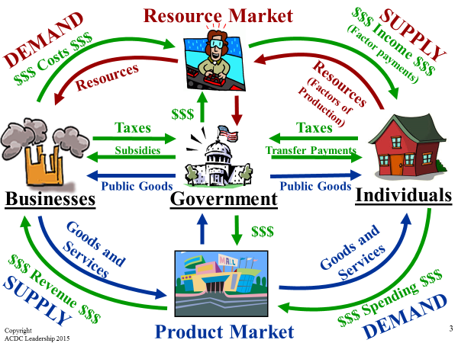
Microeconomics can be summarized by the relationship & interaction between households, businesses, and government

Slide 12
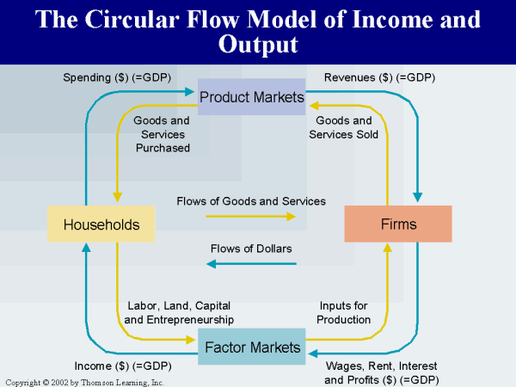
Now watch this incredibly informative & important video on the Circular Flow Model; there might even be a Quiz afterwards…
https://www.youtube.com/watch?v=_PKH2wtDT3E

Slide 13
Milestone Review
SSEMI1b) According to the circular flow model, where do firms earn revenue?
in households
in the factor market
in the product market
provided by the government

Slide 14
REVIEW
What scarce productive resources do households possess and exchange in the Resource Market?
Who are the buyers and sellers in the Factor Market?
Who are the buyers and sellers in the Product Market?
What’s another term for Businesses?
How do Firms make profits?
What role does money play in a market economy?
How do Households earn income?
What is utility?
What are the goals of Firms and Households?
Now, draw a properly labeled Circular Flow Model with your fingers in the air!
Quick, name your top 10 European capital cities that you want to visit.

Slide 15
https://www.youtube.com/watch?v=g9aDizJpd_s

Slide 16
ACTIVATOR
During the holiday season of 1996, a children’s toy appeared on Good Morning America. The toy, produced by Mattel, had sat on the shelves with very little sales until its appeared on the TV show. After its appearance. Its popularity skyrocketed and it became the most sought after product of the holiday season. Unfortunately, Mattel didn’t anticipate the doll’s popularity, only producing 400,000 units, and were not able to provide the product in a timely manner at the store level (over 1 million were in demand).
Because of the lack of supply and intense demand for the product, the Tickle Me Elmo doll was sold as high as $2,500 per unit through private sellers on classified ads!
How does this demonstrate ECONOMIC principles?

Slide 17
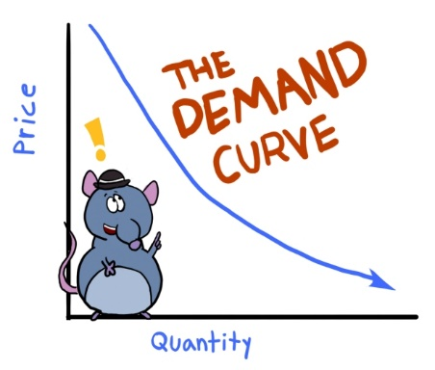
DEMAND
What 3 things are required in order to have DEMAND?

Slide 18
Demand Application Chart
Indicate 3 items that you want on one side, whether you can afford them or not in the next, and whether you are willing to buy them in the last.
Desired Items | Ability/Afford | Willingness | Demand
1.
2.
3.

Slide 19
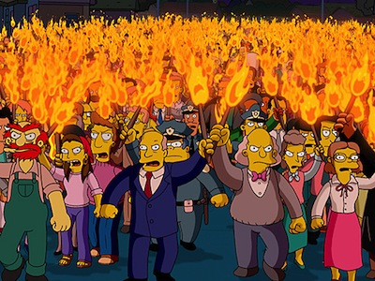
Law of Demand & Demand Curves
What is the Law of Demand, and what factors cause movement along the curve?

Slide 20
Understanding Demand
Demand – amount of a good or service that a consumer DESIRES and is WILLING & ABLE to buy at all prices during a given time period
Quantity Demanded (Qd) – amount of a good or service a consumer is willing & able to buy at….EACH PARTICULAR PRICE during a given time period
So do you see the subtle but IMPORTANT difference between Demand & Qd???
LAW OF DEMAND states that when the price of a good or service falls, consumers buy more (Quantity) of it (& vice versa)
INVERSE RELATIONSHIP (opposite) between PRICE & Qd, so the more something costs the less people will buy (common sense, right?)

Slide 21
LAW OF DEMAND
As Price Falls…
…Quantity Demanded Rises
As Price Rises…
…Quantity Demanded Falls
Quantity Demanded
Price

Slide 22
Example of Demand
I am willing to sell several A’s in Honors Economics. How much will you pay?
Demand Schedule
A Demand Schedule shows the relationship between price & Qd
A Demand Curve shows the same info & the curve ALWAYS SLOPES DOWNWARD!!!!!!!!!!!!!!!!!!
Movement along the Demand Curve is caused by a change in the PRICE of a product, which changes the Quantity Demanded (Qd) of a product
Price | Quantity Demanded
$5 $10 $50 $100 $500 $1,000 | ? ? ? ? ? ?

Slide 23
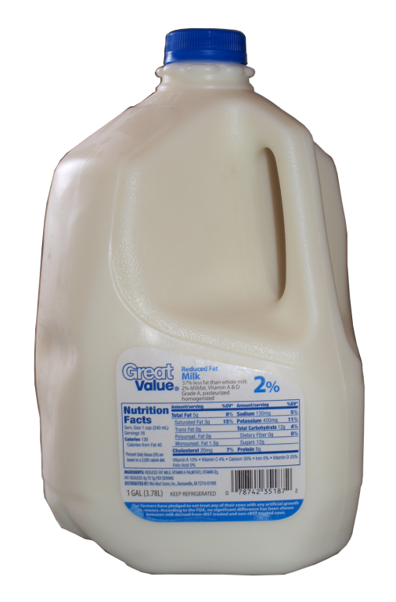
GRAPHING DEMAND
Demand Schedule
Price of Milk
Draw this large in your notes
$5
4
3
2
1
Price | Quantity Demanded
$5 | 10
$4 | 20
$3 | 30
$2 | 50
$1 | 80
10 20 30 40 50 60 70 80
Q
Quantity of Milk
Copyright
ACDC Leadership 2015

Slide 24
GRAPHING DEMAND
Demand Schedule
Price of Milk
$5
4
3
2
1
Price | Quantity Demanded
$5 | 10
$4 | 20
$3 | 30
$2 | 50
$1 | 80
Demand DOWN to the Dirt!!!!
Demand
10 20 30 40 50 60 70 80
Q
Quantity of Milk
24

Slide 25
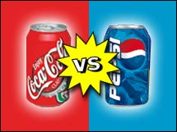
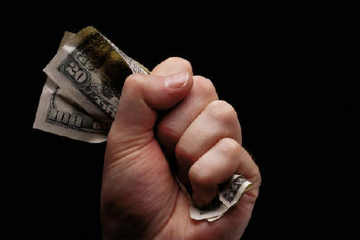
Why does the Law of Demand occur?
The law of demand is the result of three separate behavior patterns that overlap:
1. The Substitution Effect
If the price goes up for a product, consumers buy less of that product and more of another substitute product (and vice versa)
2. The Income Effect
If the price goes down for a product, the purchasing power increases for consumers -allowing them to purchase more.

Slide 26
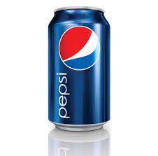
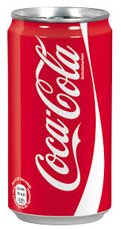
Substitution Effect
$0.99 $1.19
$0.99

Slide 27
INCOME EFFECT
$44.50 $19.50

Slide 28
Why does the Law of Demand occur?
3. Law of Diminishing Marginal Utility
U-
TIL-
IT-
Y
Utility = Satisfaction
We buy goods because we get utility from them
The law of diminishing marginal utility states that as you consume more units of any good, the additional satisfaction from each additional unit will eventually start to decrease
In other words, the more you buy of ANY GOOD the less satisfaction you get from each new unit.
Discussion Questions:
What does this have to do with the Law of Demand?
How does this effect the pricing of businesses?

Slide 29
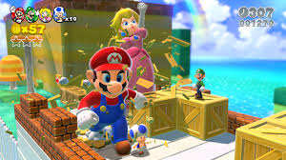
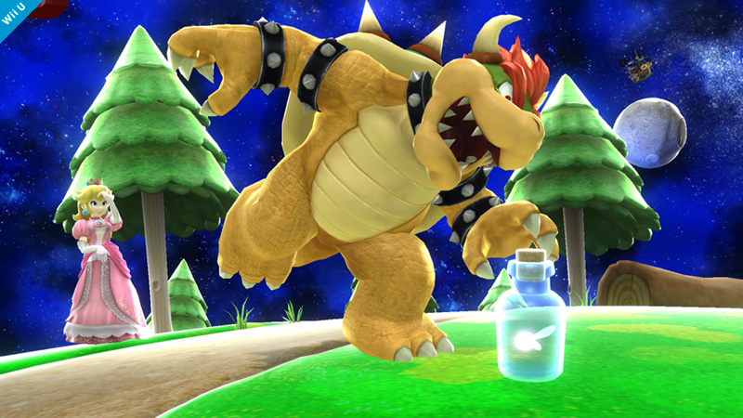
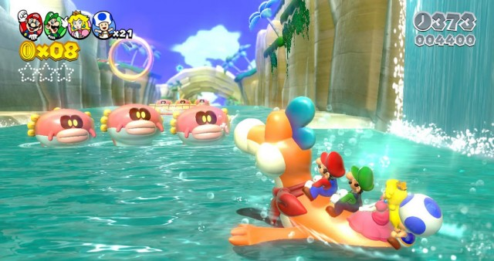
Law of Diminishing Marginal Utility
On a personal level
30 minutes playing Mario 3D is blissful!
1 hours playing is still sort of fun, but starting to get old
2 hours of Mario has become dull, and my fingers are hurting!

Slide 30
Can you see the Law of Diminishing Marginal Utility in Disneyland’s pricing strategy?
Change
N/A
$54
$33
$15
$10
$5

Slide 32
Milestone Review
SSEMI2a) Assuming that the graph follows the normal laws of economics, the line represents
demand.
supply.
equilibrium price.
production possibilities.
Price
Quantity

Slide 33
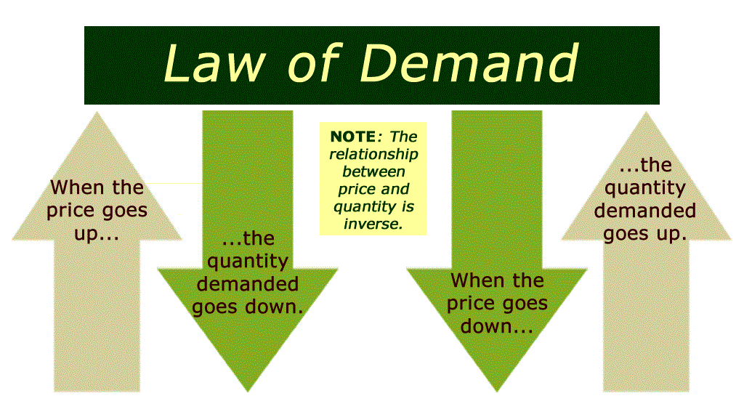

Slide 34
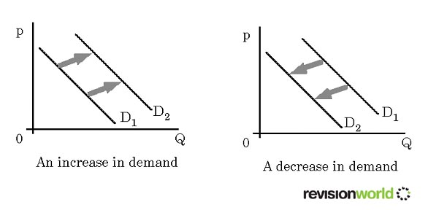
What factors cause Shifts of the Demand Curve?
Remember that a change in Qd is caused by a change in PRICE
Changes in Demand are reflected as a shift in the curve
Shifts to the RIGHT indicate an INCREASE in demand
Shifts to the LEFT indicate a DECREASE in demand

Slide 35
Demand

Slide 36
Shifts in Demand
CHANGES IN DEMAND
Ceteris paribus-“all other things held constant.”
When the ceteris paribus assumption is dropped, movement no longer occurs along the demand curve. Rather, the entire demand curve shifts.
A shift means that at the same prices, more people are willing and able to purchase that good.
This is a change in demand, not a change in quantity demanded
Changes in price
DON’T shift
the curve!

Slide 37
Change in Demand
Demand Schedule
What if cereal
makes you smarter?
Price of Cereal
$5
4
3
2
1
Price | Quantity Demanded
$5 | 10
$4 | 20
$3 | 30
$2 | 50
$1 | 80
Demand
o
Q
10 20 30 40 50 60 70 80
Quantity of Cereal
37

Slide 38
Change in Demand
Demand Schedule
Price of Cereal
$5
4
3
2
1
Price | Quantity Demanded
$5 | 10
$4 | 20
$3 | 30
$2 | 50
$1 | 80
Demand
o
Q
10 20 30 40 50 60 70 80
Quantity of Cereal
38

Slide 39
Change in Demand
Demand Schedule
Price of Cereal
$5
4
3
2
1
Price | Quantity Demanded
$5 | 10
$4 | 20
$3 | 30
$2 | 50
$1 | 80
Demand
o
Q
10 20 30 40 50 60 70 80
Quantity of Cereal
39

Slide 40
Change in Demand
Demand Schedule
Price of Cereal
$5
4
3
2
1
Price | Quantity Demanded
$5 | 30
$4 | 40
$3 | 50
$2 | 70
$1 | 80 100
Demand
o
Q
10 20 30 40 50 60 70 80
Quantity of Cereal
40

Slide 41
Change in Demand
Demand Schedule
Price of Cereal
Increase in Demand
Prices didn’t change but people want MORE cereal
$5
4
3
2
1
Price | Quantity Demanded
$5 | 30
$4 | 40
$3 | 50
$2 | 70
$1 | 80 100
D₂
Demand
o
Q
10 20 30 40 50 60 70 80
Quantity of Cereal
41

Slide 42
Change in Demand
Demand Schedule
What if cereal
causes baldness?
Price of Cereal
$5
4
3
2
1
Price | Quantity Demanded
$5 | 10
$4 | 20
$3 | 30
$2 | 50
$1 | 80
Demand
o
Q
10 20 30 40 50 60 70 80
Quantity of Cereal
42

Slide 43
Change in Demand
Demand Schedule
Price of Cereal
$5
4
3
2
1
Price | Quantity Demanded
$5 | 10
$4 | 20
$3 | 30
$2 | 50
$1 | 80
Demand
o
Q
10 20 30 40 50 60 70 80
Quantity of Cereal
43

Slide 44
Change in Demand
Demand Schedule
Price of Cereal
$5
4
3
2
1
Price | Quantity Demanded
$5 | 10
$4 | 20
$3 | 30
$2 | 50
$1 | 80
Demand
o
Q
10 20 30 40 50 60 70 80
Quantity of Cereal
44

Slide 45
Change in Demand
Demand Schedule
Price of Cereal
$5
4
3
2
1
Price | Quantity Demanded
$5 | 0
$4 | 5
$3 | 20
$2 | 30
$1 | 80 60
Demand
o
Q
10 20 30 40 50 60 70 80
Quantity of Cereal
45

Slide 46
Change in Demand
Demand Schedule
Price of Cereal
$5
4
3
2
1
Decrease in Demand
Prices didn’t change but people want LESS cereal
Price | Quantity Demanded
$5 | 0
$4 | 5
$3 | 20
$2 | 30
$1 | 80 60
D₂
Demand
o
Q
10 20 30 40 50 60 70 80
Quantity of Cereal
46

Slide 47
Change in Demand
Demand Schedule
What if the price
of MILK goes up?
Price of Cereal
$5
4
3
2
1
Price | Quantity Demanded
$5 | 10
$4 | 20
$3 | 30
$2 | 50
$1 | 80
Demand
o
Q
10 20 30 40 50 60 70 80
Quantity of Cereal
47

Slide 48
What Causes a Shift in Demand?
5 Shifters (Determinates) of Demand:
Tastes and Preferences
Number of Consumers
Price of Related Goods
Income
Future Expectations
Changes in PRICE don’t shift the curve. It only causes movement along the curve.

Slide 49
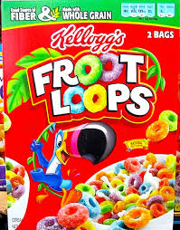
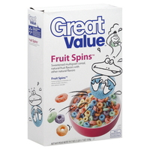
Consumer Income
A consumer’s income affects their demand for goods & services
Increase in income will cause an increase in consumption
Decrease in income will cause a decrease in consumption
Normal good – income rises, demand rises
Inferior good – income rises, demand falls
or
or

Slide 50
Consumer Tastes/Preferences
Changes in popularity of products are seen by the consumer “dollar vote”
Advertising – influence of trends & marketing by firms can affect demand
Popularity of product decreases, decreases in demand
Popularity of a product increases, increases in demand
Star Wars was all the hype in the 1970s & 1980s, but lost its popularity for a few decades, but now the DEMAND for the FORCE has once again been AWAKENED!!! See what I did there?

Slide 51
Consumer Future Expectations
Consumer Expectations refers to the way people think about the future, as it relates to consumption
Expectations for future prices can affect consumption for the present

Slide 52
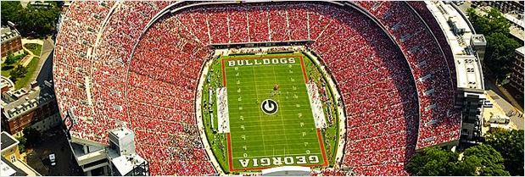
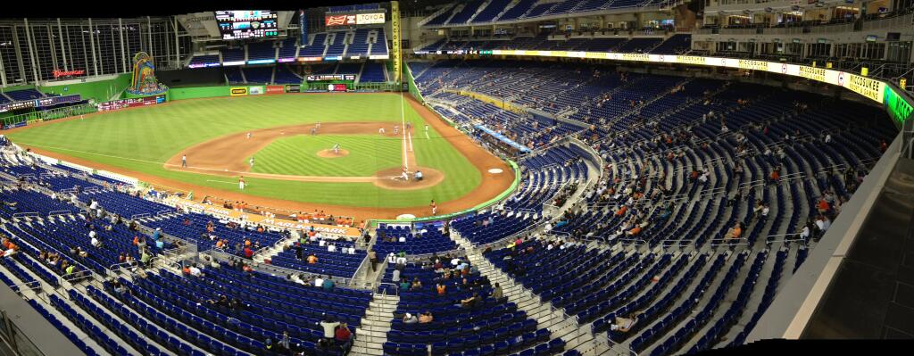
Market Size/Population
An increase in the number of consumers can cause an increase or decrease in the demand for products
Increase in population = increase in demand
Decrease in population = decrease in demand
UGA game day at Sanford Stadium in Athens, GA
Miami Marlins average weekly crowd

Slide 53
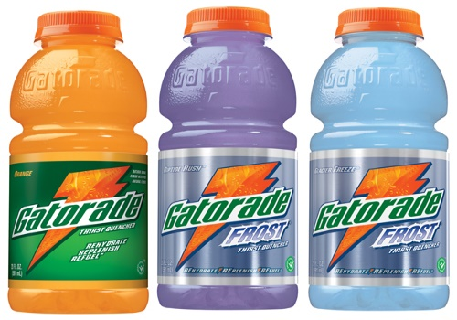
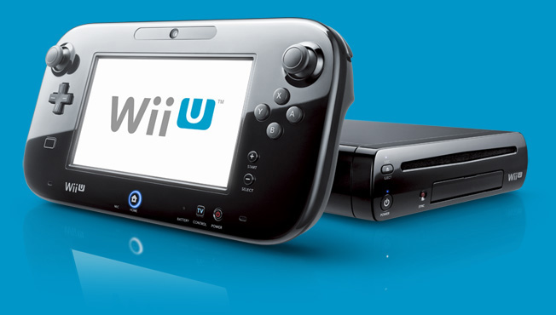
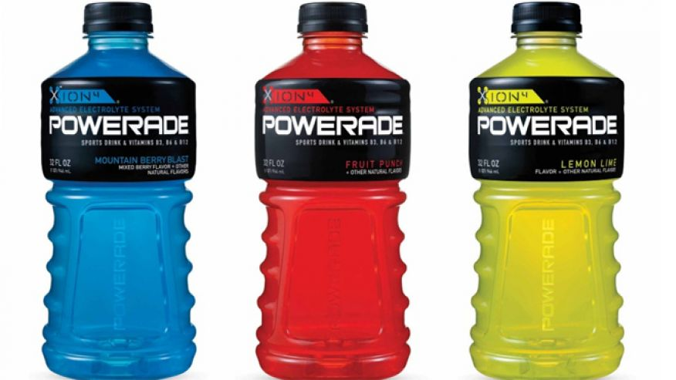
Price of Related Products (Substitutes & Complimentary Goods)
Demand for goods can be affected by the price for related goods
Complements – demand of one good increases as a result of the purchase of another good
Substitutes – demand for one good decreases because another good is used in its place
Increases purchase of games
Vs.

Slide 54
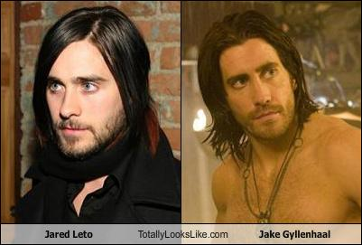
Substitutes
54
Notes:
54

Slide 55
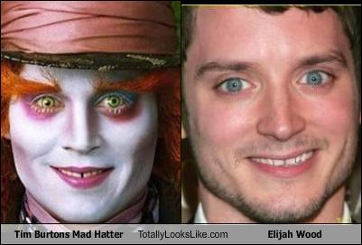
Substitutes
55
Notes:
55

Slide 56
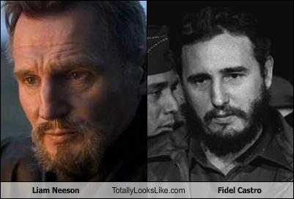
Substitutes
56
Notes:
56

Slide 57
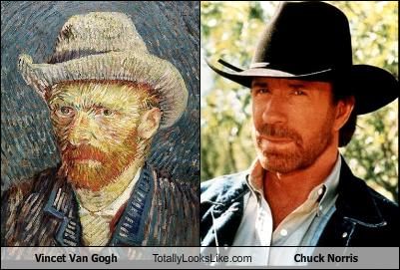
Substitutes
57
Notes:
57

Slide 58
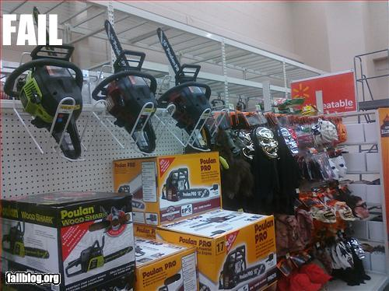
Complements
58
Notes:
58

Slide 59
Practice
First, identify the determinant (shifter) then decide if demand will increase or decrease
 | Shifter | Increase or Decrease | Left or Right
1
2
3
4
5
6
7
8
Notes:
Number of consumers, increase.
Income, decrease.
Substitutes, decrease.
Price doesn’t shift curve, no change.
Tastes and preferences, decrease.
Expectations, increase.
Complements, decrease.
Price doesn’t shift curve, no change.

Slide 60
Practice
First identify the determinant (Shifter). Then decide if demand will increase or decrease
Hamburgers (a normal good)
Population boom
Incomes fall due to recession
Price for Carne Asada burritos falls to $1
Price increases to $5 for hamburgers
New health craze- “No ground beef”
Hamburger restaurants announce that they will significantly increase prices NEXT month
Government heavily taxes shake and fries causes their prices to quadruple.
Restaurants lower price of burgers to $.50
60
Notes:
Number of consumers, increase.
Income, decrease.
Substitutes, decrease.
Price doesn’t shift curve, no change.
Tastes and preferences, decrease.
Expectations, increase.
Complements, decrease.
Price doesn’t shift curve, no change.
60

Slide 61
Milestone Review
SSEMI2b) Which of the following would be considered substitute goods?
batteries to a flashlight
software to a computer
butter to margarine
peanut butter to jelly
Price
D
Quantity

Slide 62
Elasticity of Demand
What is Elasticity of Demand, and how is elasticity measured?
https://www.youtube.com/watch?v=HHcblIxiAAk
AC/DC Economics: Elasticity of Demand

Slide 63
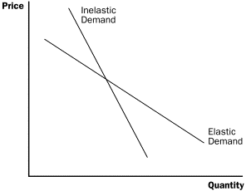
What is Elasticity of Demand?
Elasticity of Demand is the degree to which changes in a good’s price affect the quantity demanded (Qd)
Demand can be ELASTIC or INELASTIC
Elastic Demand exists when a small change in a good’s price causes a MAJOR, OPPOSITE change in Qd
small price increase = a large drop in Qd
Inelastic Demand – demand for a good or service is unaffected when the price of that good or service changes
If REVENUES increase after a price increase, the demand is INELASTIC

Slide 64
Determinants of Elasticity
Necessities v. Luxuries: Need v. Want
Existence of Substitutes
Proportion of Income: % of a person’s total budget used to buy the good
The time allowed to adjust for the price change
More time allowed, the greater the elasticity
Elastic Demand
Inelastic Demand
Luxury items
Things that have substitutes
Very expensive items
Necessities
Things with no substitutes
Inexpensive items

Slide 65
Total Revenue Test
Total Revenue – amount of money a company receives for selling its products (Total Revenue = P x Q)
Total Revenue Test – method of measuring elasticity by comparing the total revenue a business would receive when its product at various prices
Inelastic = Price ; Total Revenue OR Price ; Total Revenue
This is why Gas Stations never have sales because it will never benefit their profit
Elastic = Price ; Total Revenue OR Price ; Total Revenue

Slide 66
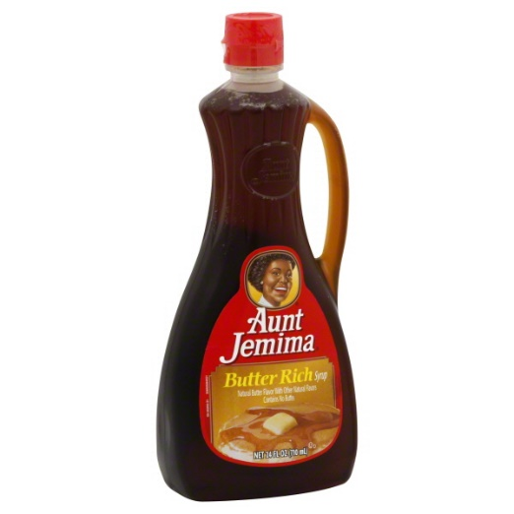
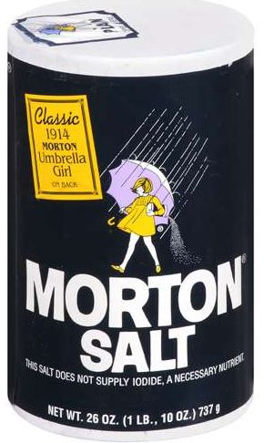
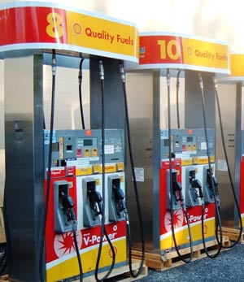
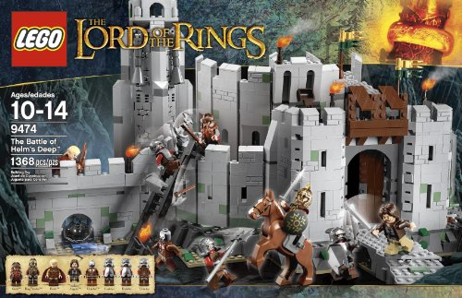
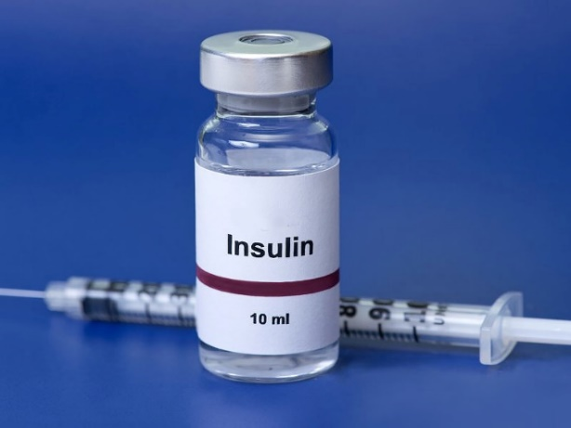
Elastic or Inelastic…Use your brains & don’t be fooled! Please explain your answer as well.

Slide 67
Mr. Crowdis stopped off at Kroger on his way home to pick up a block of sharp cheddar cheese for grits casserole for dinner. Much to his surprise and excitement cheese was on sale for $2.99 instead of $5.99! What did Mr. Crowdis do next...? Why? What happened to the Demand Curve for cheese because of this...?
Quick, State the Law of Demand!
Price
$5.99
Now, give a scenario that would cause the Demand Curve to shift to the right. Be sure to explain the shifter.
$2.99
D
Quantity
(Cheese)

Slide 68
REVIEW
What 3 things are needed in order to have Demand?
What NEVER changes Demand, but ALWAYS changes Quantity demanded?
State the Law of Demand with Confidence!
Finish the statement: Demand ______ to the _______!
What are the 3 reasons why Demand curves slope downward?
List the 5 Determinants of Demand, provide an example of each, and explain how it would impact demand.
What is meant by elasticity of demand?
Give an example of a product with elastic demand.
What are the 3-4 rules of demand elasticity?
Give an example of inelastic demand (relatively & perfectly inelastic).
Name your top 10 fast food restaurants.

Slide 69
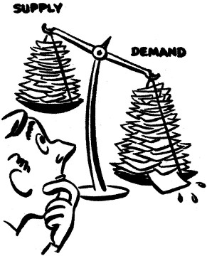
Supply Time
Up to the SKY!!!

Slide 70
Example of Supply
You own a lawn mower and you are willing to mow lawns.
How many lawns will you mow at these prices?
Price per lawn mowed | Quantity Supplied
Supply Schedule
$1
$5
$20
$50
$100
$1000
70

Slide 71
What is Supply, and how is Supply and Quantity Supplied (Qs) different?
Supply is the quantity of goods & services that producers (firms/businesses) are WILLING to offer at ALL possible prices during a given time period
Quantity Supplied (Qs) is the amount of a good or service that a producer is willing to sell at EACH PARTICULAR PRICE
Remember the Lawn Mower Activity

Slide 72
What is the Law of Supply?
LAW OF SUPPLY – states that producers supply more goods & services when they can sell them at higher prices and fewer goods & services when they must sell them at lower prices
Producers’ actions are based on the pursuit of PROFITS!
Those Greedy Capitalists!
And how do businesses make profits?
You make a profit when revenues are greater than the costs of production
Revenue – Cost of Production = Profit

Slide 73
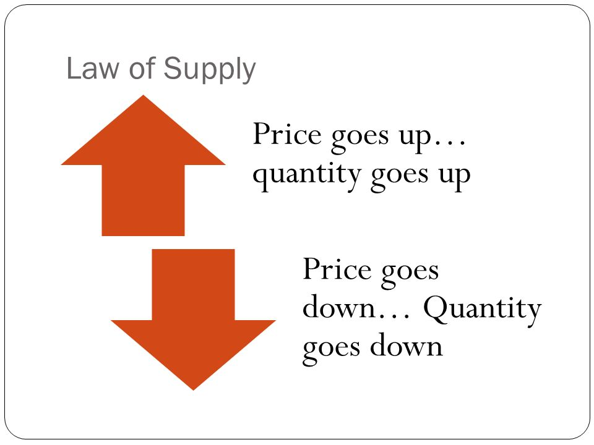
Direct (positive) relationship between price & Qs of a product

Slide 74
Supply

Slide 75
GRAPHING SUPPLY
Supply Schedule
Price of Cereal
Draw this large in your notes
$5
4
3
2
1
Price | Quantity Supplied
$5 | 50
$4 | 40
$3 | 30
$2 | 20
$1 | 10
o
Q
10 20 30 40 50 60 70 80
Quantity of Cereal
75

Slide 76
GRAPHING SUPPLY
Supply Schedule
Price of Cereal
Supply
$5
4
3
2
1
Price | Quantity Supplied
$5 | 50
$4 | 40
$3 | 30
$2 | 20
$1 | 10
o
Q
10 20 30 40 50 60 70 80
Quantity of Cereal
76

Slide 77
GRAPHING SUPPLY
Supply Schedule
What if new
companies start making
cereal?
Price of Cereal
Supply
$5
4
3
2
1
Price | Quantity Supplied
$5 | 50
$4 | 40
$3 | 30
$2 | 20
$1 | 10
o
Q
10 20 30 40 50 60 70 80
Quantity of Cereal
77

Slide 78
Change in Supply
Supply Schedule
Price of Cereal
Supply
$5
4
3
2
1
Price | Quantity Supplied
$5 | 50
$4 | 40
$3 | 30
$2 | 20
$1 | 10
o
Q
10 20 30 40 50 60 70 80
Quantity of Cereal
78

Slide 79
Change in Supply
Supply Schedule
Price of Cereal
Supply
$5
4
3
2
1
Price | Quantity Supplied
$5 | 50
$4 | 40
$3 | 30
$2 | 20
$1 | 10
o
Q
10 20 30 40 50 60 70 80
Quantity of Cereal
79

Slide 80
Change in Supply
Supply Schedule
Price of Cereal
Supply
$5
4
3
2
1
Price | Quantity Supplied
$5 | 70
$4 | 60
$3 | 50
$2 | 40
$1 | 10 30
o
Q
10 20 30 40 50 60 70 80
Quantity of Cereal
80

Slide 81
Change in Supply
Supply Schedule
Price of Cereal
Supply
S₂
$5
4
3
2
1
Price | Quantity Supplied
$5 | 70
$4 | 60
$3 | 50
$2 | 40
$1 | 10 30
Increase in Supply
Prices didn’t change but there is MORE cereal produced
o
Q
10 20 30 40 50 60 70 80
Quantity of Cereal
81

Slide 82
Change in Supply
Supply Schedule
What if a drought
destroys corn and wheat
crops?
Price of Cereal
Supply
$5
4
3
2
1
Price | Quantity Supplied
$5 | 50
$4 | 40
$3 | 30
$2 | 20
$1 | 10
o
Q
10 20 30 40 50 60 70 80
Quantity of Cereal
82

Slide 83
Change in Supply
Supply Schedule
Price of Cereal
Supply
$5
4
3
2
1
Price | Quantity Supplied
$5 | 50
$4 | 40
$3 | 30
$2 | 20
$1 | 10
o
Q
10 20 30 40 50 60 70 80
Quantity of Cereal
83

Slide 84
Change in Supply
Supply Schedule
Price of Cereal
Supply
$5
4
3
2
1
Price | Quantity Supplied
$5 | 50
$4 | 40
$3 | 30
$2 | 20
$1 | 10
o
Q
10 20 30 40 50 60 70 80
Quantity of Cereal
84

Slide 85
Change in Supply
Supply Schedule
Price of Cereal
Supply
$5
4
3
2
1
Price | Quantity Supplied
$5 | 30
$4 | 20
$3 | 10
$2 | 1
$1 | 10 0
o
Q
10 20 30 40 50 60 70 80
Quantity of Cereal
85

Slide 86
Change in Supply
Supply Schedule
Price of Cereal
Supply
$5
4
3
2
1
S₂
Price | Quantity Supplied
$5 | 30
$4 | 20
$3 | 10
$2 | 1
$1 | 10 0
Decrease in Supply
Prices didn’t change but there is LESS cereal produced
o
Q
10 20 30 40 50 60 70 80
Quantity of Cereal
86

Slide 87
Change in Supply
Supply Schedule
What if cereal companies
find a quicker way to make
cereal ?
Price of Cereal
Supply
$5
4
3
2
1
Price | Quantity Supplied
$5 | 50
$4 | 40
$3 | 30
$2 | 20
$1 | 10
o
Q
10 20 30 40 50 60 70 80
Quantity of Cereal
87

Slide 88
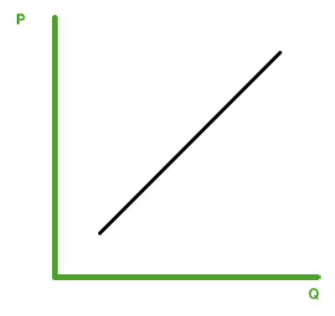
Milestone Review
SSEMI2) Assuming that the graph follows the normal laws of economics, the line represents
demand.
supply.
equilibrium price.
production possibilities.

Slide 89
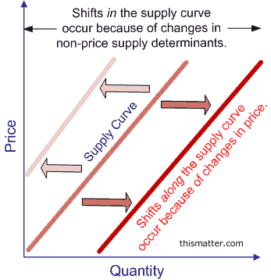
What are the non-price factors that cause the Supply Curve to SHIFT?

Slide 90
6 Determinants (SHIFTERS) of Supply
Prices/Availability of inputs (resources)
Number of Sellers
Technology
Government Action: Taxes & Subsidies
5. Opportunity Cost of Alternative Production
6. Expectations of Future Profit
Changes in PRICE don’t shift the curve. It only causes movement along the curve.

Slide 91
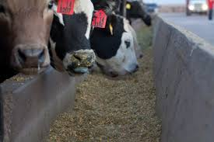
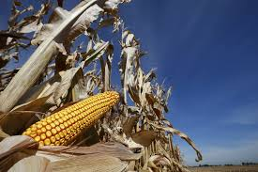
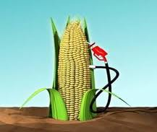
Input Costs – the cost of producing the good increases/decreases based on the materials necessary to produce (inputs)
Inputs are the Productive Resources necessary to produce: land, labor, capital, entrepreneurship (factors of production)
For example, why have beef prices risen?
cause
and
Livestock feed becomes more expensive
Drought
Ethanol Fuel
Making beef prices extremely high

Slide 92
Technology & Productivity
Technological innovations improve productivity & increase ability to supply
Productivity – amount of goods & services produced per unit of input
Xerox copy machines
Gutenberg printing press (1450s) greatly increased the spread of information & productivity
Better technology shifts the Supply Curve to the Right

Slide 93
Government Tools
#1
#2
Taxes & Gov’t Regulations increase the cost of production & will reduce the incentive to produce , so the Supply Curve will shift to the LEFT (decrease)

Slide 95
Government Tools
Subsidy – Gov’t payment that helps cover the cost of an economic activity that can benefit the public as a whole
Subsidies motivate firms to produce because they are guaranteed revenue from the government (shifts Supply Curve to the RIGHT)
Name 2 industries that the Gov’t may grant subsidies.
Agriculture Subsidy
Energy Subsidy
Oil Industries
Green Energy (Solar)
#3

Slide 96
Number of Sellers (Competition)
Number of sellers – an increase/decrease in the number of sellers can cause an increase or decrease in the supply of goods & services

Slide 97
Future Expectations
Expectations – suppliers inventory will reflect how they view the economy in the future
Suppliers will build up their inventory if they feel the economy will be strong, reduce inventory if they feel it will be weak
OR

Slide 98
Supply Shock
Supply Shock – a sudden shortage of a good due to a natural disaster or human error
Natural disasters – drought, earthquake, hurricane
Human error – gulf oil spill, refinery fire, etc.

Slide 99
Just Remember the Difference Between A Change in Quantity Supplied(Price) and a Change in Supply (6 Determinants)
Quantity Supplied (Qs) – A change in the amount a supplier will produce as a result of a change in price
Reflected as movement along the curve
Supply – A change in the amount a supplier can produce as a result of a change in one of the non-price determinates
Reflected as a shift in the curve left (decrease) or right (increase)

Slide 100
Supply Practice
First, identify the determinant (shifter) then decide if supply will increase or decrease
 | Shifter | Increase or Decrease | Left or Right
1
2
3
4
5
6
100
Notes:
Number of consumers, increase.
Income, decrease.
Substitutes, decrease.
Price doesn’t shift curve, no change.
Tastes and preferences, decrease.
Expectations, increase.
Complements, decrease.
Price doesn’t shift curve, no change.
100

Slide 101
Supply Practice
Which determinant (SHIFTER)?
Increase or decrease?
Which direction will curve shift?
Hamburgers
Mad cow disease kills 20% of cows
Price of burgers increase 30%
Government taxes burger producers
Restaurants can produce burgers and/or tacos. A demand increase causes the price for tacos to increase 500%
New bun baking technology cuts production time in half
Minimum wage increases to $10
Notes:
Decrease in availability of resources, decrease.
Price doesn’t shift curve, no shift.
Government action, decrease.
Opportunity cost of alternative production, decrease.
Technology, increase.
Price of resources, decrease.

Slide 102
How does Elasticity of Supply affect Production?
Elasticity of Supply is the degree to which price changes affect the Qs
An ELASTIC Supply exists when a small change in price causes a MAJOR change in the Qs
Elastic products usually can be made:
Quickly
Inexpensively
Using a few readily available resources
An INELASTIC Supply exists when a change in a good’s price has little impact on the Qs
Inelastic products typically requires a great deal of:
Time
Money
Resources that are not readily available
Because suppliers cannot easily change the production rates of such goods to meet the changing demand

Slide 103
What are the costs of production?
Productivity – amount of goods & services produced per unit of input
Total Product – all the product a company makes in a given period of time, with a given amount of input
Marginal Product – the change in output generated by adding one more unit of input
LAW of DIMINISHING RETURNS – states that as more of ONE input is added to a fixed supply of other resources, productivity increases up to a point; but at some point, marginal product will diminish

Slide 104
Costs of Production
Costs of Production: Fixed Costs + Variable Costs = Total Costs
Fixed Costs – expenses that owners of a business must incur whether they produce nothing, a little, or a lot
Rent/Mortgage, Insurance, Utilities, Salaried Employees
Variable Costs – business costs that vary as the level of production output changes
Wages, Resources, Shipping, Advertising
Marginal Cost (MC) – the additional costs of producing ONE MORE UNIT of output
Calculating MC allows the business to determine the profitability of increasing or decreasing production

Slide 105
Earning the Highest Profit
Profit = Total Revenue – Total Costs
Total Revenue – income a business receives from selling a product
Total Revenue = Price x Quantity purchased at that price)
Ex: Mario’s Pizza sells 60 pizzas at $10.99 each ($10.99 x 60 = $659.40 is TR)
Marginal Revenue – added revenue per unit of output (money made from each additional unit sold)
Profit-maximizing Output – greatest amount of profits when marginal cost & marginal revenue are equal; after this point, profits begin to decline

Slide 106
Marginal Returns
Increasing marginal returns – Increases in output per worker added by the firm
Diminishing marginal returns – Additional workers increase total output, but at a decreasing rate
https://www.youtube.com/watch?v=xLSRMt-wWAM
Negative Marginal Returns – Adding additional workers decreases output

Slide 107
Milestone Review
SSEMI2e) What happens to the Supply of cars if the Auto Union demands a 30% increase in wages?
Increase; shift right
Decrease; shift right
Increase; shift left
Decrease; shift left
Price
S
Quantity
(cars)

Slide 108
REVIEW
What is the #1 goal of entrepreneurs?
In which market do firms earn revenues? How are profits determined?
What is the difference between Supply and Quantity Supplied (Qs)?
Finish the statement: Supply ______ to the _______!
State the Law of Supply like a true Economist would. What type of relationship do price and Qs have?
What are the 6 Determinants of Supply? And give an example of each one and how it would impact Supply, Prices, and Quantity Supplied.
What Gov’t tool actually increases Supply? Why is that…?
If the cost of labor increases due to a minimum wage increase, what happens to Supply?
What happens to Supply if there are advancements in technology?
List your top 10 Super heroes in order from best to least favorite.

Slide 109
PRICES
Price – the value of a product as established by Supply & Demand
Prices serve as a link between producers & consumers

Slide 110
Market Driven – Market forces, not Gov’t policy, determine prices, so the system basically runs itself
Neutral – Both the producer & consumer make choices that determine the equilibrium price
What are the characteristics of the Price System?
(Hint: p. 175 in the textbook)
Efficient – Resources are allocated efficiently since prices adjust until the maximum number of goods & services are sold
Flexible – When market conditions charge, so do prices

Slide 111
Explain what is going on in the picture as the expert Microeconomist that you are all becoming!!!
Who did this concept originate from…?

Slide 112
https://www.youtube.com/watch?v=RP0j3Lnlazs
Econ Movies #4: Supply & Demand

Slide 113
Defining the Equilibrium
Market Equilibrium – the point of balance where Demand & Supply curves intersect
Market clearing price – price that has cleared the market, accepted by both buyers & sellers
In other words, Qd = Qs
Qd
Qs

Slide 114
Supply and Demand are put together to determine equilibrium price and equilibrium quantity
P
Supply Schedule
Demand Schedule
S
$5
4
3
2
1
P | Qd
$5 | 10
$4 | 20
$3 | 30
$2 | 50
$1 | 80
P | Qs
$5 | 50
$4 | 40
$3 | 30
$2 | 20
$1 | 10
D
o
Q
10 20 30 40 50 60 70 80
114

Slide 115
Supply and Demand are put together to determine equilibrium price and equilibrium quantity
P
Supply Schedule
Demand Schedule
S
$5
4
3
2
1
P | Qd
$5 | 10
$4 | 20
$3 | 30
$2 | 50
$1 | 80
P | Qs
$5 | 50
$4 | 40
$3 | 30
$2 | 20
$1 | 10
Equilibrium Price = $3 (Qd=Qs)
D
o
Q
10 20 30 40 50 60 70 80
Equilibrium Quantity is 30
115

Slide 116
Supply and Demand are put together to determine equilibrium price and equilibrium quantity
What if the price
increases to $4?
P
Supply Schedule
Demand Schedule
S
$5
4
3
2
1
P | Qd
$5 | 10
$4 | 20
$3 | 30
$2 | 50
$1 | 80
P | Qs
$5 | 50
$4 | 40
$3 | 30
$2 | 20
$1 | 10
D
o
Q
10 20 30 40 50 60 70 80
116

Slide 117
At $4, there is disequilibrium. The quantity demanded is less than quantity supplied.
P
Supply Schedule
Demand Schedule
S
$5
4
3
2
1
Surplus
(Qd<Qs)
P | Qd
$5 | 10
$4 | 20
$3 | 30
$2 | 50
$1 | 80
P | Qs
$5 | 50
$4 | 40
$3 | 30
$2 | 20
$1 | 10
How much is the surplus at $4?
Answer: 20
D
o
Q
10 20 30 40 50 60 70 80
117

Slide 118
How much is the surplus if the price is $5?
What if the price
decreases to $2?
P
Supply Schedule
Demand Schedule
S
$5
4
3
2
1
P | Qd
$5 | 10
$4 | 20
$3 | 30
$2 | 50
$1 | 80
P | Qs
$5 | 50
$4 | 40
$3 | 30
$2 | 20
$1 | 10
Answer: 40
D
o
Q
10 20 30 40 50 60 70 80
118

Slide 119
At $2, there is disequilibrium. The quantity demanded is greater than quantity supplied.
P
Supply Schedule
Demand Schedule
S
$5
4
3
2
1
P | Qd
$5 | 10
$4 | 20
$3 | 30
$2 | 50
$1 | 80
P | Qs
$5 | 50
$4 | 40
$3 | 30
$2 | 20
$1 | 10
How much is the shortage at $2?
Answer: 30
Shortage
(Qd>Qs)
D
o
Q
10 20 30 40 50 60 70 80
119

Slide 120
How much is the shortage if the price is $1?
P
Supply Schedule
Demand Schedule
S
$5
4
3
2
1
P | Qd
$5 | 10
$4 | 20
$3 | 30
$2 | 50
$1 | 80
P | Qs
$5 | 50
$4 | 40
$3 | 30
$2 | 20
$1 | 10
Answer: 70
D
o
Q
10 20 30 40 50 60 70 80
120

Slide 121
The FREE MARKET system automatically pushes the price toward equilibrium.
P
Supply Schedule
Demand Schedule
S
$5
4
3
2
1
When there is a surplus, producers lower prices
P | Qd
$5 | 10
$4 | 20
$3 | 30
$2 | 50
$1 | 80
P | Qs
$5 | 50
$4 | 40
$3 | 30
$2 | 20
$1 | 10
When there is a shortage, producers raise prices
D
o
Q
10 20 30 40 50 60 70 80
121

Slide 122
One more example of Market Equilibrium, Surplus & Shortage graphed based on the Laws of Supply & Demand for your viewing pleasure & educational growth!
http://study.com/academy/lesson/identifying-shortages-and-surpluses-in-microeconomics.html

Slide 123
Milestone Review
SSEMI2c) Which statement accurately describes the contents of this graph?
At the equilibrium price, quantity supplied equals quantity demanded.
At the equilibrium price, quantity supplied exceeds quantity demanded.
When the price goes above the equilibrium price, quantity demanded increases.
When the price goes below the equilibrium price, quantity supplied increases.

Slide 124
Equilibrium Price & Changes in Demand & Supply
Okay, now I challenge you to draw these 2 graphs to prove that I’m right. Go ahead; let’s do it!
Supply increases
If Demand increases
Equilibrium price falls
Equilibrium price rises
OR
THEN
OR
THEN
If Demand decreases
Supply decreases

Slide 125
https://www.youtube.com/watch?v=V0tIOqU7m-c

Slide 126
Supply and Demand Time!!! Draw the Graphs (correctly labeled), list the “Shifter,” and show the impact of the change in the Market
Consumer income increased 10%; change in market for normal goods
Hurricane destroyed Florida's orange groves; change in market for orange juice
Price of peanut butter decreased; change in market for jelly
Price of coffee tripled; change in market for coffee
Better technology in widget production; change in market for widgets
Price of livestock feed decreased by 50%, change in market for ground beef
Gov’t subsidizes solar energy; change in market for solar panels
The price of pretzels decreases by 33%; change in the market for pretzels
2018 U.S. birthrate increased by 50 %; change in market for diapers
Advertising for hoverboards increase popularity so more firms enter the market as sellers; change in market for hoverboards

Slide 127
Double Shifts in Supply and Demand
https://www.youtube.com/watch?v=K0AQ9rK8MN4
AC/DC Economics: Double Shifters

Slide 128
Analyze the political cartoon, and be able to explain it to the class as the economic masterminds that you all are becoming!
Now, Draw the Graph that is being implied in the cartoon! I’m waiting!

Slide 129
Milestone Review
SSEMI2a) In a market economy, a high price will usually cause
producers to offer less and consumers to buy less.
producers to offer less and consumers to buy more.
producers to supply more and consumers to buy less.
producers to supply more and consumers to buy more.

Slide 130
Milestone Review
SSEMI2e) In the graph, what happened to the equilibrium price when the supply curve moved from S1 to S2?
It did not change.
The equilibrium price went up.
The equilibrium price went down.
It indicated a decrease in demand.
Now give me a scenario and a “Shifter” why this occurred in the market

Slide 131
Disequilibrium
Disequilibrium – occurs when the quantity supplied is not equal to the quantity demanded
Surplus – result of Qs > Qd, usually because prices are too high
Shortage – result of Qd > Qs, usually because prices are too low

Slide 132
Market Disequilibrium
When the Free Market experiences disequilibrium (Surplus or Shortage), a new equilibrium clearing price must be established by producers decreasing or increasing the price & production
And then there are those that believe the GOVERNMENT MUST INTERVENE to fix the system!!!!!!!!

Slide 133
https://www.youtube.com/watch?v=1EzY4Vl460U

Slide 134
Price Ceilings
Price Ceilings – gov’t imposed, legal maximum price that can be charged for a good/service
New York introduced rent control in the 1940s as a way to provide affordable housing, but it resulted in shortage of NY apartments
Price ceilings cause a shortage in the amount of the product

Slide 135
Price Floors
Price Floors – gov’t imposed, minimum price that can be legally charged for a good or service
Price floors cause a surplus to occur in the market
Minimum wage is a well-known price floor
Minimum wage can cause a surplus of workers, causing unemployment to rise

Slide 136
Milestone Review
SSEMI2g) Which of these is MOST LIKELY a result of apartment rent controls?
a shortage of apartments
increased mobility of workers
decreased demand for apartments
a dramatic increase in rental rates
Now, Draw this Supply & Demand Graph

Slide 137
REVIEW
What would Adam Smith call the market equilibrium?
How are prices calculated in a market economy?
What is meant by market equilibrium?
What occurs when Qs > Qd? How does the free market fix this…
What occurs when Qd > Qs? How does the free market fix this…
Draw a Supply and Demand Graph for a Dairy Queen Butterfinger Blizzard with a market equilibrium price at $3.50 and quantity of 10 with your fingers!
What is it called when the Government intervenes with prices in the market?
What do price ceilings always cause to happen in the market? Where on a graph are they located? Draw it with your fingers. Give an example of one.
What do price floors always cause to happen in the market? Where on a graph are they located? Draw it with your fingers. Give an example of one.
Name 5 exotic pets that you would own if allowed.

Slide 138
Whew! Thank Goodness we’re done with all that Supply & Demand nonsense!!!!
And now Ladies & Gentlemen it’s time for…wait for it…can you guess it?
Market structures!

Slide 139
Spectrum of Competition
More Competitive Less Competitive
Perfect Competition
Monopolistic Competition
Oligopoly
Monopoly

Slide 140
Perfect Competition
Perfect Competition (Pure) is the simplest & most competitive market structure; a large number of firms producing identical products
4 characteristics:
Identical Products
Many buyers and sellers
Market Price based on supply & demand
(“Price Takers”)
No barriers to entry

Slide 141
Monopolistic Competition
Monopolistic Competition – many companies selling similar products but not identical; brand control (“little monopolies”)
4 Characteristics:
Many buyer and sellers
Slight control over price
Brand Differentiation
(main difference between perfect & monopolistic competition)
Low Barrier to Entry

Slide 142
Oligopoly
Oligopoly – a market structure in which a few large firms dominate a market; a few of the largest firms produce at least 70-80% of the output.
Examples: Automobile industry, commercial airlines, beer industry, oil cartels, web browsers, smartphones, etc.
4 Characteristics:
A few firms (2-3)
Identical/slightly different products
Market Power
High Barriers to Entry
https://www.youtube.com/watch?v=JMq059SAQXM
(Oligopolies explained by the Dark Knight)

Slide 143
Oligopolies Can Interfere With the Free Market
Collusion – businesses work together to agree to price fix, which damages the free market (sell at same or very similar prices)
Cartel – a formal organization of producers that fix prices and control supply
OPEC: Organization of Petroleum Exporting Countries

Slide 144
Monopoly
Monopoly – when one company controls the market of a good/service and can effectively dictate prices (least competitive)
4 Characteristics:
One Seller
No Substitutes
“Price Maker”/Market Power
Complete Barrier to Entry
https://www.youtube.com/watch?v=Sb_-wfmJnHA
Crash Course Economics #25: Monopolies and other Anti-Competitive Markets

Slide 145
Natural Monopolies
A natural monopoly is a monopoly in an industry in which high infrastructural costs and other barriers to entry relative to the size of the market give the largest supplier in an industry, often the first supplier in a market, an overwhelming advantage over potential competitors. This frequently occurs in industries where capital costs predominate and deter the need for competition in an area and include public utilities to provide public goods such as water services and electricity.

Slide 146
Okay, “Smart People” try and answer this ?
What is meant by “Price Wars?”
What is an example of non-price competition?
What 2 types of market structures use non-price competition in an effort to avoid engaging in “Price Wars” with each other?
Monopolistic Competition & Oligopolies

Slide 147
 | Perfect Competition | Monopolistic Competition | Oligopoly | Monopoly
How many suppliers are there?
What influence do firms have over price?
How much competition exists between firms?
Are all firms selling identical or similar products?
Is it easy or difficult to enter the market?
Provide an example of each
What happens to the Supply

Slide 148
Milestone Review
SSEMI3b) Which market structure is BEST indicated by the photograph?
monopoly
oligopoly
pure competition
monopolistic competition

Slide 149
Activator – Business Organizations Write down three occupations that you’re considering for your future. Categorize each of your choices based on who your employer might be for each job.
Job | Employer
1.
2.
3.

Slide 150
Business Organizations
Business organization (firm) – establishment formed to bring goods & services to the consumers in the market
3 types: 1) Sole proprietorship, 2) Partnership, 3)Corporation
How do they differ?
Each has different structures & levels of liability (responsibility)
Liability – legal obligation to pay debts/injury settlements incurred by the business

Slide 151
Sole proprietorship – a business owned by one person Most common type of business organization 75% of all U.S. businesses are sole proprietorships Relatively the most profitable
Advantages
Disadvantages
Easy to start up
Easy to manage
You keep ALL the PROFITS
There are no separate business taxes
Easy to close down shop (dissolve/liquidate)
UNLIMITED LIABILITY
Difficult to raise financial capital
Limited managerial experience
Hard to attract qualified employees
Limited life of company (dissolves when owner is gone)

Slide 152
Sole Proprietorships

Slide 153
Partnership – business owned by at least 2 people This is the least common business organization (only about 5%) General Partnership – each partner is responsible for everything Limited Partnership – some partners are not “active” Articles of Partnership – outline the type of partnership, to the state, between partners.
Advantages
Disadvantages
Easy to start
Easier to manage (partners bring different strengths & expertise)
Easier to find financial capital
More efficient operations (larger, more capital & specialization)
Easier to attract better/qualified employees
Unlimited Liability
Each partner could be responsible for the other’s actions
YOU BOUGHT WHAT!!!
Possible conflict between partners
Limited life of business

Slide 154
Partnerships
Apple Inc. (1976) began as a partnership between Steve Jobs and Steve Woz. Woz's technical skills paired with Jobs' business foresight makes the two an ultimate business match and successfully changed the world!

Slide 155
Corporations
Corporation – is a business organization owned by individual shareholders, each of whom faces limited liability for the firms debt
Account for 20% of all businesses, but 90% of all products sold
Considered a separate legal entity (legal being)
Corporations issue STOCK (Shares) to investors (Shareholders)
Shareholders can receive DIVIDENDS & are the OWNERS of the business, but face no liability for the firm’s obligations
Common stock – get one vote per share when electing the Board of Directors
Preferred stock – non-voting shares but you get any dividends before common stock holders
If you own the majority (51%) of the stock, then you control the company

Slide 156
Corporations
Advantages
Disadvantages
Easy to raise financial capital by selling stock or issuing bonds
Ability to offer higher salaries & greater benefits allows corporations to recruit the best, brightest, most talented, ambitious, and professional employees & managers
Limited liability
Unlimited life (transfer ownership by selling stock)
Can be difficult and expensive to get CHARTER to start corporation
Shareholders usually have little input in the corporation
DOUBLE TAXATION of corporation profits
Much more GOVERNMENT REGULATION….never a good thing!

Slide 157
Corporations

Slide 159
Mergers
Merger – combine with another company to become one entity
Horizontal merger – firms in the same market with a similar good or service merge
Half and Ebay
Facebook and Instagram
American Airlines and US Airways
Vertical merger – firms join two or more firms involved in different stages of producing the same good
Control all phases of the product from production to sales (monopoly)
Conglomerates – business mergers with large companies, more than three businesses

Slide 160
Other Organizations
Multinationals – large corporation that produces and sells its goods and services throughout the world
Business Franchise – semi-independent business that pays fees and royalties to a parent company
Business is granted right to sell using the name, product & brand of the company
Zaxbys, McDonalds, Subway, etc.
Cooperative (Co-0ps) – business organization owned & operated by a group of individuals for their shared benefit
Nonprofit Organizations – business that gears towards benefiting society (philanthropy)
Labor Unions – organized group of workers whose aim is to improve working conditions, hours, wages and fringe benefits for its members.

Slide 161
Milestone Review
SSEMI3a) In a business organization, the splitting of management and ownership into two distinct functions is an example of a(n)
merger.
corporation.
entrepreneur.
partnership.

Slide 162
REVIEW
List the 4 types of Market Structures from most competitive to least competitive.
What are the key characteristics of perfect competition, monopolistic competition, oligopolies, and monopolies? Give an example of each.
What is it called when oligopolies work together and set prices? Example.
Give an example of a natural monopoly and explain why they’re legal in the U.S.
What does Liability mean when owning a business?
List the pros and cons of each of the 3 types of business organizations.
Which business organization is the most common, least common, responsible for approximately 90% of all sales in America?
How do corporations raise revenue? So, who are the actual owners…?
List the top 10 board games of all time!

Slide 163
THE END
And there you have it folks…Microeconomics is now behind you; up next… Macroeconomics!!!
But 1st lets see how many American millennials perceive capitalism, free enterprise, and business today
http://stosselintheclassroom.org/videos/how_millennials_view_capitalism/

