Slide 1
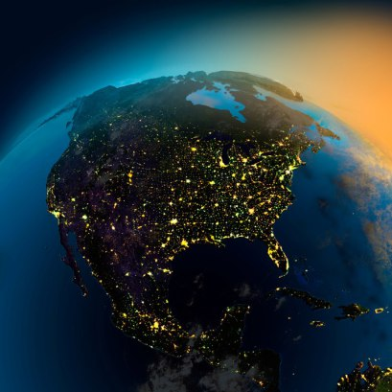
Unit 2: The US & Canada
Cultural Notes

Slide 2
The Impact of Immigration

Slide 3
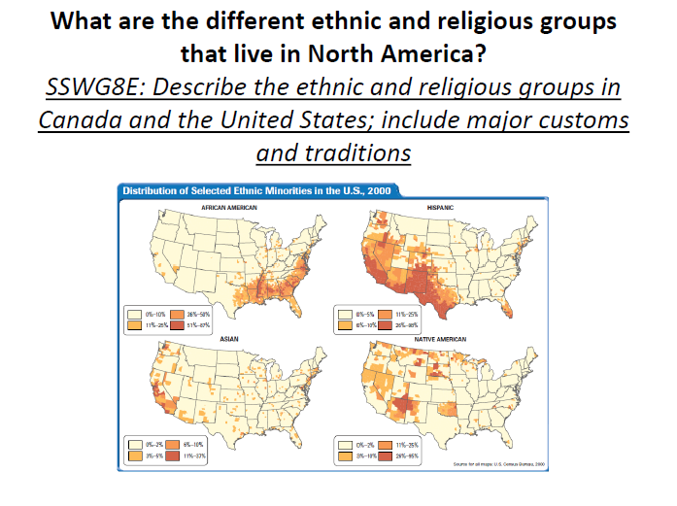
Unit 2: The US & Canada
Cultural Notes

Slide 4

The People
The United States
The US population is among the most diverse.
Diversity reflects the influence of immigration on the country.
Canada
Canadians trace their roots to immigrants.
Some Canadians are descendants of Native Americans.

Slide 5
The People
People in the US and Canada have a high standard of living.
  Able to have many personal choices and opportunities
  Agricultural surplus makes food inexpensive
  Housing varies
    High-rise apartments
    Multi-family row houses
    Suburban houses

Slide 6
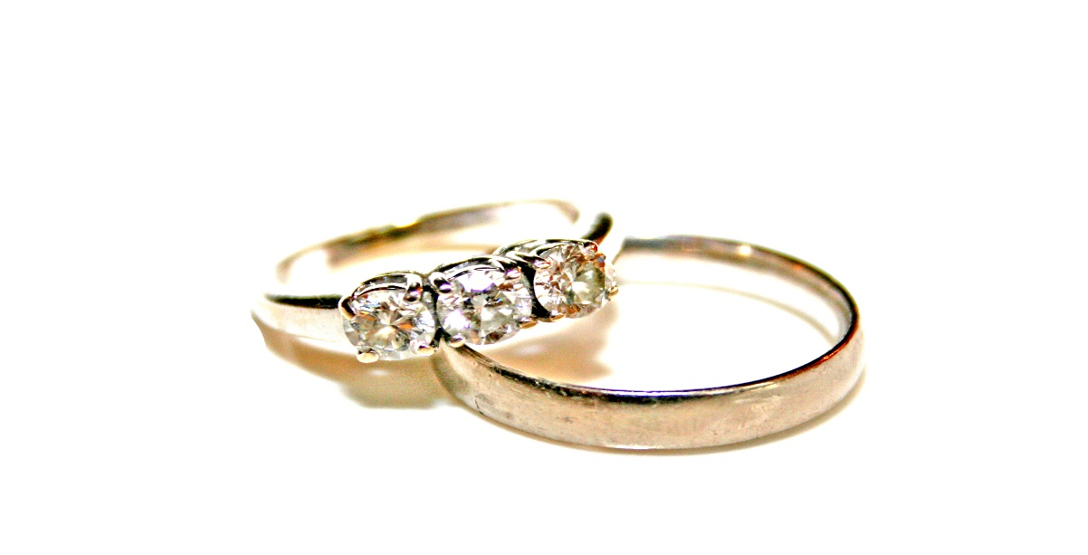
The People
  US Households
  50% of households are married couples
    22% have children under the age of 18
    61% have 1 or 2 children
  Canada
  69% are married couples
  41% have children under the age of 18

Slide 7
The United States
Over 300 million people live in the US
Many are descendants of immigrants or are immigrants
2.5 million are Native Americans
Europeans, Asians, and Latin Americans make up the rest of the population

Slide 8
The United States
Immigrants came for:
  Religious freedom
  Political freedom
  Better economic opportunities
  Fled war or natural disasters

Slide 9
The United States
Natural resources and rapid industrial and economic development attract immigrants
Many faced discrimination, but offered hard work, enthusiasm, and diverse cultural practices

Slide 10
The United States
Immigrants today seek jobs, education, career opportunities, or refuge from political situations
In 2008, 12.5% of the US population was foreign born.
Half of the foreign born were from Latin America

Slide 11
Canada
Immigrants came for:
  Political freedom
  Religious freedom
  Economic opportunities
  Education
  Refuge from war

Slide 12
Canada
Loyalists fled to Canada from the British colonies after the American Revolution
Many settled in the Maritime Provinces of Nova Scotia, New Brunswick, and Prince Edward Island
Mix of ethnic origins varies from province to province

Slide 13
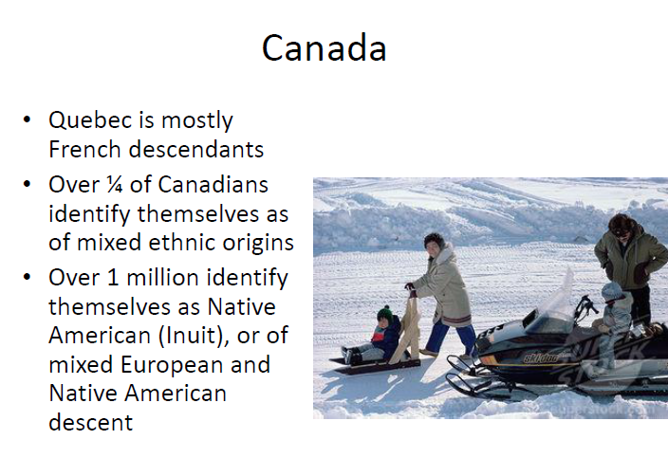
Canada
Quebec is mostly French descendants
Over ¼ of Canadians identify themselves as mixed ethnic origins
Over 1 million identify as Native American (Inuit), or of mixed European and Native American descent

Slide 14
Culture of the United States

Slide 15
Culture of the United States
Languages and Religion
English is the main language
People also use words phrases from other languages
Some people are bi-lingual
The growing Latino population has made Spanish the second most common language

Slide 16
Culture of the United States
Languages and Religion
Most Americans are Christian
Other religions include Judaism, Islam, Hinduism, & Buddhism

Slide 17

Culture of the United States
Education and Healthcare
Education is a network of public and private schools
Attending school is required until age 16
USA has a 99% literacy rate

Slide 18

Culture of the United States
Education and Healthcare
Healthcare is available to many with the Affordable Healthcare Act
  About 25 million previously uninsured gained coverage (2016)
Some citizens lost their coverage or are now unable to purchase health insurance due to expense
  Roughly 12.8 million previously insured now without (2016)

Slide 19
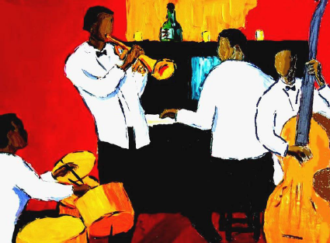
Culture of the United States
The Arts
Americans integrated art, music, and storytelling into daily life
European settlement caused art in America to be dominated by European traditions

Slide 20
Culture of the United States
The Arts
Mid 1800s- people began to create their own art forms reflecting their lives and culture
Jazz was developed by African Americans

Slide 21
Culture of Canada

Slide 22
Culture of Canada
Language and Religion
Two official languages
  English
  French
Reflects the power struggle between French and British in the past
French is dominant in the province of Quebec

Slide 23

Culture of Canada
Language and Religion
Other languages
  Chinese
  Italian
  German
Native languages
  Cree
  Inuktitut

Slide 24
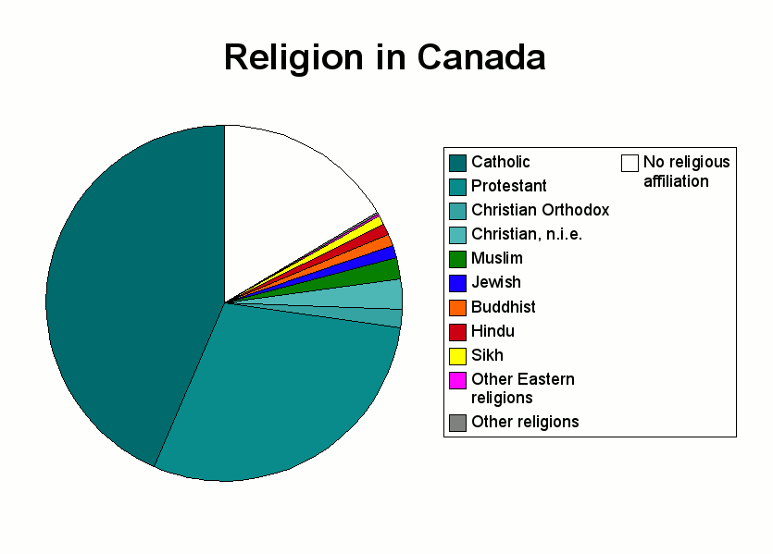
Culture of Canada
Language and Religion
Christianity is the largest religion
Other religions
  Islam
  Buddhism
  Hinduism
  Judaism
  Sikhism

Slide 25
Culture of Canada
Language and Religion
Multiple religions reflects Canada’s diverse immigrant population

Slide 26
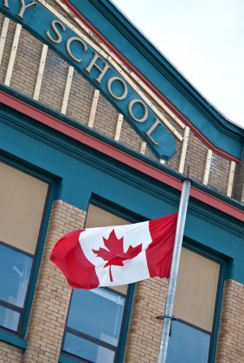
Culture of Canada
Education and Healthcare
99% literacy rate
Network of public and private schools
Each province is responsible for organizing and administering public education
Required for ages 6 – 16

Slide 27

Culture of Canada
Education and Healthcare
Government helps pay for healthcare for all its citizens
Each province finances & manages its own healthcare systems

Slide 28
Culture of Canada
Education and Healthcare
High life expectancy has led to increased costs which has resulted in limiting benefits and raising taxes

Slide 29
Culture of Canada
The Arts
Influenced by British, French, American, and native cultures
Immigrant population has added to the literature, visual arts, theater, and music

Slide 30
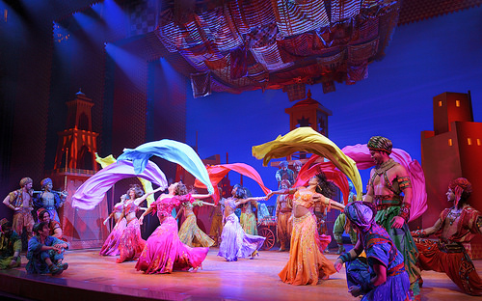
Culture of Canada
The Arts
Government promotes locally produced cultural products in mass media since the 1950s
Toronto is highly regarded in theater and music

Slide 31
United States Population Density

Slide 33
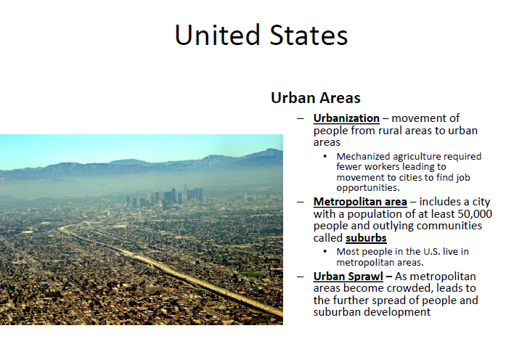

Slide 35
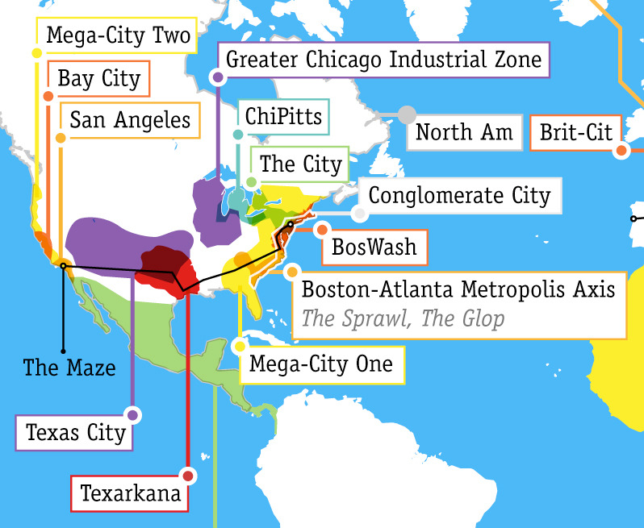

Slide 36
Canadian Population Density

Slide 39
Economic Activities

Slide 40
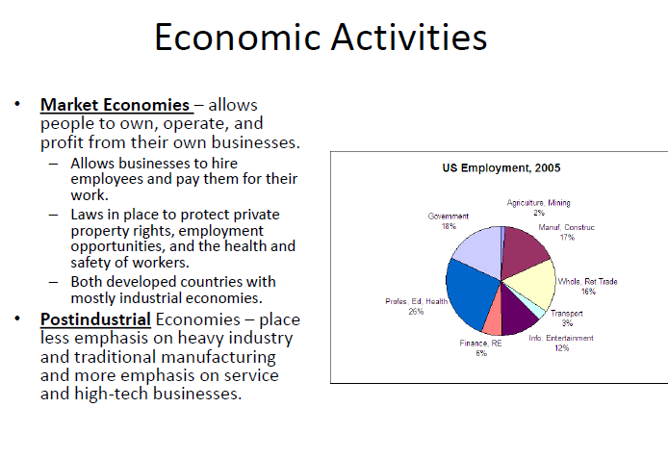

Slide 42
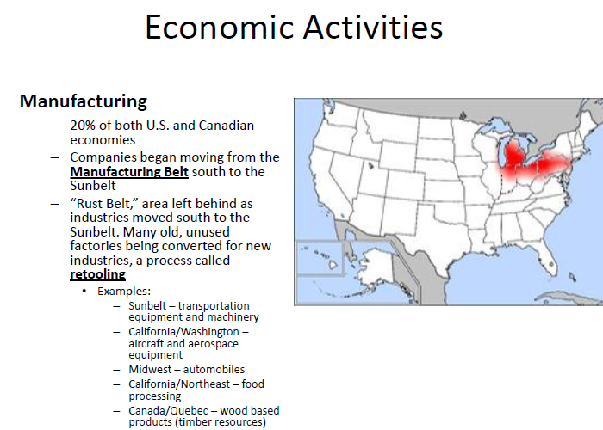

Slide 43
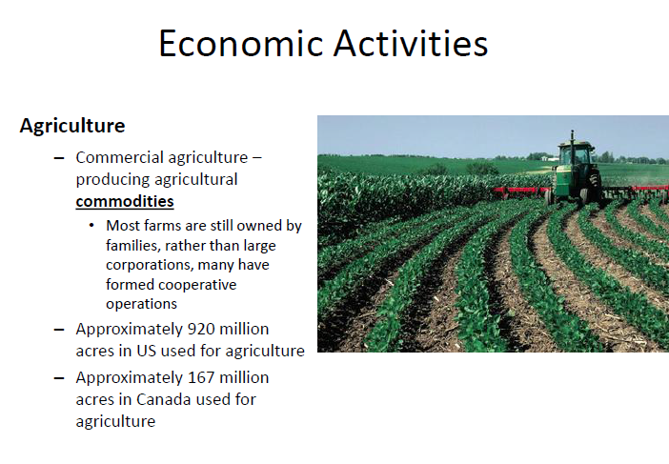

Slide 44
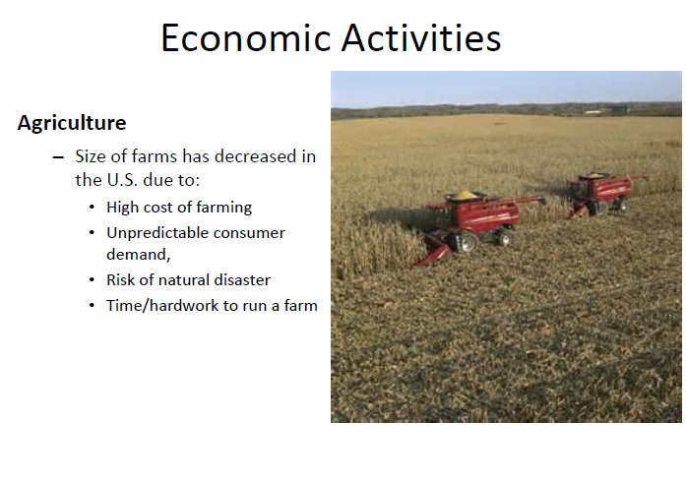

Slide 45
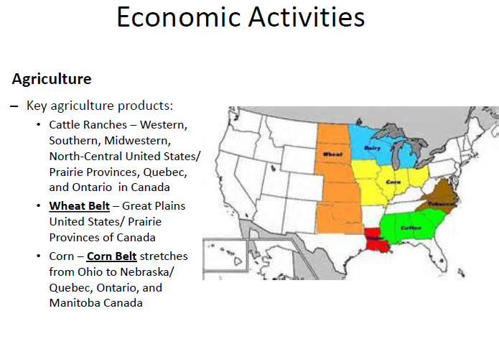

Slide 46
Trade
&
Interdependence

Slide 49
