Slide 1
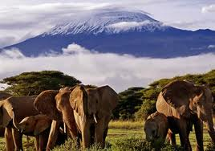
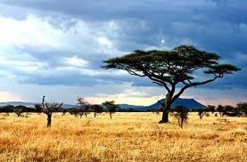
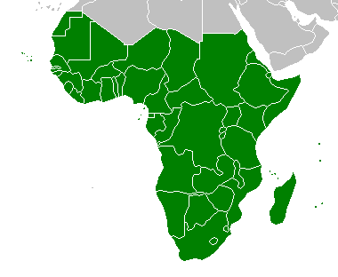
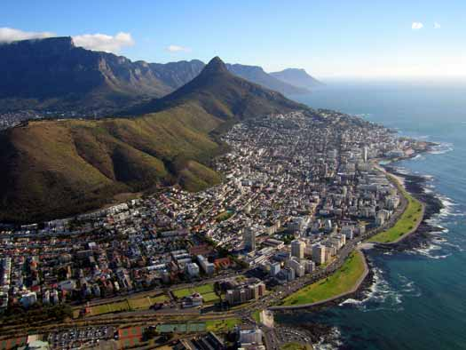
Sub-Saharan Africa
Natural Resources and Climate

Slide 2
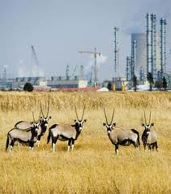
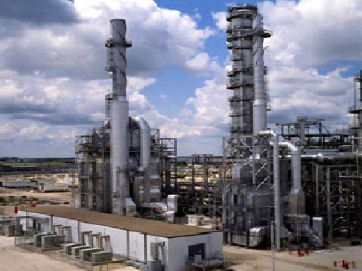
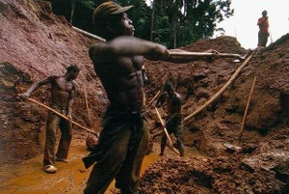
Natural Resources
Story of plenty and scarcity
Africa has a large amount of the world’s minerals, but many countries lack the industrial base or money to develop them
Major source of conflict in the area

Slide 3
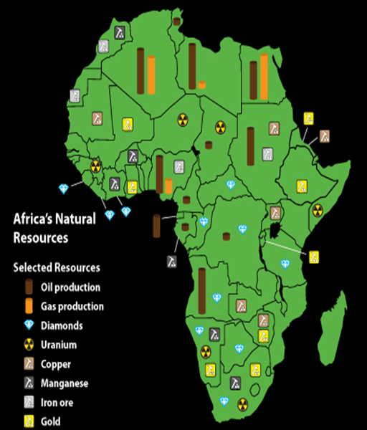

Slide 4
Wealth of Minerals
One of the world’s richest continents
Ores-account for ½ export value
Gold,
Platinum- South Africa- 80%
Chromium- South Africa, world largest producer
Cobalt- 42 % of world’s supply
Copper,
Diamonds (African blood diamonds)

Slide 5
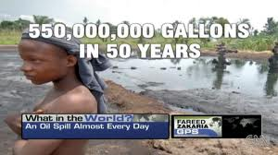
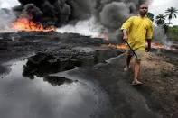
Oil Resources
Nigeria is a leading petroleum producer, Angola and Gabon have developing petroleum industries.

Slide 6
Diversity of resources
Rain Forests to roaring rivers= diversity
Coffee, 2nd most profitable commodity (20%)
Lumber
Sugar, palm oil, cocoa
Agriculture- single most important economic activity (1/3 of exports). 66% earn their living via agriculture

Slide 7
Climate
Most of Sub-Saharan Africa lies between the tropics of Cancer and Capricorn (90%), has a tropical climate with warm temperatures.
This area experiences two seasons (2 wet, 2 dry), defined by rainfall, the temperatures never drop below freezing.
Why is that important?
In temperate zones rain is reliable (North), but in other areas it can be very unreliable.
Drought= fact of life (especially in the East)

Slide 8
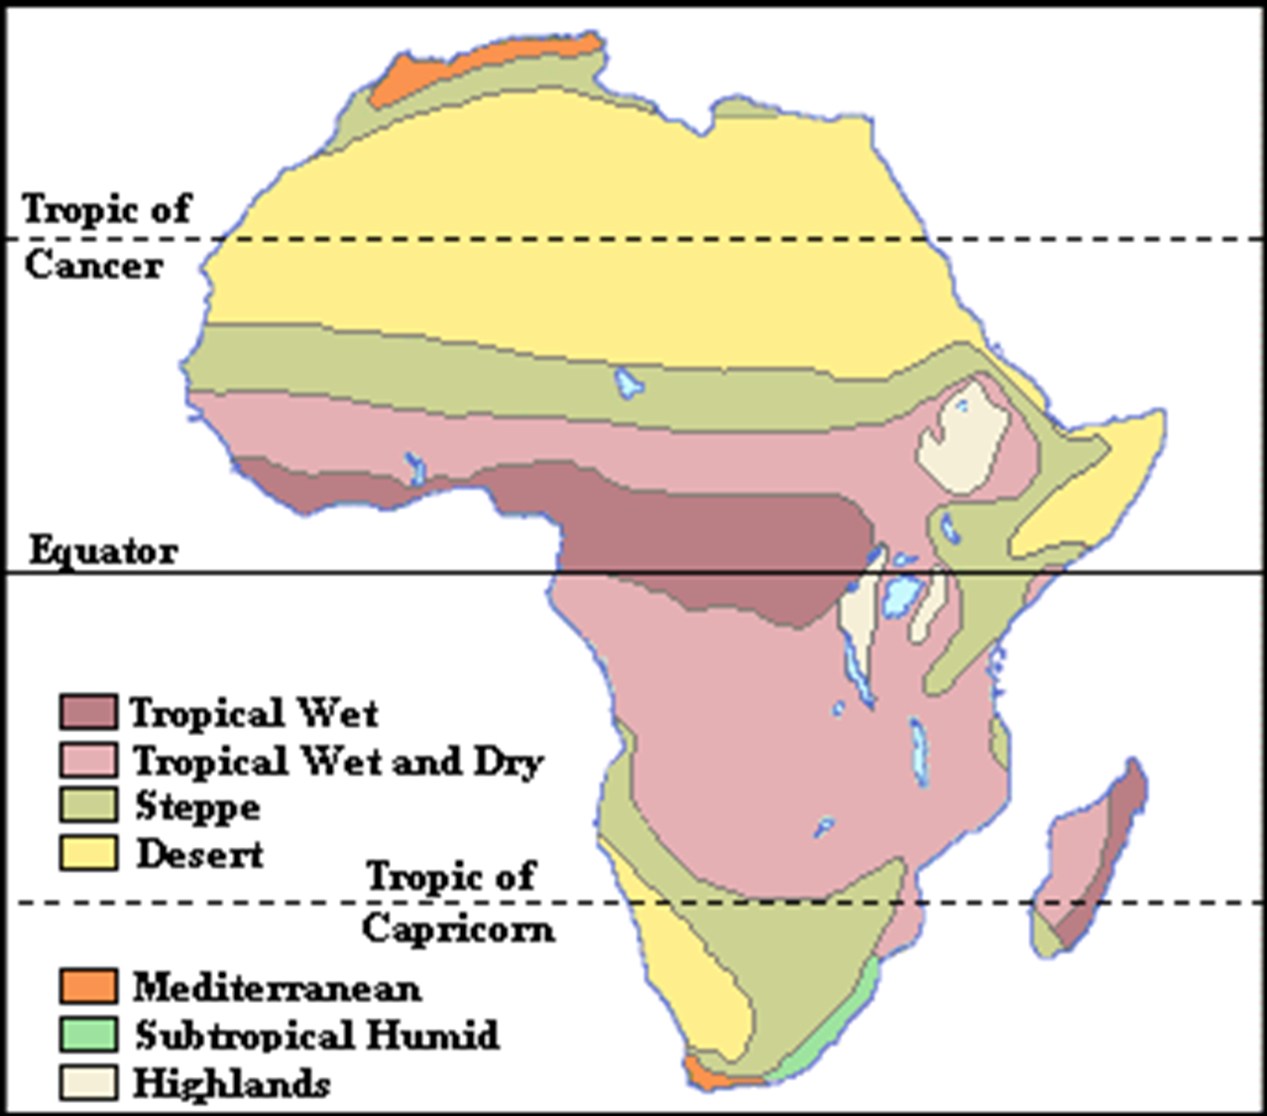

Slide 9
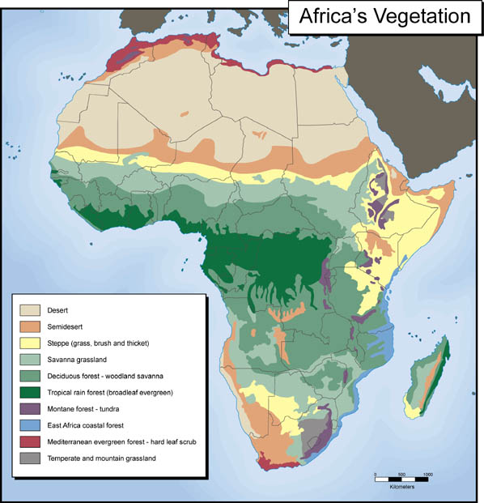
Climate

Slide 10
Nigeria
Oil discovered here in 1956.
Rich deposits in the Niger Delta made the country one of the wealthiest in Africa.
However, the drilling for oil leads to damaged land and a threat to the human population.
Today, Nigeria is the 6th leading oil exporter in the world = 80-90% of income.
Extract 2 million barrels per day, most going to the U.S.

Slide 11
Oil in Nigeria
In the 1970s high oil process led the government to borrow heavily for the future sell of oil, but the prices fell.
Causes of Economic Decline
Mismanagement
Poor planning
Corruption
Declining prices
Ethnic conflicts and resentment from oil wealth

Slide 12
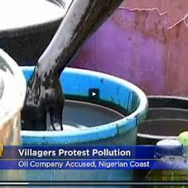
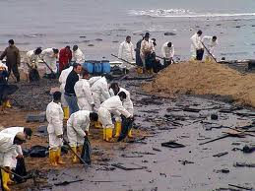
Destroying Land and People
More than 4,000 oil spills occurred in the Niger Delta over the past 4 decades.
Cleanup operations have been slow, sometimes nonexistent
Fires often result, acid rain is produced, respiratory diseases.
Pipeline explosions killed more than 2,000 people (1998-2000)
Bandits trying to resell oil.

Slide 13
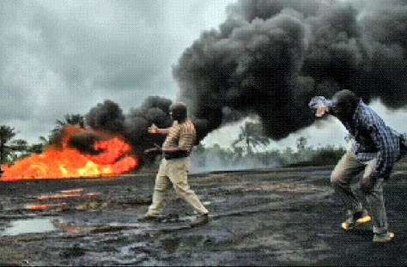
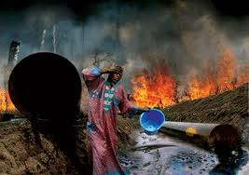
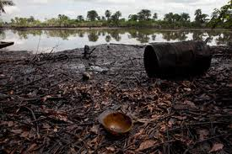

Slide 14
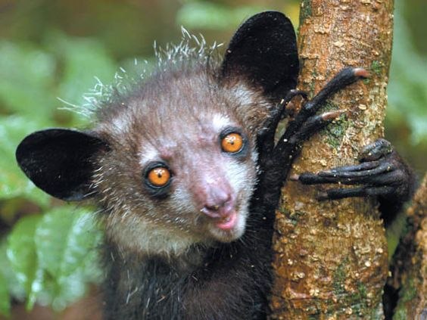
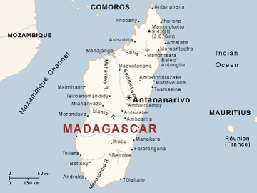
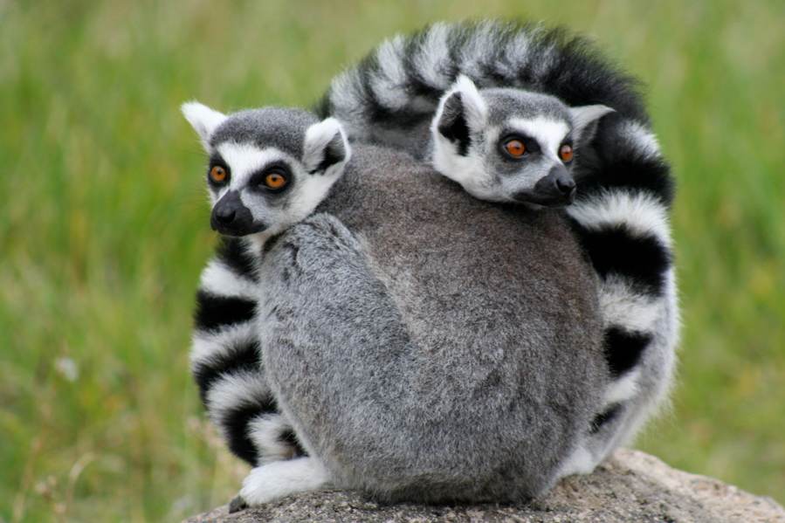
Madagascar
Largest amount of funds for
conservation
4th largest island
One of the richest ecologies, with 25% of the flowering plants in Africa
Notes:
http://listverse.com/2013/10/05/10-weird-and-wonderful-creatures-from-madagascar/

